Slide 1
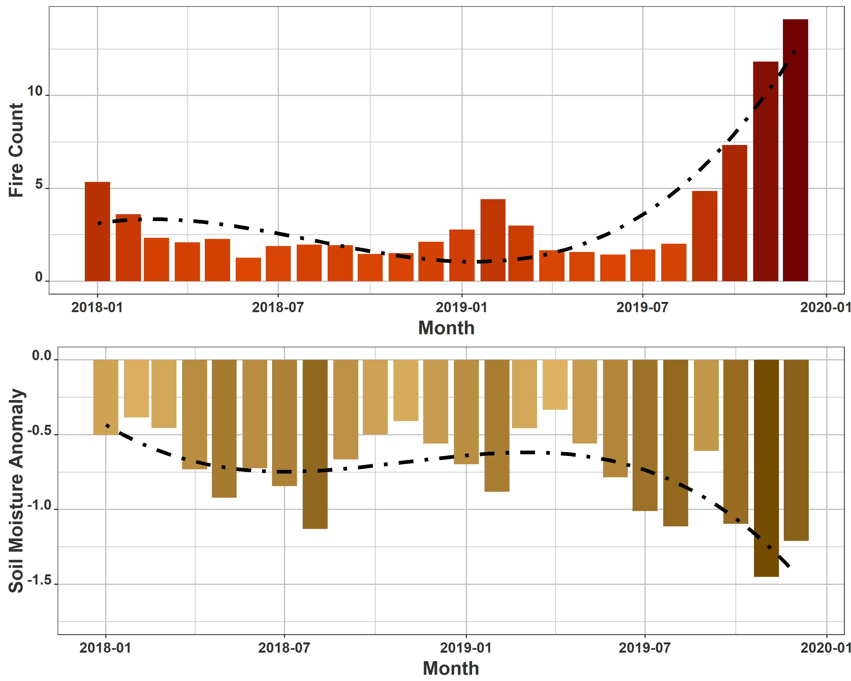
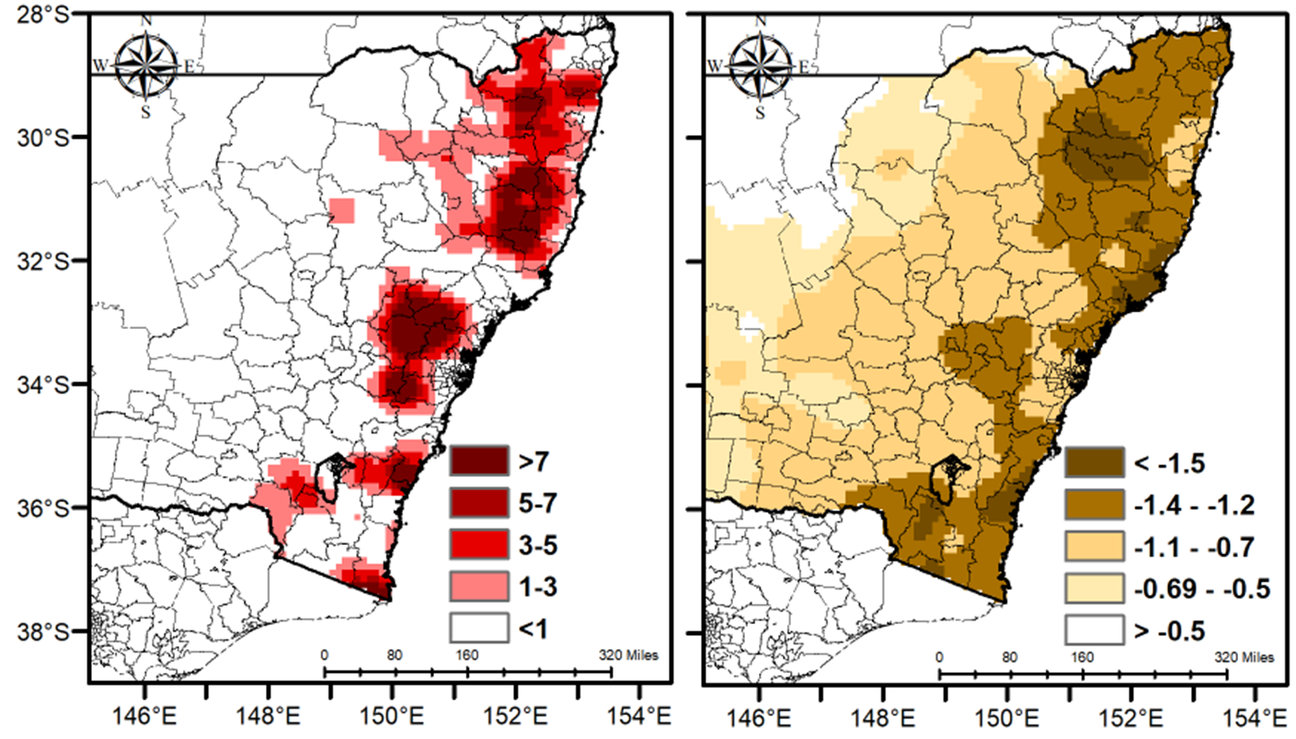
Leveraging Google Earth Engine and NASA Soil Moisture Active Passive (SMAP)
for Assessing Australian Fire Susceptibility and Potential Impacts
Nazmus Sazib, Iliana Mladenova, John D. Bolten
Hydrological Sciences Lab, NASA GSFC
Fire Count (November-December 2019)
Soil Moisture Anomaly (November-December 2019)
Figure 1
Figure 2
Satellite-based maps of soil moisture deviations from average conditions (anomalies) and observed fires over New South Wales in Australia demonstrate the utility of using space-based sensors for assessing potential fire impact and susceptibility.
Earth Sciences Division – Hydrosphere, Biosphere, and Geophysics

Slide 2
Name: John D. Bolten, Hydrological Sciences Lab, NASA GSFC E-mail: john.bolten@nasa.gov Phone: 240-302-5377
References:
Sazib, N., I. Mladenova, and J. Bolten. 2018. "Leveraging the Google Earth Engine for Drought Assessment Using Global Soil Moisture Data." Remote Sensing, 10 (8): 1265 [10.3390/rs10081265]
Mladenova, I. E., J. D. Bolten, W. T. Crow, et al. 2019. "Evaluating the Operational Application of SMAP for Global Agricultural Drought Monitoring." IEEE Journal of Selected Topics in Applied Earth Observations and Remote Sensing, 1-11 [10.1109/jstars.2019.2923555]
Bolten, J., W. T. Crow, X. Zhan, T. J. Jackson, and C. A. Reynolds. 2010. "Evaluating the Utility of Remotely Sensed Soil Moisture Retrievals for Operational Agricultural Drought Monitoring." IEEE J. Sel. Top. Appl. Earth Observations Remote Sensing, 3 (1): 57-66 [10.1109/JSTARS.2009.2037163]
Data Sources:
We used the Google Earth Engine-based NASA-USDA SMAP global soil moisture data, which provides soil moisture information across the globe at 0.25°x0.25° spatial resolution. This data set includes surface and subsurface soil moisture (mm), soil moisture profile (%), surface and subsurface soil moisture anomalies (-). Fire count data sets were obtained from NASA Earth Observations (https://neo.sci.gsfc.nasa.gov/). The fire data sets are produced from data collected by the by the Moderate Resolution Imaging Spectroradiometer (MODIS), aboard NASA's Terra and Aqua satellites.
Soil Moisture Anomaly:
https://developers.google.com/earth-engine/datasets/catalog/NASA_USDA_HSL_soil_moisture
Fire Count:
https://neo.sci.gsfc.nasa.gov/archive/geotiff.float/MOD14A1_M_FIRE/
Technical Description of Figures
Figure 1: Time series of monthly root zone soil moisture deviations from average conditions (anomalies) and observed fire counts over New South Wales, Australia from January 2018 to January 2020. The root zone soil moisture anomalies and observed fire counts showed the opposite trend whereby dryer soil moisture condition is generally associated with more fire activity. The time series analysis of fire count data revealed a higher number of fire activity during the 2019-2020 fire season, where the number of fire in December 2019 was fifteen times higher compared to the last fire year. Figure 2: Spatial distribution of observed fire counts (left) and root zone soil moisture anomalies (right) over New South Wales, Australia for the November-December 2019. The fire count map mostly agreed with the soil moisture anomaly map, indicating that fire is more likely to occur in drought-affected areas.
Scientific significance, societal relevance, and relationships to future missions:
Satellite-based soil moisture data can help better anticipate the potential impact of fire on soil water availability and crop production. In addition, satellite-based soil moisture observations can aid our understanding of the linkage between soil moisture and fire, and their combined impact on crop health and crop production. The cloud-based data enabled by a NASA - Google Earth Engine partnership demonstrate the value of concurrent satellite-based SMAP soil moisture data for mapping, monitoring, and assessing regional fire potential impact and susceptibility. The potential of SMAP based soil moisture data for evaluating fire susceptibility suggests the importance of data continuity for SMAP mission, and the significance of long-term remote-sense soil moisture product to assess the impact of fire on agriculture properly.
Earth Sciences Division – Hydrosphere, Biosphere, and Geophysics
Notes:
2

Slide 3
Can we close the global carbon budget through reconciling definitions?
B. Poulter¹, M Kondo², PK Patra³, S Sitch⁴ and Global Carbon Project colleagues
¹NASA Biospheric Sciences, ²Chiba University, ³JAMSTEC, ⁴University of Exeter
South America
Uncertainties in net-carbon exchange between ‘top-down’ and ‘bottom-up’ methods can be resolved by including hydrologic components (lateral carbon fluxes) into atmospheric inversions (in fig., INV_{AB}). Biospheric model ensembles that in include land-use change emissions (TRENDY_{S3}) now more reasonably agree with INV_{AB}, bringing us closer to the elusive goal of closing the global carbon budget.
Earth Sciences Division – Hydrosphere, Biosphere, and Geophysics

Slide 4
Name: B. Poulter, Biospheric Sciences, NASA GSFC
E-mail: benjamin.poulter@nasa.gov
Phone: 301-614-6659
References:
Kondo, M, PK Patra, S Sitch, P Friedlingstein, B Poulter, F Chevallier, P Ciais, JG Canadell, A Bastos, R Lauerwald, L Calle, K Ichii, P Anthoni, A Arneth, V Haverd, AK Jain, E Kato, M Kautz, RM Law, S Lienert, D Lombardozzi, T Maki, T Nakamura, P Peylin, C Rodenbeck, R Zhuravlev, T Saeki, H Tian, D Zhu and T Ziehn. 2019. State of the science in reconciling top-down and bottom-up approaches for terrestrial CO2 budget. Global Change Biology, doi:10.1111/gcb.14917.
Friedlingstein, P, MW Jones, M O’Sullivan, RM Andrew, J Hauck, GP Peters, W Peters, J Pongratz, S Sitch, C Le Quéré, DCE Bakker, J G Canadell, P Ciais, RB Jackson, P Anthoni, L Barbero, A Bastos, V Bastrikov, M Becker, L Bopp, E Buitenhuis, N Chandra, F Chevallier, LP Chini, KI Currie, RA Feely, M Gehlen, D Gilfillan, T Gkritzalis, DS Goll, N Gruber, S Gutekunst, I Harris, V Haverd, RA Houghton, G Hurtt, T Ilyina, AK Jain, E Joetzjer, JO Kaplan, E Kato, K Klein Goldewijk, JI Korsbakken, P Landschützer, SK Lauvset, N Lefèvre, A Lenton, S Lienert, D Lombardozzi, G Marland, PC McGuire, J R Melton, N Metzl, DR Munro, JEMS Nabel, S-I Nakaoka, C Neill, AM Omar, T Ono, A Peregon, D Pierrot, B Poulter, G Rehder, L Resplandy, E Robertson, C Rödenbeck, R Séférian, J Schwinger, N Smith, PP Tans, H Tian, B Tilbrook, FN Tubiello, GR van der Werf, AJ Wiltshire, and S Zaehle. 2019. Global Carbon Budget 2019. Earth Syst. Sci. Data 11:1783–1838.
Data Sources: CASA; LPJ; ODIAC; MODIS; GOSAT; OCO-2;
Technical Description of Figures:
Understanding individual sources of emissions of carbon dioxide and their removal from the atmosphere by land and ocean processes is fundamental for monitoring, prediction, and informing climate mitigation. This study illustrates that uncertainties can be significantly reduced by paying attention to definitions and differences in methodologies. Accounting for land-use change and hydrologic lateral losses leads to higher agreement (between TRENDY_{S3} and INV_{AB}) for Southeast Asia, but less so for South America, where processes like shifting cultivation are challenging to capture in biosphere models.
Scientific significance, societal relevance, and relationships to future missions:
Missions in development, such as the Designated Observables “Surface Biology and Geology” or linked with the Explorer class variables will form the basis for improving both the top-down and bottom-up approaches. For example, improved satellite observations and general circulation models will provide a basis for reducing uncertainties in atmospheric inversion approaches. In addition, higher accuracy observations of land-surface processes linked to carbon exchange and land-use and land-cover change will reduce uncertainties in carbon and water processes linked to net carbon dioxide emissions.
Earth Sciences Division – Hydrosphere, Biosphere, and Geophysics
Notes:
4

Slide 5
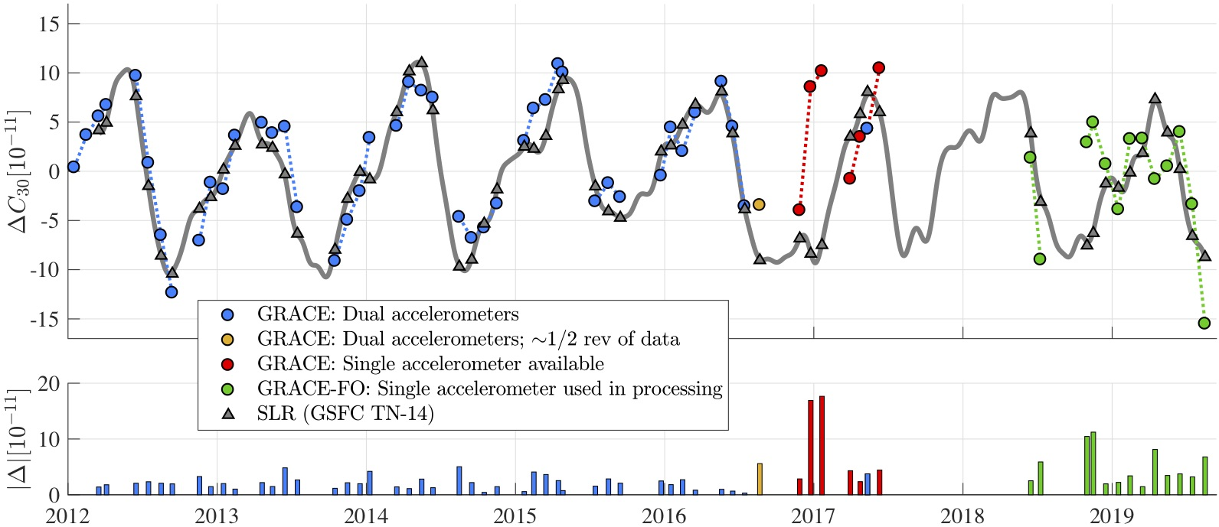
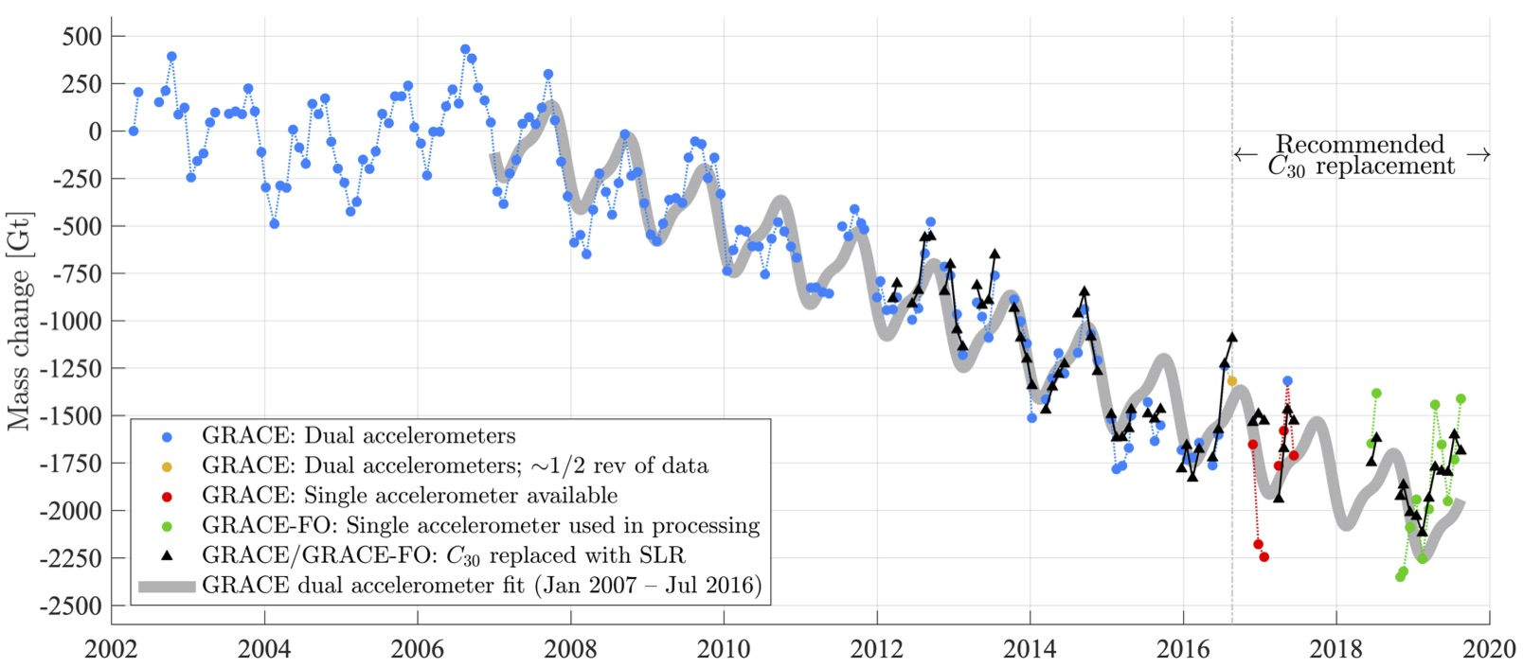
Replacing GRACE/GRACE-FO C₃₀ with satellite laser ranging: Impacts on Antarctic Ice Sheet mass change
Bryant D. Loomis¹, Kenneth E. Rachlin^{1,2}, David N. Wiese³, Felix W. Landerer³, Scott B. Luthcke¹
¹Geodesy and Geophysics Lab, NASA GSFC , ²KBR, ³Jet Propulsion Laboratory
C₃₀ time series from SLR and GRACE/GRACE-FO (relative to the mean)
Antarctic Ice Sheet time series with & without C₃₀ replacement
Figure 1
Figure 2
Figure 1
Figure 2
The C₃₀ coefficient describes the pear shape of the Earth’s gravity field, and its accurate recovery is critical to measuring mass changes in the Antarctic Ice Sheet. A new GSFC-led study demonstrates the accuracy of C₃₀ determined with satellite laser ranging (SLR) after the launch of the LARES satellite in 2012. Beginning in 2016, the GRACE/GRACE-FO C₃₀ estimates are problematic due to the loss of one accelerometer in the data processing. The issue is resolved by using the SLR C₃₀ values.
Earth Sciences Division – Hydrosphere, Biosphere, and Geophysics

Slide 6
Name: Bryant Loomis, Geodesy and Geophysics Lab, NASA GSFC E-mail: bryant.d.loomis@nasa.gov Phone: 301.614.5590
References:
Loomis, B. D., Rachlin, K. E., Wiese, D. N., Landerer, F. W., Luthcke, S. B. (2020) “Replacing GRACE/GRACE-FO $C_{30}$ with satellite laser ranging: Impacts on Antarctic Ice Sheet mass change,” Geophysical Research Letters, doi:10.1029/2019GL085488
Data Sources: GRACE/GRACE-FO Level 2 is distributed via PO.DAAC. Satellite laser ranging (SLR) normal point data is obtained from CDDIS, the global data center for the International Laser Ranging Service (ILRS). The GSFC 7-satellite SLR solution includes data from LAGEOS 1 & 2, Starlette, Stella, AJISAI, Larets, and LARES.
Technical Description of Figures:
Figure 1: (Top) $C_{30}$ time series relative to the mean as determined with the JPL RL06 GRACE/GRACE-FO and GSFC 7-satellite SLR solutions. The gray line is the weekly 28-day sliding-window SLR solution and the gray triangles are the TN-14 values that correspond to the GRACE/GRACE-FO solution months. (Bottom) The absolute difference between the GRACE/GRACE-FO and SLR $C_{30}$ estimates. We note the excellent agreement between the SLR and GRACE values when both GRACE accelerometers are fully functional, and the poor agreement with GRACE/GRACE-FO when they are not.
Figure 2: Mass change in the Antarctic Ice Sheet computed from JPL RL06 GRACE/GRACE-FO with and without $C_{30}$ replacement. The best-fit regression model computed from GRACE data over the span January 2007 – July 2016 is included and has been extended through the most recent GRACE-FO monthly solution. The IJ05_R2 GIA model has been removed. We note the significant impact on the computed Antarctic Ice Sheet mass changes when the SLR $C_{30}$ values are used to replace the problematic GRACE/GRACE-FO single accelerometer values.
Scientific significance, societal relevance, and relationships to future missions: The accurate recovery of changes to the Antarctic Ice Sheet is of utmost importance, as the ice contained therein has the potential to substantially impact sea level rise in the coming decades and centuries. Continued monitoring of Antarctic Ice Sheet mass change is among the key priorities identified in the two recent Decadal Surveys on Earth Science and Applications from Space and is an essential goal for the GRACE and GRACE-FO missions. Our analysis shows that the loss of an accelerometer near the end of the GRACE mission, and the sub-optimal performance of an accelerometer on GRACE-FO, significantly impacts the ability of those missions to accurately recover variability in $C_{30}$and the Antarctic Ice Sheet. This major issue is resolved by replacing the GRACE/GRACE-FO $C_{30}$ values with those obtained by GSFC with SLR, which are provided operationally to the GRACE-FO Science Data System in Technical Note 14. Over the dual accelerometer span of January 2007 – July 2016, GRACE determines a mass change rate of –167 $±$ 29 Gt year⁻¹. Over the single accelerometer span of August 2016 – August 2019, GRACE/GRACE-FO determines mass change rates of –170 $±$ 43 and – 92 $±$ 54 Gt year⁻¹ with and without $C_{30}$ replacement, respectively. This result highlights the major impact $C_{30}$ replacement has on the scientific analysis of the results; specifically the extended corrected data set reveals a similar rate of mass loss as the prior decade, whereas the uncorrected data set would erroneously report a $\sim$45% reduction in the rate of mass loss in recent years.
Earth Sciences Division – Hydrosphere, Biosphere, and Geophysics
Notes:
6

