Slide 1

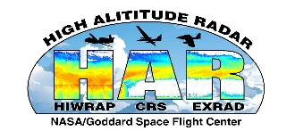
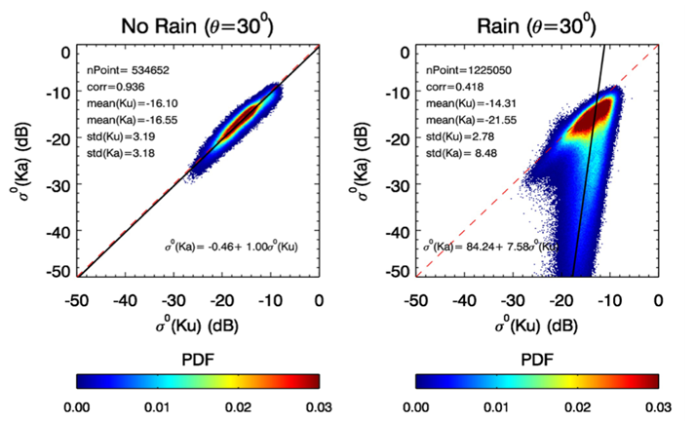

Estimation of the Wind Vector over Ocean in the Presence of Rain Using a Dual-Frequency Airborne Scatterometer
Robert Meneghini*, Liang Liao⁺, Gerald M. Heymsfield*
(*Code 612, NASA/GSFC, ⁺Morgan State University, GESTAR)
The normalized radar cross section (NRCS or σ⁰) from the ocean surface is strongly related to roughness that is driven by wind stress. The Ku (14 GHz) and Ka (35 GHz) radar bands, which are commonly used for estimating ocean surface winds, have a relatively constant differential response to wind speed and direction, but undergo substantial differential attenuation when rain is present. The different, and separable, responses to wind and rain allow for estimation of surface winds in raining conditions.

Slide 2
Name: Robert Meneghini, NASA/GSFC, Code 612
E-mail: robert.meneghini-1@nasa.gov
Phone: 301-614-5652
References:
R. Meneghini, L. Liao and G. M. Heymsfield, 2019: Attenuation Correction over Ocean for the HIWRAP Dual-Frequency Airborne Scatterometer. J. Atmos. Oceanic Technol., 36, 2015-2030.
Li, L., and Coauthors, 2016: The NASA High-Altitude Imaging Wind and Rain Airborne Profiler. IEEE Trans. Geosci. Remote Sens., 54, 298–310, https://doi.org/10.1109/TGRS.2015.2456501.
Data Sources: The data used in the study were obtained from measurements by the NASA HIWRAP (High-Altitude Imaging Wind and Rain Airborne Profiler) instrument which was developed by the Goddard Space Flight Center under NASA’s Instrument Incubator Program. NOAA supported HIWRAP flights during the 2015-2017 SHOUT (Sensing Hazard with Operational Unmanned Technology) field campaign.
Technical Description of Figures:
Left Graphic: The normalized radar cross sections (NRCS or σ⁰) at Ka-band (35.6 GHz) versus Ku-band (13.9 GHz) are shown for cases in the absence of rain.
Right Graphic: The normalized radar cross sections (NRCS or σ⁰) at Ka-band (35.6 GHz) versus Ku-band (13.9 GHz) are shown for cases in the presence of rain. The effect of rain on the measured NRCS is to move the data along a line of slope from the nominal rain-free line. The slope is determined by the ratio of the Ka-band to the Ku-band path attenuations while the distance along this line is proportional to the magnitude of the path attenuations at Ku- and Ka-band.
Scientific significance, societal relevance, and relationships to future missions: Accurate estimates of near-surface ocean vector winds are critical to understanding air-sea interactions that help drive the global circulation of the oceans and atmosphere. One of the disadvantages of traditional scatterometer measurements, which use radar backscattering from the surface to infer wind speed and direction, is the influence of precipitation. This introduces errors into the near-surface wind estimates through a modification of the scattered radar signal. This study proposes and analyzes a method that mitigates this source of error, exploiting the differential attenuation at two radar bands that have a consistent response to surface roughness. Such advances to near-surface ocean wind estimates will expand knowledge about global circulation and improve the ability to sense winds in extreme conditions such as tropical cyclones. Additionally, the knowledge gained from this study will impact current and future NASA missions, such as the Global Precipitation Measurement (GPM) mission as well as measurement concepts listed in the 2017 Decadal Survey including the Designated Clouds, Convection, and Precipitation (currently under study) or Explorer-class Ocean Surface Winds and Currents.
Earth Sciences Division - Atmospheres
Notes:
2

Slide 3
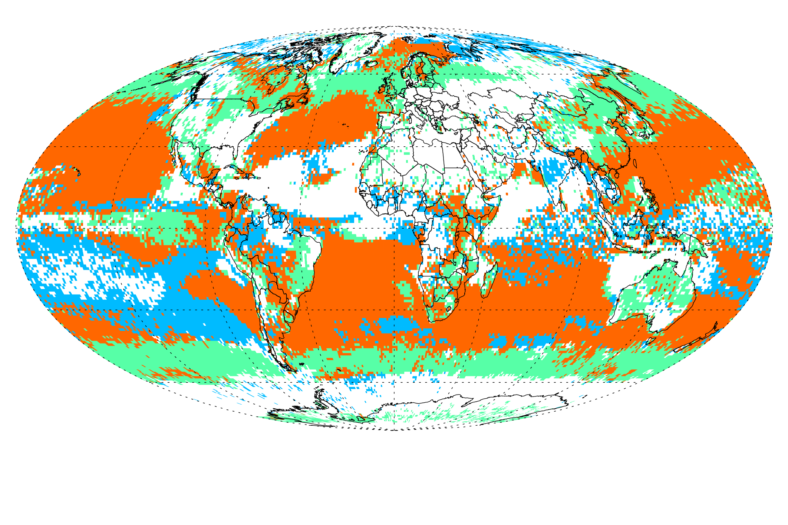
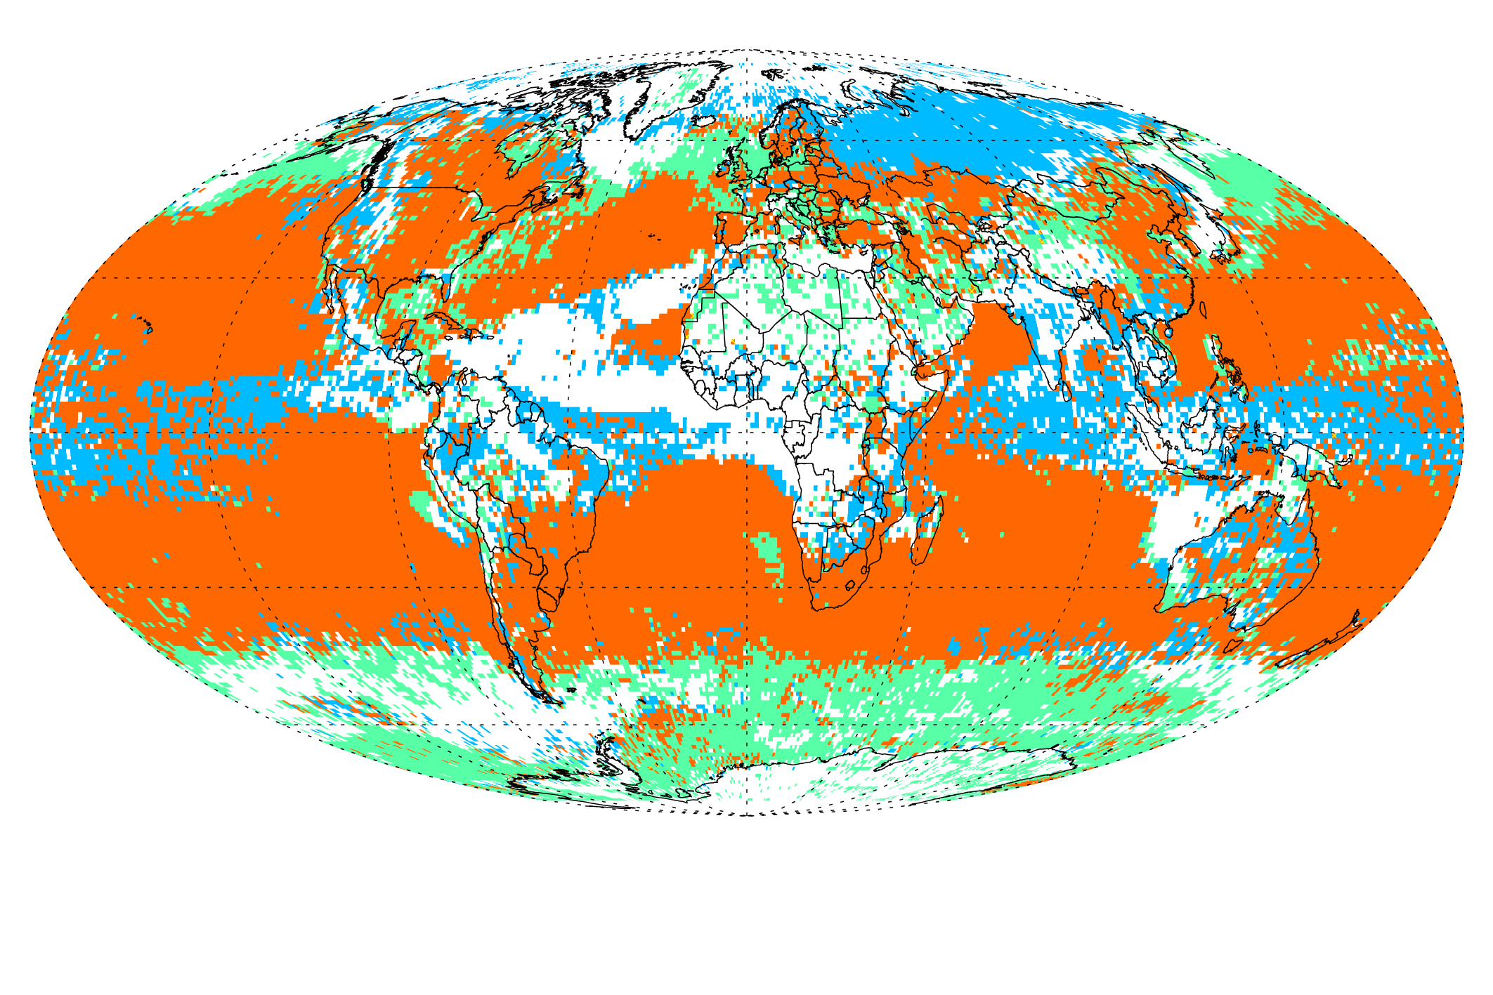
Searching for signals of aerosol-cloud interactions with large-scale datasets
Lazaros Oreopoulos, Nayeong Cho, Dongmin Lee, Code 613, NASA/GSFC
1st indirect effect
2nd indirect effect
We employed a satellite-based 12-year global dataset to examine whether cloud properties and cloud radiative effects differ under distinct aerosol loadings (AODs) in ways that are consistent with the classic aerosol-cloud interaction paradigms. The figures above are two evidence exhibits of aerosol effects on MODIS-inferred liquid cloud regimes, showing areas where either one or both available aerosol datasets indicate the existence of 1st (“Twomey”) and 2nd (“Albrecht”) aerosol indirect effect.

Slide 4
Name: Lazaros Oreopoulos, NASA/GSFC, Code 613
E-mail: Lazaros.Oreopoulos@nasa.gov
Phone: 301-614-6128
References:
Albrecht, B. A. (1989), Aerosols, Cloud Microphysics, and Fractional Cloudiness, Science, 245(4923), 1227–1230.
Oreopoulos, L., Cho, N.,and Lee, D. ( 2020). A global survey of apparent aerosol‐cloud interaction signals. Journal of Geophysical Research: Atmospheres, 125, e2019JD031287. https://doi.org/10.1029/2019JD031287.
Twomey, S. (1977), Influence of pollution on shortwave albedo of clouds, Journal of Atmospheric Sciences, 34(7), 1149–1152.
Data Sources: MODIS aerosol and cloud data used in this study are available at https://ladsweb.modaps.eosdis.nasa.gov; CERES fluxes at https://eosweb.larc.nasa.gov/project/ceres/syn1deg-3hour_ed4a; and MERRA‐2 aerosol and meteorological variable reanalysis at https://disc.gsfc.nasa.gov/datasets?project=MERRA-2 ; TMPA precipitation data at https://pmm.nasa.gov/data-access/downloads/trmm. L. Oreopoulos acknowledges funding support from NASA's MEaSURES and PMM programs. D. Lee acknowledges funding support from NASA's NIP program.
Technical Description of Figures:
Graphic: Maps showing where first and second indirect effects may be occurring for clouds identified by MODIS as belonging to liquid regimes. We use as criterion the sign of sensitivity, defined as the logarithmic derivative for each one-degree grid cell of a cloud property or a cloud radiative quantity with respect to aerosol optical depth (AOD). For the first indirect effect we require these sensitivity signs to occur simultaneously: negative for cloud effective radius (from MODIS), positive for cloud optical depth (from MODIS), positive for the shortwave cloud radiative effect (from CERES). For the second indirect effect we require these sensitivity signs to occur simultaneously: positive for cloud fraction (from MODIS), positive for cloud optical depth (from MODIS), positive for the both the shortwave and longwave cloud radiative effects (from CERES). Different colors are used for grid cells where the criteria are met solely for MODIS and MERRA‐2 AODs and for grid cells where agreement between the two AOD data sets exists. These results are obtained from 12 years (December 2002 to November 2014) of daily one-degree gridded data, so this is a “large data volume” global study.
Scientific significance, societal relevance, and relationships to future missions: Detecting climate-relevant aerosol-cloud interactions from space is a very challenging endeavor particularly when only ”snapshot” observations are available for large parts of the planet (i.e., from polar orbiting satellites) and when confounding meteorological influences are also present. Our study has attempted, quite successfully, detection of aerosol-cloud interaction signals under such imperfect observations and limitations by counteracting with: (1) Large data volume and focus on only the most prevalent aerosol-cloud interactions; (2) Classifying clouds into regimes thereby constraining to some extent meteorological variability; (3) Using both a satellite and a re-analysis aerosol dataset. Ideally, a more diverse information content should be exploited, sacrificing perhaps universal spatiotemporal coverage. Such information content should possibly comprise information on the type and vertical location of aerosol, microphysical cloud properties such as profiles of droplet number concentrations, the short-term temporal evolution of cloud and aerosol fields, and the state of the atmosphere. We should strive for such measurements in future missions most notably that (those) targeting the Aerosol, Cloud, Convection and Precipitation (A-CCP) observables recommended by the 2017 Earth Science Decadal Survey.
Earth Sciences Division - Atmospheres
Notes:
4

Slide 5
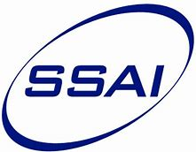
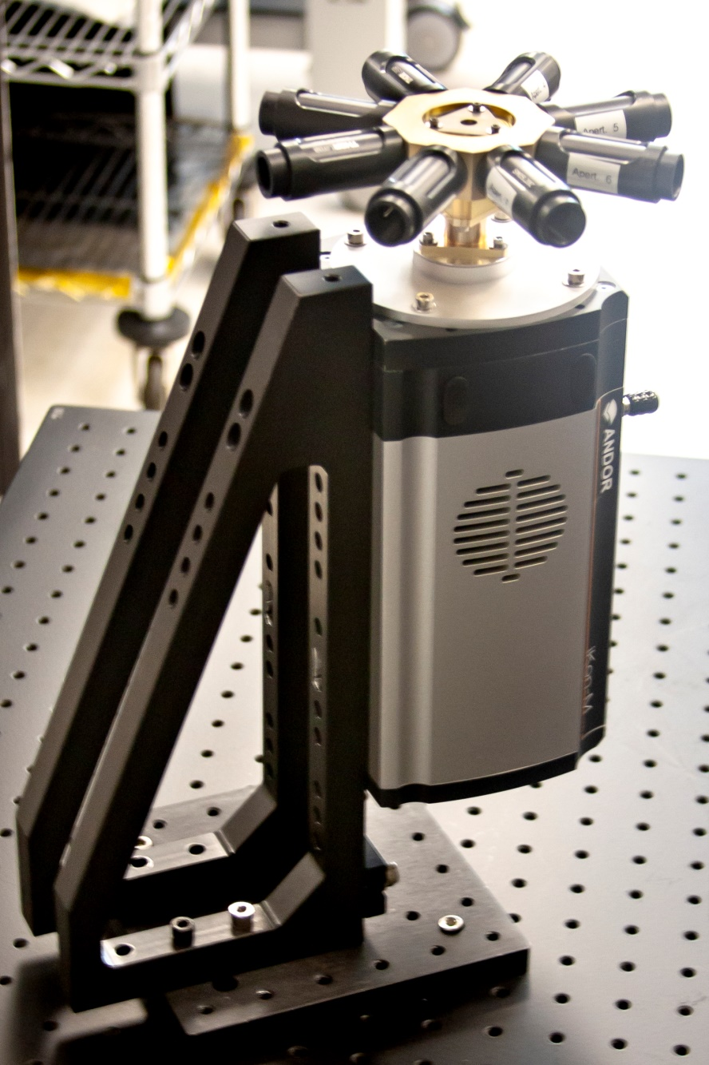

New Sensor for Stratospheric Aerosol Measurements - MASTAR
Matthew DeLand (SSAI/614), Matthew Kowalewski (USRA/614), Peter Colarco (614)
MASTAR – Multi-Angle Stratospheric Aerosol Radiometer
Develop compact version of operational OMPS Limb Profiler to improve stratospheric aerosol measurements
Multiple simultaneous viewing directions improve aerosol characterization and spatial sampling for better climate model accuracy
Simplified optical design enables 3U-Cubesat form factor
Funding support from IRAD, Code 610, IIP, ESTO has advanced design from “tabletop” model to NASA high-altitude balloon test flight (Fall 2020)

Slide 6
Name: Matthew DeLand, SSAI and NASA/GSFC Code 614
E-mail: matthew.deland@ssaihq.com
Phone: 301-867-2164
References:
Kowalewski, M. G., DeLand, M. T., Colarco, P. R., Ramos-Izquierdo, L., Mamakos, W., and DiGregorio, A. J. (2020). Evolution of the Multi-Angle Stratospheric Radiometer. Presented at the American Meteorological Society 100th Annual Meeting, Boston, MA, 13-17 January 2020.
DeLand, M., Colarco, P., Kowalewski, M., Ramos-Izquierdo, L., and Gorkavyi, N. (2019). MASTAR: Limb scattering measurements of stratospheric aerosols. Presented at the 10th Atmospheric Limb Workshop, Greifswald, Germany, 4-7 June 2019.
Acknowledgements: Nick Gorkavyi (SSAI/614) created the initial concept for this instrument. Luis Ramos-Izquierdo (551) has led the optical design of MASTAR, and William Mamakos (Design Interface) has led the mechanical design and fabrication of MASTAR.
Data Sources:
Laboratory measurements (stray light, bandpass, radiometric calibration). Rooftop measurements at NASA GSFC with clear sky conditions to demonstrate overall performance.
Ongoing measurements from Suomi NPP OMPS LP instrument (operated by NASA) will provide “truth” data set for test flight of MASTAR on research balloon.
Technical Description of Figures:
Graphic 1: The MASTAR instrument uses 8 apertures, each separated by 45° in azimuth, to view the atmospheric limb and collect radiance profiles. The nominal altitude coverage of each viewing slit on-orbit is 0-60 km. Six apertures use a pair of bandpass filters (centered at 675 nm and 850 nm) to collect scattered radiance data, from which aerosol extinction profiles are retrieved. Two apertures (aligned orthogonally to each other) measure radiance profiles at 350 nm for use in altitude registration determination. Light from all apertures hits a central octagonal prism and is directed downward to a CCD detector for data capture and analysis.
Scientific significance, societal relevance, and relationships to future missions: Aerosol climate effects arise from both tropospheric and stratospheric aerosols. While previous assessments of aerosol-climate effects have focused on the impact of anthropogenic aerosols in the troposphere (e.g. IPCC [2013]), the stratospheric component of aerosol profiles is also important. This component can have multiple sources (e.g. smaller volcanic eruptions, anthropogenic pollution, large wildfires), and leads to a global cooling that offsets some of the warming expected from increases in greenhouse gases. Including stratospheric aerosol effects in climate models is thus a priority for the Earth science community to improve climate model accuracy. Possible geoengineering projects that involve stratospheric aerosol injection would also require thorough monitoring for validation. Existing climate models can produce significantly different results even when given the same prescribed aerosol perturbation. Improving these model characterizations hinges on better observational data to constrain processes and their representation. Vertically resolved measurements of aerosol extinction with extensive spatial sampling are needed to supply the appropriate initial distribution of aerosol loading, composition, and size distribution for model calculations. The recently released Decadal Survey for Earth Science identifies aerosol measurements (including vertical profiles) as a priority observable that is “essential to the overall program” for quantification of their impact on climate forcing [Nat. Acad., 2018]. The current OMPS Limb Profiler instrument has limited sensitivity to aerosols in the Southern Hemisphere because of its viewing geometry. The MASTAR instrument makes measurements in both forward and backward directions along the orbit track to provide a consistent sensitivity to aerosol abundance at all latitudes. Simultaneous cross-track measurements will supply valuable additional information about inhomogeneous events such as volcano eruption plumes. These measurements could also support near-real time requirements such as routing of air traffic to avoid the hazards posed by such plumes.
Earth Sciences Division - Atmospheres
Notes:
6

Slide 7
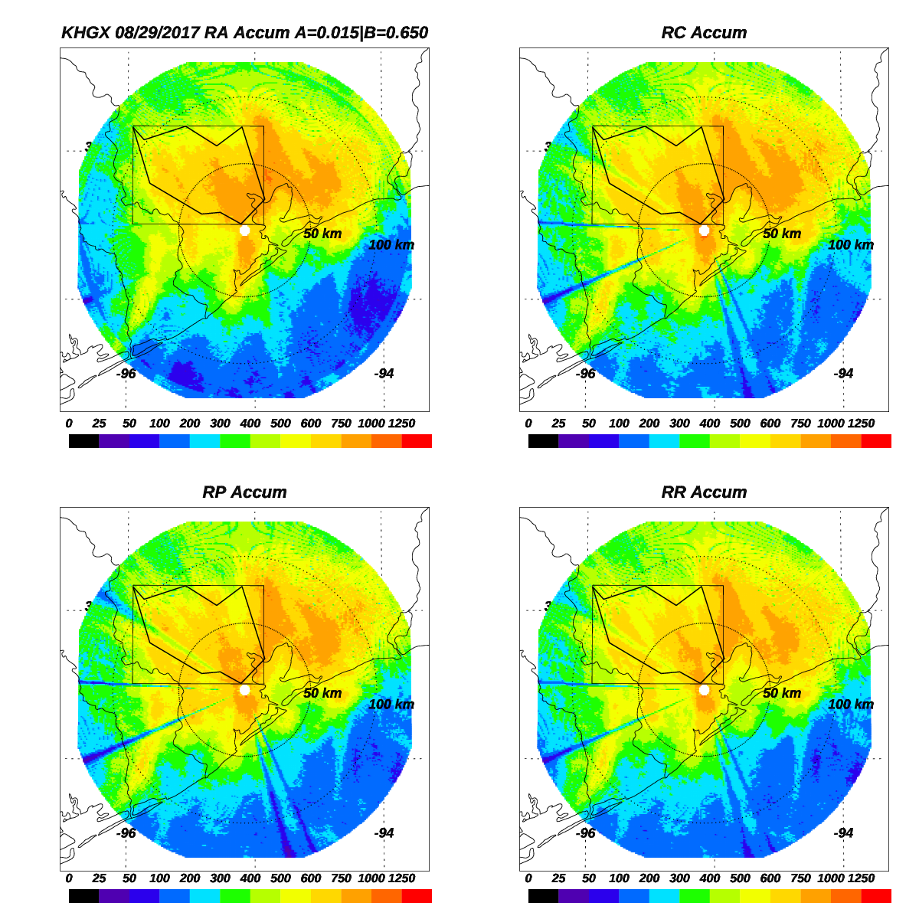
Radar Retrievals of Extreme Rainfall During Hurricane Harvey
David B. Wolff, Code 610.W, NASA GSFC Wallops Flight Facility
Hurricane rainfall is very difficult to retrieve using conventional radar estimates due to the unique collection of a large number of small and medium drop sizes, and the near saturated vertical profile of water and ice within the storm. Hurricane Harvey made landfall west of Houston, TX, on August 25, 2017, and stalled over south central Texas for several days. Parts of the Houston area received more than 1 m of rainfall over a five-day period.
NASA Global Precipitation Measurement (GPM) assessed several common radar retrieval methods using WSR-88D radar data and Harris County Flood Warning System rain gauges during Hurricane Harvey. An attenuation-based method (Panel A) was developed and compared to three conventional retrievals that rely on measured radar variables as input (Panels B-D). The attenuation-based retrieval provided very low biases of about 5%, while the other methods resulted in underestimation of the areal rainfall by about 50%, and suffered from significant blockage of the radar beam.
A
B
Beam blockage
C
D
All accumulations above are in mm

Slide 8
Name: David B. Wolff, Code 610.W, NASA GSFC Wallops Flight Facility
E-mail: David.B.Wolff@nasa.gov
Phone: 757-824-1515
References:
Wolff D. B. et al. 2019, Assessing Dual-Polarization Radar Estimates of Extreme Rainfall during Hurricane Harvey. Journal of Atmospheric and Oceanic Technology, 36, 2501-2520.
Cifelli R. et al. 2011, A New Dual-Polarization Radar Rainfall Algorithm: Application in Colorado Precipitation Events. Journal of Atmospheric and Oceanic Technology, 28, 352-364.
Bringi V. N. et al. 2004, Evaluation of a New Polarimetrically Based ZR Relation. Journal of Atmospheric and Oceanic Technology, 21, 612-623.
Ryzhkov A. et al. 2014, Potential Utilization of Specific Attenuation for Rainfall Estimation, Mitigation of Partial Beam Blockage, and Radar Networking. Journal of Atmospheric and Oceanic Technology, 31, 599-619.
Wang Y., and V. Chandrasekar, 2009: Algorithm for Estimation of the Specific Differential Phase. Journal of Atmospheric and Oceanic Technology, 26, 2565-2578.
Data Sources: The radar data used for this study was obtained from the NOAA/NWS WSR-88D radar in Houston, TX. The 15-minute gauge data were obtained from the Harris County Flood Warning System. A total of 120 gauges within and near Harris County, TX were utilized for validation of the radar estimates. The data covered the period August 25-29, 2017.
Technical Description of Figures:
Figure 1: Four different rain estimators were compared. Panel A shows the five day accumulation using an attenuation-based estimator (RA). This technique utilizes the differential phase along a ray segment to estimate the rain rate. Because the differential phase is immune to beam blockage, it is able to provide rain estimates over the entire radar domain. Panels B-D show the “hybrid” polarimetric estimators of Cifelli et al. 2011 (RC), Bringi et al. 2007 (RP) and Wang et al. 2009 (RR), respectively. These hybrid methods rely on observations of reflectivity and differential reflectivity, both of which are strongly affected by beam blockage and calibration errors. Hence, none of the hybrid method were able to mitigate the blockages. The hybrid methods also significantly underestimated the total rainfall by up to 50%, while the attenuation-based method had a bias of only +5%. The rectangle is the area within the radar domain that the study generated the rain accumulations. The polygon within the rectangle is a rough outline of Harris County, TX.
Scientific significance, societal relevance, and relationships to future missions: The ability to accurately estimate rain areal rainfall during Hurricanes is extremely important for flood warnings and rescue. Conventional methods that utilize only the measured radar data are not effective in hurricanes due to the rather unusual combination of a large number of small and medium drops. This finding is extremely valuable for future now-casting of hurricane rainfall events and flood warning/prediction, which can save lives. Improved radar retrievals benefit local communities, but also provide validation for improved global estimates from NASA missions such as GPM.
Earth Sciences Division - Atmospheres
Notes:
8

