Slide 1



Evapotranspiration maps help diagnose the cause
of unexpected degradation of land hydrology forecasts
Thomas Holmes¹, Wade Crow³, Concha Arroyo³, Joaquin Muñoz Sabater4 , Chris Hain²,
Fangni Lei³, Jianzhi Dong¹, Joseph G. Alfieri¹ and Martha Anderson³
¹Hydrological Sciences Lab, NASA GSFC, ²NASA MSFC, ³USDA ARS, ⁴ECMWF
Figure 1: The assimilation of soil moisture information (EXPR) generally improves the correlation (R) of modeled SM with in situ data compared too the free running model (OL).
Figure 2: Improved soil moisture does not consistently propagate to ET as seen in reduced correlation of the 24-hr ET forecast with both in situ and remote sensing data.
When satellite soil moisture (SM) was assimilated within a land surface model, we found that the accuracy of the forecast decreased in unexpected ways. Even though we could confirm that the surface moisture analysis was improved (Figure 1), the accuracy of the forecasted evapotranspiration rate (ET) decreased (Figure 2). Our analysis revealed a bias in the link between soil moisture and ET, which is the most likely cause of this degradation. With this study we show that even in a high-quality assimilation framework, model errors can be reinforced by data assimilation, rather than mitigated.
Earth Sciences Division – Hydrosphere, Biosphere, and Geophysics

Slide 2
Name: Thomas Holmes, Hydrological Sciences Branch, NASA GSFC
E-mail: thomas.r.holmes@nasa.gov
Phone: 301-6145444
References:
Crow, Wade T., Concepcion A. Gomez, Joaquin Muñoz Sabater, Thomas RH Holmes, Christopher R. Hain, Fangni Lei, Jianzhi Dong, Joseph G. Alfieri and Martha C. Anderson: Soil moisture/evapotranspiration over-coupling on L-band brightness temperature assimilation: sources and forecast implications. In review Journal of Hydrometeorology.
Muñoz‐Sabater, J., and co-authors. 2019: Assimilation of SMOS brightness temperatures in the ECMWF Integrated Forecasting System, Q J R Meteorol Soc., 145, 2524– 2548, https://doi.org/10.1002/qj.3577.
Data Sources: The assimilation land surface model is the Tiled ECMWF Scheme for Surface Exchanges over Land incorporating the land surface hydrology (HTESSEL) model used operationally by ECMWF. L-band observations are obtained by the soil moisture and ocean salinity satellite (SMOS). Evaluation datasets used are soil moisture from USDA Soil Climate Analysis Network (SCAN) and NOAA United States Climate Reference Network (USCRN), evapotranspiration (ET) from eddy-covariance sites within the AmeriFlux network, and satellite retrieval estimates based on the thermal channel of the Geostationary Operational Environmental Satellites (GOES) and optical channels of the Moderate Resolution Imaging Spectrometer (MODIS).
Technical Description of Figures:
Graphic 1: The difference in correlation (R) of HTESSELS soil moisture analysis (SM) with in situ data. EXPR represents the model runs with assimilation of SMOS L-band observations, and OL represents the model without any assimilation. The period covered by this experiment is the 2012– 2013 boreal summer.
Graphic 2: Difference in correlation of 24-hr forecast of ET with both in situ (square boxes) and remote sensing data (background map).
Scientific significance, societal relevance, and relationships to future missions: This work helps to improve the integration of NASA observations with land surface models that are used for weather prediction.
Earth Sciences Division – Hydrosphere, Biosphere, and Geophysics
Notes:
2

Slide 3
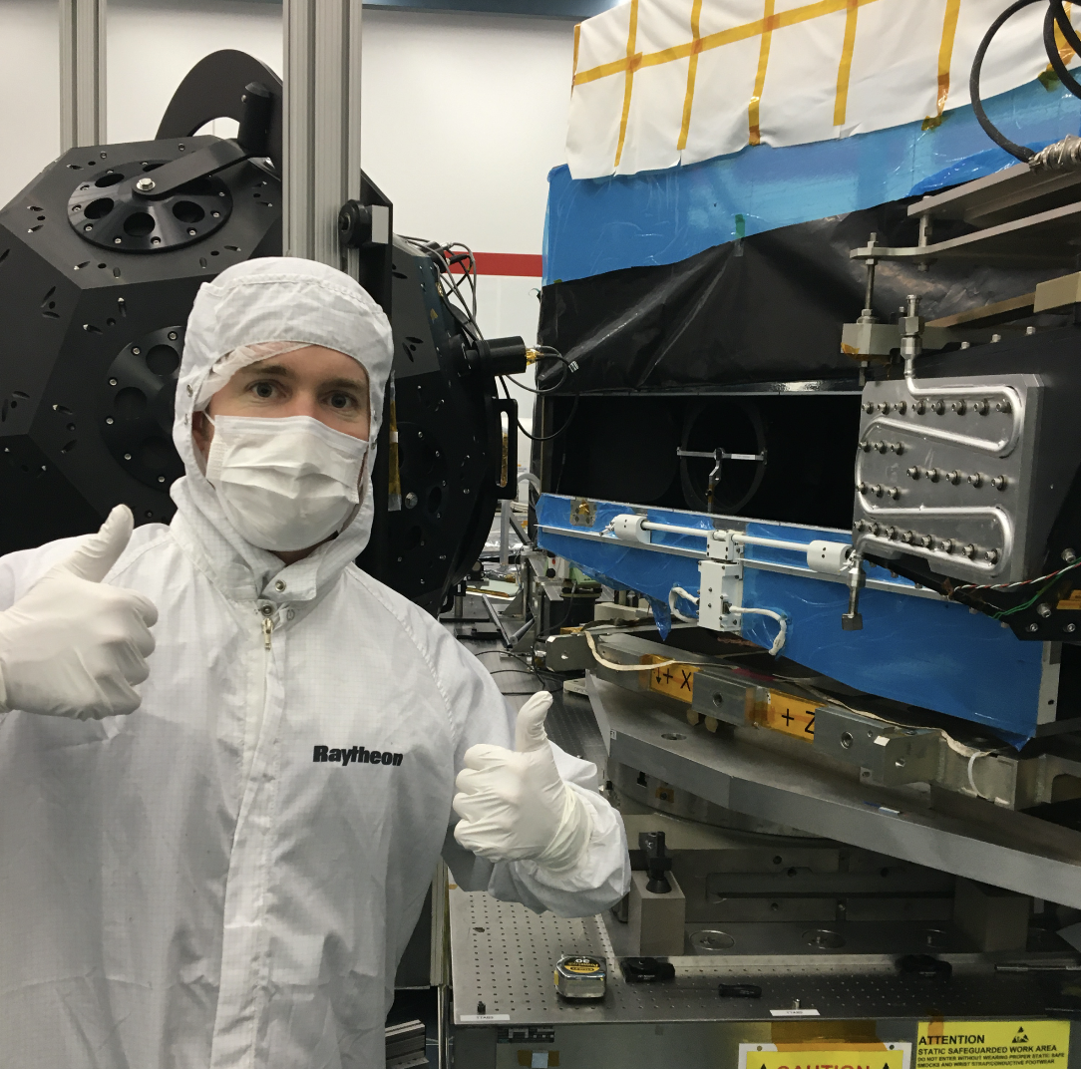
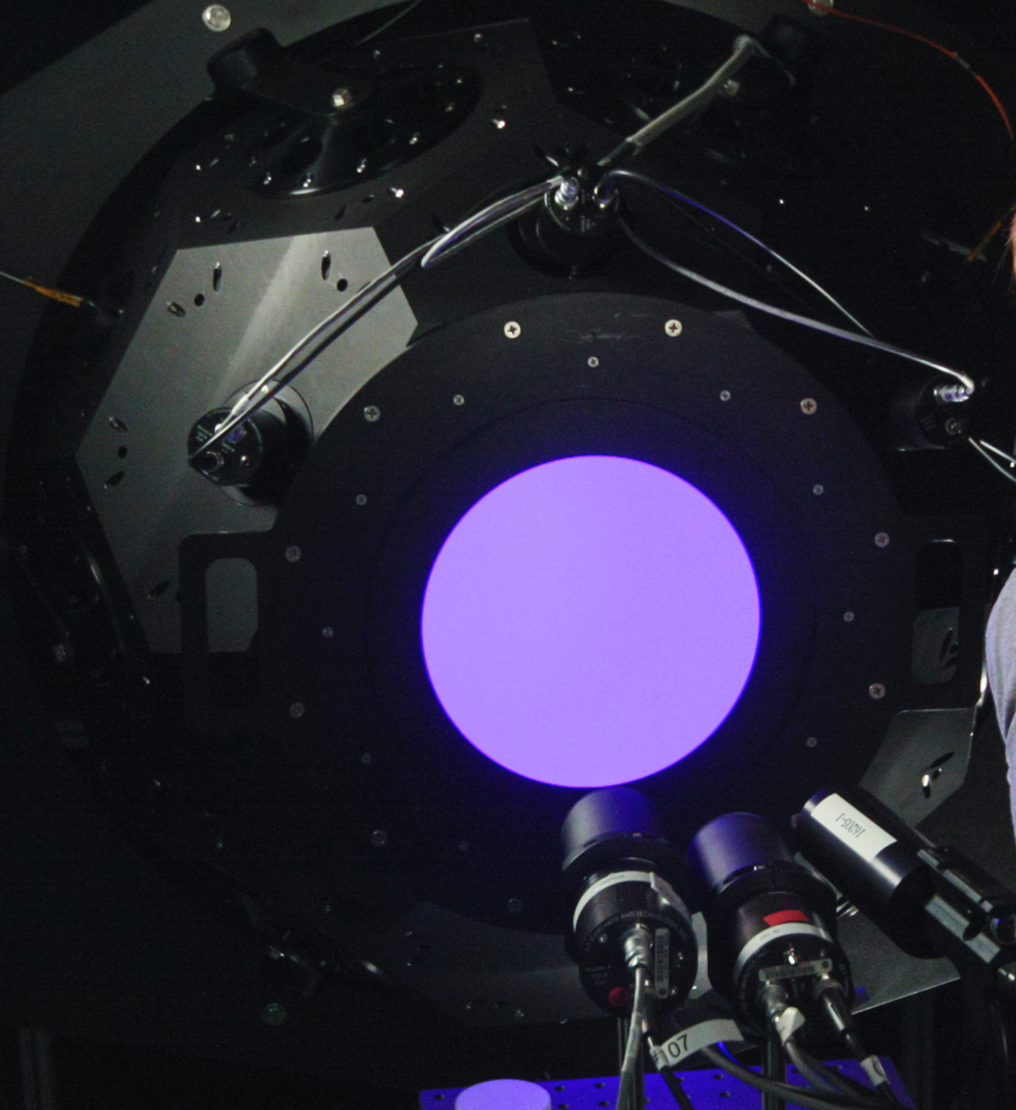
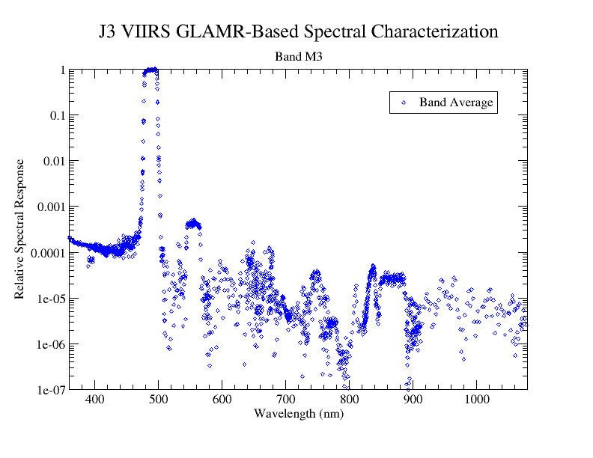
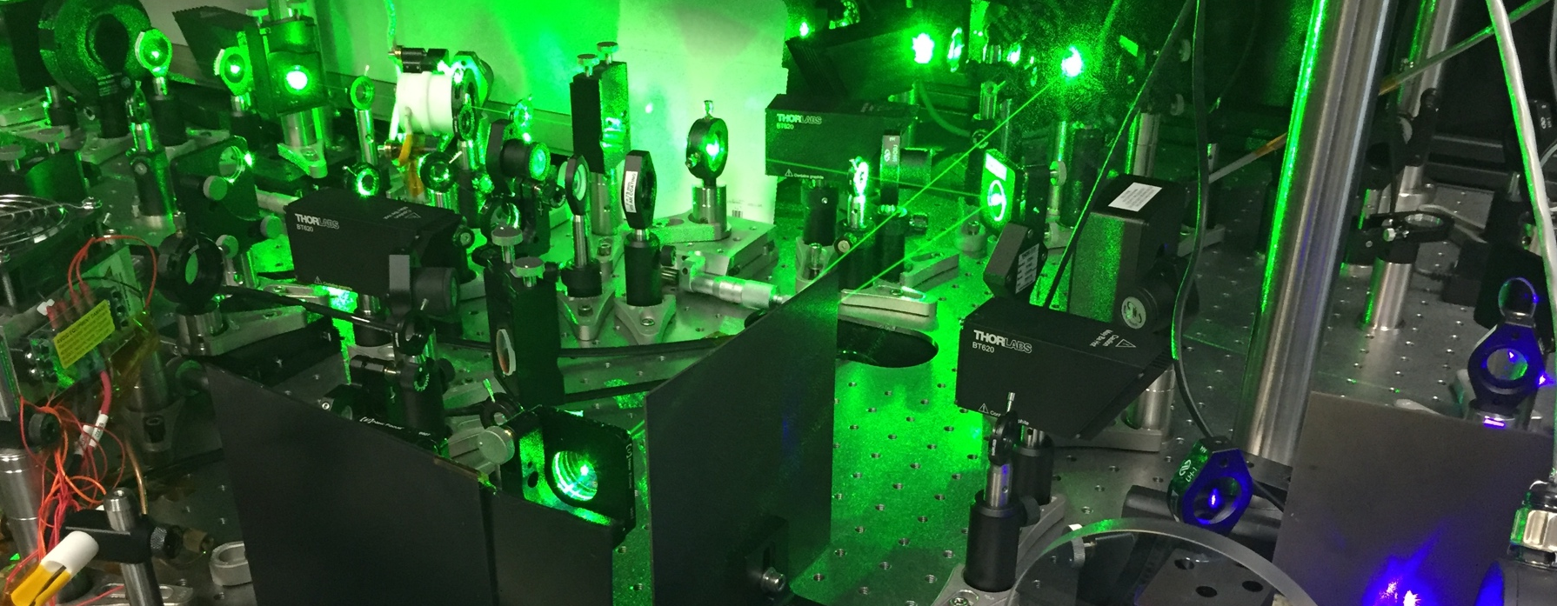
Laser-based characterization of JPSS-3 VIIRS
Joel McCorkel¹, Brendan McAndrew², Julia Barsi¹, Chris Moeller³, Kurt Thome¹, Jim Butler¹, James Gleason⁴
¹NASA/GSFC Code 618, ²NASA/GSFC Code 550, ³Univ of Wisconsin-Madison, ⁴NASA/GSFC Code 614
Figure 3
Figure 1
Figure 2
The Goddard Laser for Absolute Measurement of Radiance (GLAMR) team deployed their laser systems to the vendor of the Joint Polar Satellite System-3 Visible Infrared Imaging Radiometer Suite (JPSS-3 VIIRS) for spectral response characterization. The GLAMR-based characterization provides significantly higher spectral accuracy and fidelity of traditional spectral characterization techniques and therefore enables more accurate retrievals of atmospheric and land surface environmental products.
Figure 4
Earth Sciences Division – Hydrosphere, Biosphere, and Geophysics

Slide 4
Name: Joel McCorkel, Biospheric Sciences Laboratory, NASA GSFC
E-mail: joel.mccorkel@nasa.gov
Phone: 301-614-6675
References: Barsi, J.A., Markham, B.L., McCorkel, J.T., McAndrew, B., Donley, E., Morland, E., Pharr, J., Rodriguez, M.R., Shuman, T.M., Sushkov, A.B., Zukowski, B.J., 2019. The Operational Land Imager-2: prelaunch spectral characterization, in: Butler, J.J., Xiong, X. (Jack), Gu, X. (Eds.), Earth Observing Systems XXIV. SPIE, p. 10. https://doi.org/10.1117/12.2529776
McCorkel, J., McAndrew, B., Barsi, J., Markham, B., Pharr, J., Rodriguez, M., Shuman, T., Sushkov, A. and Zukowski, B., 2019, July. First Results from Laser-Based Spectral Characterization of Landsat 9 Operational Land Imager-2. In IGARSS 2019 IEEE International Geoscience and Remote Sensing Symposium. https://doi.org/10.1109/IGARSS.2019.8898508
Moeller, C., Schwarting, T., McCorkel, J., Moyer, D. and McIntire, J., 2019, September. JPSS-2 VIIRS version 2 at-launch relative spectral response characterization. In Earth Observing Systems XXIV (Vol. 11127, p. 111270D). International Society for Optics and Photonics. https://doi.org/10.1117/12.2530022
Technical Description of Figures:
Figure 1: The GLAMR integrating sphere is on the left in front and JPSS-3 VIIRS is on the right. A GLAMR scientist is in front giving thumbs up after final inspection of the sphere’s alignment to VIIRS’s telescope.
Figure 2: A photo of the GLAMR integrating sphere that is coupled to the laser output via fiber optic, in this case the GLAMR laser is tuned to 400 nm. The randomizing effect of the integrating sphere converts the gaussian beam output from the fiber to a near-ideal source of radiance. Before satellite sensor characterization, the radiometers that are staring into the sphere transfer SI-traceable radiometric knowledge to the monitors on the sphere.
Figure 3: Example plot of the relative spectral response of ”M3” channel of JPSS-3 VIIRS that is centered near 490 nm that shows features such as crosstalk with adjacent channels and potential filter leaks. Each data point in the horizontal direction represents a step in the spectral sweep by the GLAMR laser system. Combined, these data points provide compressive spectral characterization of the solar-reflective channels of VIIRS.
Figure 4: The continuously tunable monochromatic light produced by GLAMR is created by lithium triborate (LBO)-based optical parametric oscillators (OPO) that converts photons from high-powered 532-nm mode-locked laser into other photons with desired frequency. This spectral tuning is accomplished with cavity geometry adjustments and crystal temperature control and is highly automated.
Scientific significance, societal relevance, and relationships to future missions:
The Visible Infrared Imaging Radiometer Suite (VIIRS) instrument collects visible and infrared imagery and global observations of land, atmosphere, cryosphere and oceans. VIIRS features daily multi-band imaging capabilities to support the acquisition of high-resolution visible and infrared atmospheric imagery including imaging of hurricanes and detection of fires, smoke and atmospheric aerosols. As with all remote sensing instruments, characterization of instrument response is an important pre-launch activity so that science retrieval algorithms can accuracy and consistently retrieve physical parameters of the environment. One of the most important instrument parameters to characterize prior to launch is spectral response. The Goddard Laser for Absolute Measurement of Radiance (GLAMR) provides an ideal light source for characterization of remote sensing instruments operating in the solar reflective spectrum: a monochromatic, extended source with SI traceability and accuracy more than ten times better than traditional calibration sources. Such a source allows better understanding of sensor features like nonlinearities, crosstalk, and scattered light which can be used to parameterize more sophisticated instrument models, the pathway for achieving accuracies to more quickly detect climate change and better decouple environmental parameters and processes.
Earth Sciences Division – Hydrosphere, Biosphere, and Geophysics
Notes:
4

Slide 5

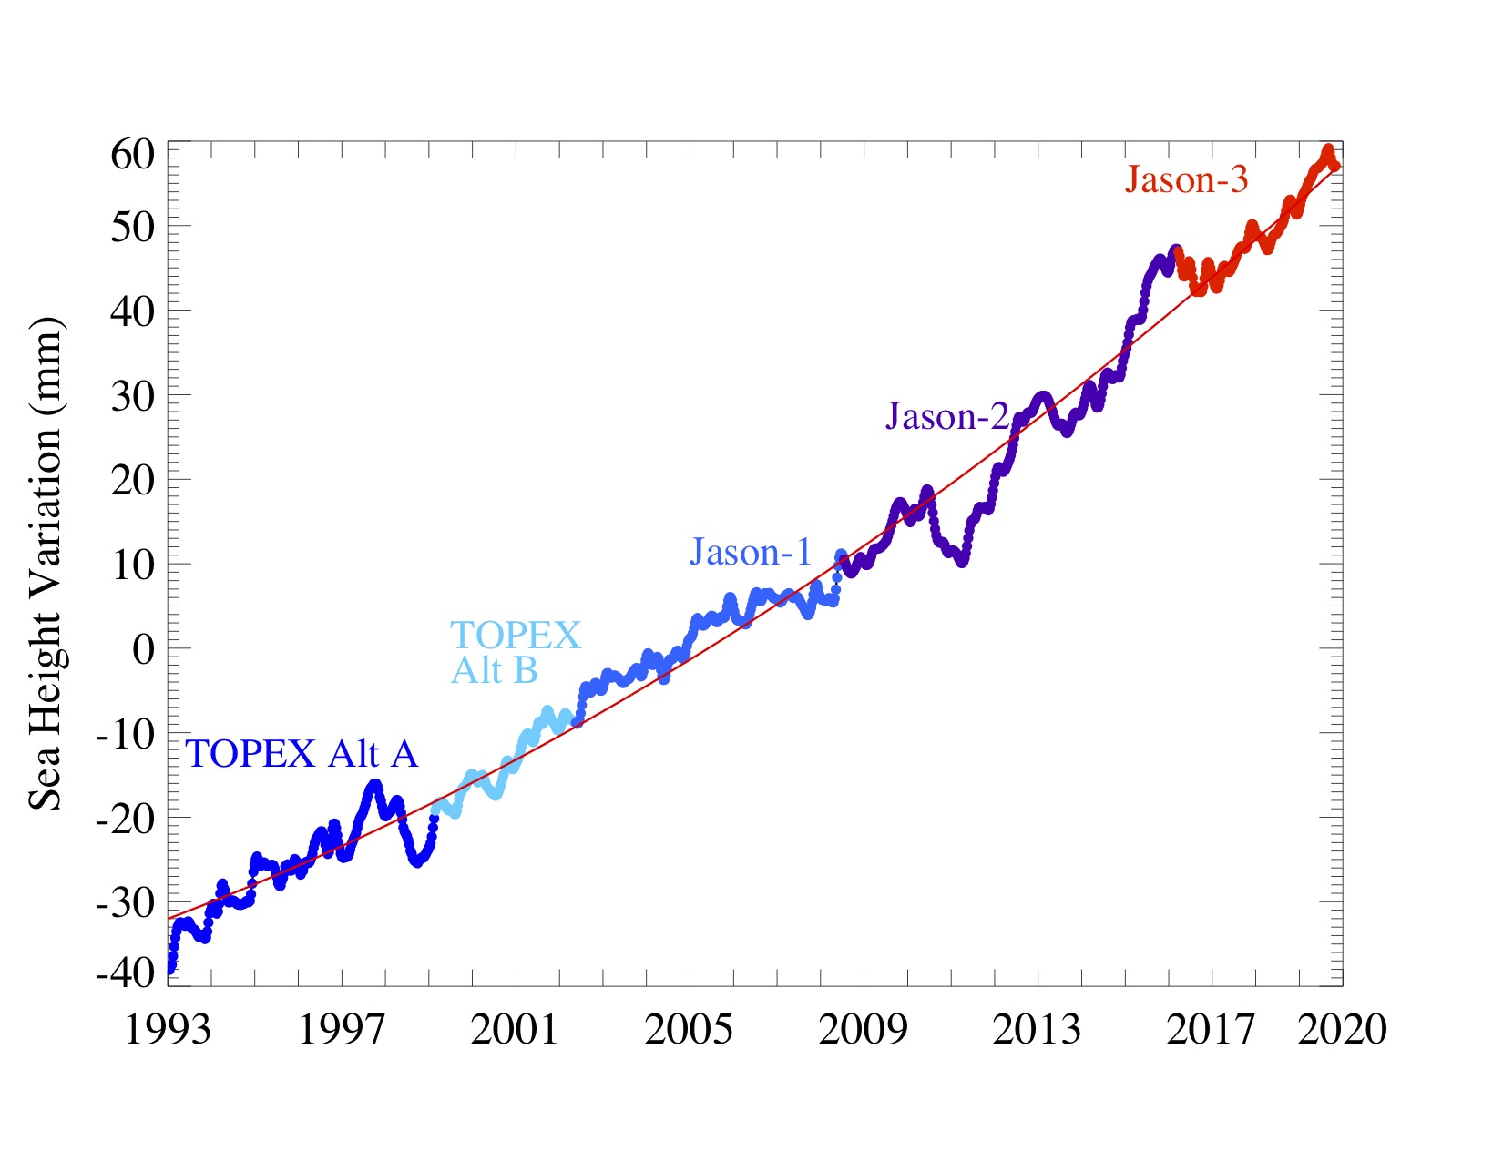
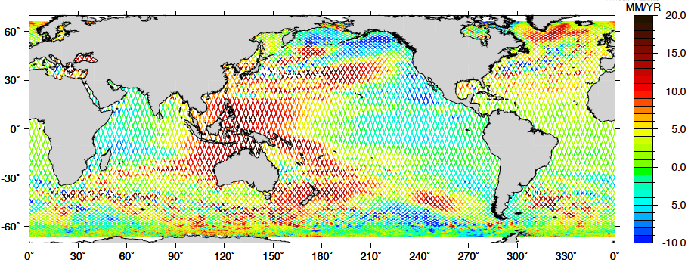
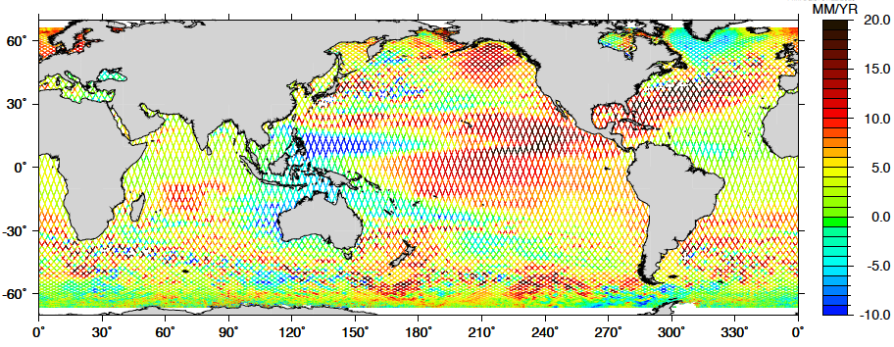
A Mission Milestone: 1000 Repeat Cycles of TOPEX/Jason Altimetry
Brian Beckley², Richard Ray¹, Xu Yang², Frank Lemoine¹, and Nikita Zelensky³
¹Geodesy and Geophysics Laboratory, NASA GSFC , ²KBR, Inc., ³U. of Md.
1993-2003
2.7 mm/y
2010-2020
4.4 mm/y
Global and regional (inset images) mean sea level variations are estimated from 1000 ten-day repeat cycles derived from the TOPEX/Poseidon, Jason-1, 2, & 3 radar altimetry missions. Continued monitoring will approach three decades with the anticipated launch of the Sentinel-6 Michael Freilich satellite in November 2020.
Earth Sciences Division – Hydrosphere, Biosphere, and Geophysics

Slide 6
Name: Brian Beckley-KBR Inc./Geophysics Lab, NASA GSFC, Code 61A
E-mail: brian.d.beckley@nasa.gov
Phone: 301-489-1115
References:
Nerem, R.S., B.D. Beckley, J.T. Fasullo, B.D. Hamlington, D. Masters, G.T. Mitchum, (2018), “Climate-change-driven accelerated sea level change detected in the altimeter era” , Proceedings of the National Academy of Sciences, 201717312 [10.1073/pnas.1717312115]
Beckley, B.D., P. S. Callahan, D.W. Hancock, G.T. Mitchum, and R.D. Ray (2017). “On the “cal mode” correction to TOPEX satellite altimetry and its effect on the global mean sea-level time series”, Journal of Geophysical Research-Oceans, 122 (11): 8371-8384, https://doi.org/10.1002/2017JC013090
Zelensky, N.P., F.G. Lemoine, B.D. Beckley, D.S. Chinn, and D. Pavlis (2017), “Impact of ITRF2014 on Altimeter Satellite Precise Orbit Determination”, Advances in Space Research, 61 (1): 45-73 [10.1016/j.asr.2017.07.044]
Beckley, B.D., N.P. Zelensky, S.A. Holmes, F.G. Lemoine, R.D. Ray, et al., (2010), “Assessment of the Jason-2 Extension to the TOPEX/ Poseidon, Jason-1 Sea-Surface Height Time Series for Global Mean Sea Level Monitoring,” Marine Geodesy, 33(S1): 447-471, doi:10.1080/01490419.2010.491029
Data Sources: Sea surface heights (SSH) are derived from reprocessed TOPEX/Poseidon, Jason-1, 2, & 3 radar altimeter measurements via the NASA MEaSUREs Integrated Multi-Mission Ocean Altimeter Data for Climate Research (http://dx.doi.org/10.5067/ALTTS-TJ124).
Technical Description of Figure: Global mean sea level variations from TOPEX, Jason-1, Jason-2, and Jason-3 with respect to a 20-year mean, are plotted every 10 days (color-coded dots depicting mission). The red line is a quadratic fit of the smoothed variations (60-day Hanning filter) with the Glacial Isostatic Adjustment (GIA) applied, and with annual and semi-annual signals removed, showing a global mean sea level rise estimated at 3.3 mm/y, accelerating at 0.10 mm/y² , from January 1993 to November 2019 (update of Beckley et al., 2010). The inset images show regional variations from the first and last ten years of the SSH time series. The SSH measurement is geocentric and thus reliant on an accurate and stable realization of the most current terrestrial reference frame ITRF2014 (Zelensky et al., 2017). Revisions to the SSH time series based on a new ITRF release, ITRF2020, is anticipated early next year.
Scientific significance, societal relevance, and relationships to future missions: Because the recent rise in sea level can be attributed primarily to ocean warming and mass loss from glaciers and ice sheets, it remains a critical indicator of human-caused climate change (https://climate.nasa.gov/vital-signs/sea-level/). Global sea level change, however, is not uniform and multi-decadal trends in sea level change reveal complex spatial patterns that are likely to be a mixture of natural and anthropogenic variability. Furthermore, changes in certain aspects of the general circulation of the ocean, such as the Atlantic Meridional Overturning Circulation, may have profound impacts on regional climate and regional sea level. A highly accurate climate data record of sea level change will be critically important if such changes are to be explained and attributed to either anthropogenic or natural drivers. As the SSH time series approaches three decades recent efforts (Nerem et al., 2018) have been able to detect and isolate the climate driven sea-level acceleration. Careful tide-gauge comparison work has shown that the current trend in sea level is well determined by satellite altimetry, especially after a recent reexamination of processing algorithms in historical TOPEX data (Beckley et al., 2017). These data provide a firm foundation and starting point for efforts to project future sea levels at both global and regional scales, and sets an accurate benchmark for the upcoming Sentinel 6 Michael Freilich continued service mission.
Earth Sciences Division – Hydrosphere, Biosphere, and Geophysics
Notes:
6

Slide 7
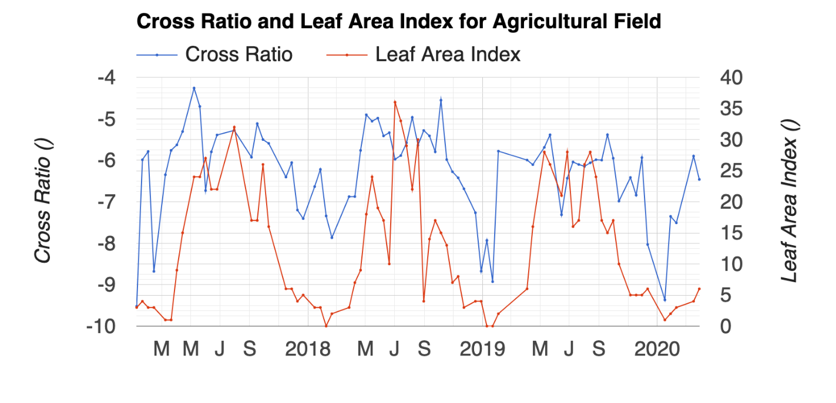
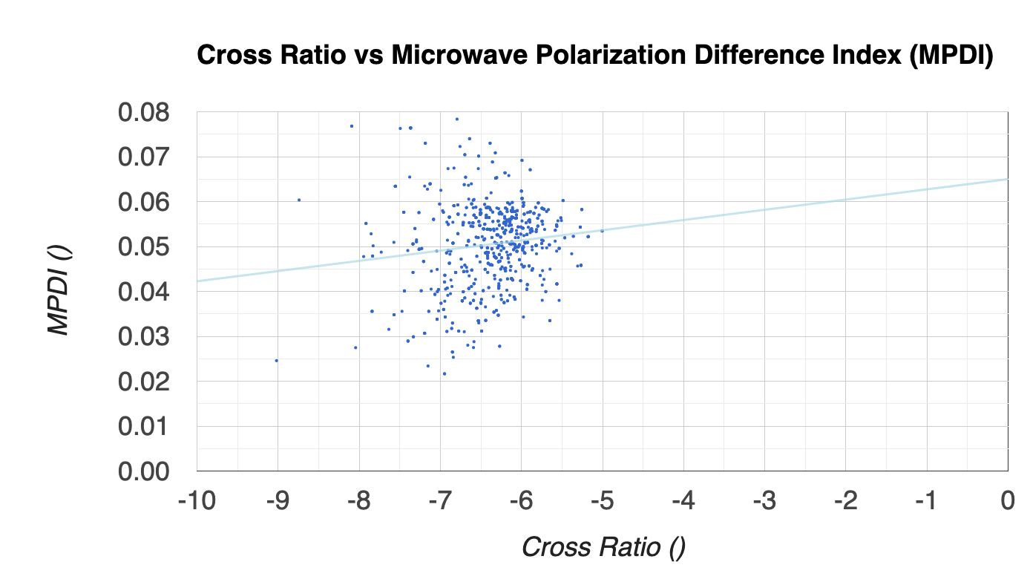
Early Results of Investigation into the Use of Radar Data to Estimate Vegetation Optical Depth at 1 km
Fritz Policelli¹ and Thomas Holmes¹
¹NASA GSFC Hydrological Sciences Lab
Vegetation Optical Depth is important because it provides information on the amount of water contained in vegetation. Understanding the amount of water contained in vegetation is useful for research on energy and water balances and for improving management of agriculture. Cross Ratio data from radar appears to have a vegetation signal. Microwave Polarization Difference Index does not appear to be correlated with Cross Ratio.
Earth Sciences Division – Hydrosphere, Biosphere, and Geophysics

Slide 8
Name: Fritz Policelli, Code 617, NASA GSFC
E-mail: fritz.s.policelli@nasa.gov
Phone: 301-614-6573
References:
A. G. C. A. Meesters, R. A. M. De Jeu and M. Owe, "Analytical derivation of the vegetation optical depth from the microwave polarization difference index," in IEEE Geoscience and Remote Sensing Letters, vol. 2, no. 2, pp. 121-123, April 2005, doi: 10.1109/LGRS.2005.843983.
K. Rötzer et al., "Relationship Between Vegetation Microwave Optical Depth and Cross-Polarized Backscatter From Multiyear Aquarius Observations," in IEEE Journal of Selected Topics in Applied Earth Observations and Remote Sensing, vol. 10, no. 10, pp. 4493-4503, Oct. 2017, doi: 10.1109/JSTARS.2017.2716638.
Data Sources:
NASA MODIS satellite instrument Leaf Area Index (LAI) data, NASA SMAP satellite Brightness Temperature data, European Space Agency (ESA) Sentinel-1 satellite Backscatter Coefficient data (σ)
Technical Description of Figures:
Figure 1: Comparison of timeseries of ESA Sentinel-1 Cross Ratio (log(σ_{HV}/σ_{VV})) and NASA MODIS LAI. The Sentinel-1 Cross Ratio appears to have a vegetation-related signal
Figure 2: Scatter plot for ESA Sentinel-1 Cross Ratio vs. SMAP Microwave Polarization Difference Index (MPDI) indicates a low correlation. A higher correlation was expected because of the apparent vegetation signal in the Sentinel-1 Cross Ratio, and the use of MPDI to calculate Vegetation Optical Depth in Meesters et al., 2005, indicating a vegetation signal in MPDI.
Scientific significance
This study is investigating the use of Sentinel-1 Cross Ratio data to produce moderate resolution Vegetation Water Content (VWC) data for use in modeling transpiration. Initial research is focused on disaggregating SMAP MPDI to moderate spatial resolution (1 km) for use in the Meesters et al., 2005 formulation of Vegetation Optical Depth (tau) as a function of MPDI. VWC is related to tau through a constant. If this method does not prove to be effective, moderate resolution VWC will be derived directly from Sentinel-1 VH polarized backscatter data per Rotzer et al., 2017. Improvement of spatial and temporal resolution evapotranspiration (ET) retrieval is a goal cited in the National Academies’ 2017 Earth Science Decadal Survey and has relevance to applications such as agricultural management.
Earth Sciences Division – Hydrosphere, Biosphere, and Geophysics
Notes:
8

