Slide 1
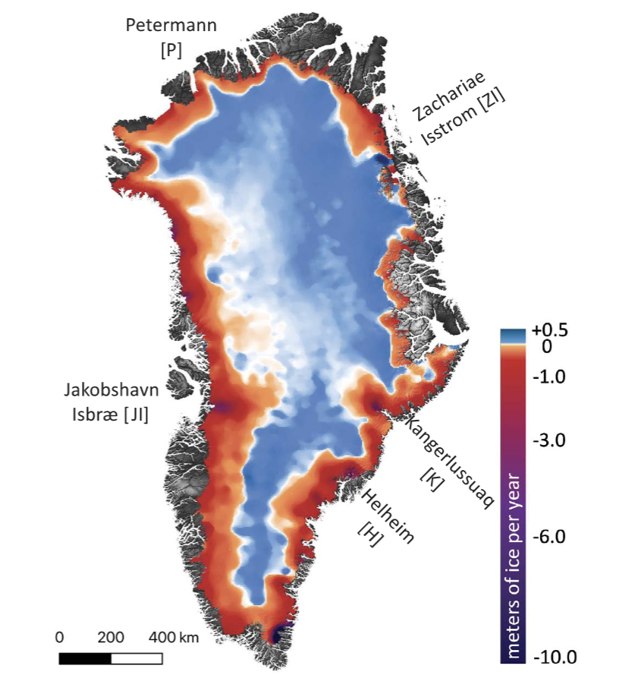
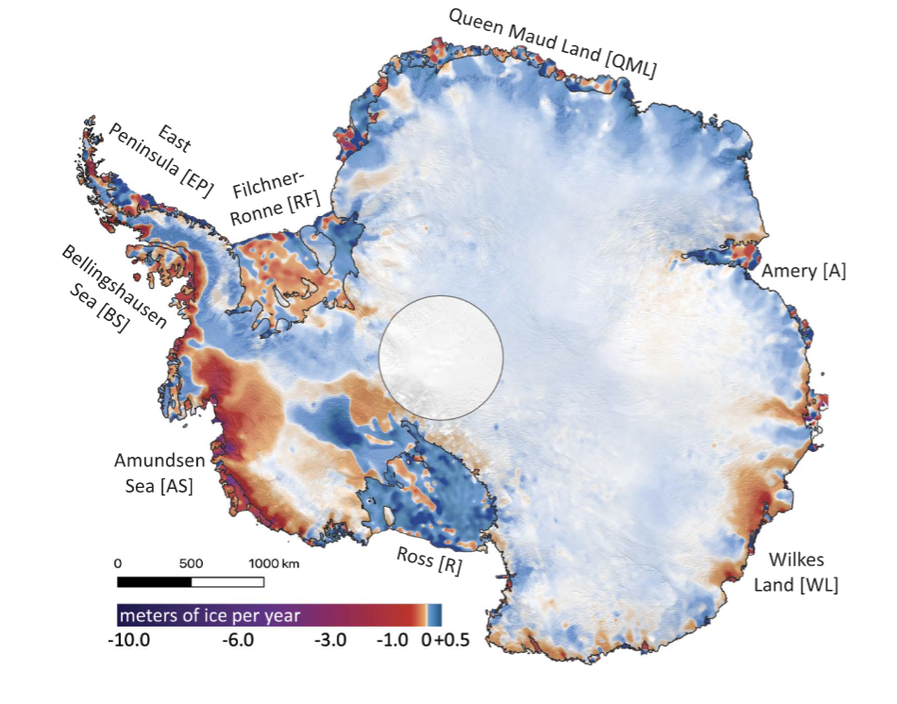
Pervasive ice sheet mass loss reflects competing ocean and atmosphere processes B.E. Smith¹, H.A. Fricker², A. Gardner³, B. Medley⁴, J. Nilsson³, F. Paolo³, N. Holschuh^{5,6}, S. Adusumilli², K. Brunt⁷, B. Csatho⁸, K. Harbeck⁹, T. Markus⁴, T. Neumann⁴, M.R. Siegfried¹⁰, H. J. Zwally^{4,7} ¹APL/University of Washington, ²Scripps Institution of Oceanography/UCSD, ³NASA/JPL, ⁴NASA/GSFC, ⁵ESS/University of Washington, ⁶Dept. of Geology, Amherst College, ⁷ESSIC/University of Maryland, ⁸Dept. Of Geological Science, University of Buffalo, ⁹NASA/GSFC/KBR, ¹⁰Dept. of Geophysics, Colorado School of Mines
Figure 1
Figure 2
Estimates of mass change were made by first computing volume change by comparing data at orbital crossovers between ICESat and ICESat-2, and then converting that volume change to mass change using a model for snow and firn processes.
Our results indicate that mass losses were larger than gains, with grounded ice loss from Greenland and Antarctica contributing 14 mm to sea level between 2003 and 2019.
Earth Sciences Division – Hydrosphere, Biosphere, and Geophysics

Slide 2
Name: Brooke Medley, Cryospheric Sciences Laboratory, NASA GSFC E-mail: brooke.c.medley@nasa.gov Phone: 301.614.6705
References
Smith, B.E., H.A. Fricker, A. Gardner, B. Medley, J. Nilsson, F.S. Paolo, N. Holschuh, S. Adusumilli, K.M. Brunt, B. Castho, K. Harbeck, T. Markus, T. Neumann, M.R. Siegfried, H.J. Zwally (2020). Pervasive ice sheet mass loss reflects competing ocean and atmosphere processes. Science. https://doi.org/10.1126/science.aaz5845
Data Sources:
Data from the ICESat mission (GLAS/ICESat L2 global Antarctic and Greenland ice sheet altimetry (doi: 10.5067/ICESAT/GLAS/DATA209)) and from the ICESat-2 mission (ATLAS/ICESat-2 L3A land ice height, version 1 (doi: 10.5067/ATLAS/ATL06.001)) used in this work are available through the National Snow and Ice Data Center (NSIDC). For simulating the evolution of the firn column through the time period of the study, we used the Community Firn Model version 1.0.3, as well as the MERRA-2 atmospheric reanalysis from the NASA GSFC Global Modeling and Assimilation Office (GMAO).
Technical Description of Figures:
Figure 1: (Top) Mass change (meters of ice equivalent per year) in Greenland.
Figure 2: (Top) Mass change (meters of ice equivalent per year) for Antarctica.
Scientific significance, societal relevance, and relationships to future missions:
NASA’s Ice, Cloud, and land Elevation Satellite-2 (ICESat-2) mission was launched in September 2018 to monitor areas of our planet undergoing rapid change, particularly in the Arctic and Antarctic. ICESat-2 carries the Advanced Topographic Laser Altimeter System (ATLAS), a photon-counting lidar that collects highly precise data to allow scientists to make surface height measurements and determine elevation change across the globe with unmatched detail. This is the first study published providing estimates of ice sheet mass change from 2003 to 2019 using data from NASA’s ICESat and ICESat-2 laser altimetry missions. Quantifying ice sheet change from this time period is one of ICESat-2’s driving mission requirements. This study uses data from the ICESat mission and compares it to recent data collected by ICESat-2 to generate the first decadal time series of ice sheet mass change by calculating elevation change and applying corrections for changes in snow accumulation, firn air content, and glacial isostatic adjustment. From the resulting mass change results, we can determine an estimate of global sea level contribution from both the Greenland and Antarctic ice sheets from 2003 to 2019. The blue regions in the interior reflect gains via snow accumulation while the red regions reflect losses via increased surface meltwater runoff (Greenland) and ocean-driven melt of ice in contact with warming waters (Greenland and Antarctica).
Earth Sciences Division – Hydrosphere, Biosphere, and Geophysics

Slide 3
Using the full spectrum of remote sensing reflectance to elucidate color shifts in the ocean
Ryan A. Vandermeulen^{1,2}, Antonio Mannino¹, Susanne E. Craig^{1,3}, and P. Jeremy Werdell¹
¹Ocean Ecology Lab, NASA GSFC , ²Science Systems and Applications, Inc., ³University Space Research Association
Pakistan
Fig. 1
Oman
Fig. 2
Every parcel of water on Earth can exhibit a unique “optical fingerprint” based on the size, shape, and composition of the microscopic materials that absorb and scatter light in water. However, the information that contributes to these optical fingerprints is comprised of multiple layers of data, so we have developed a new way to simplify this complex signal in order to make it easier to visualize and interpret. This new tool helps better conceptualize how satellites detect subtle changes in the color of the ocean over time and space.
Earth Sciences Division – Hydrosphere, Biosphere, and Geophysics

Slide 4
Name: Ryan A. Vandermeulen, Code 616.1 NASA GSFC/SSAI E-mail: ryan.a.vandermeulen@nasa.gov Phone: 301-286-8966
References:
Vandermeulen, R. A., Mannino, A., Craig, S.E., Werdell, P.J., 2020: “150 shades of green: Using the full spectrum of remote sensing reflectance to elucidate color shifts in the ocean,” Remote Sensing of Environment, 247, 111900, https://doi.org/10.1016/j.rse.2020.111900
Data Sources:
NASA Goddard Space Flight Center, Ocean Ecology Laboratory, Ocean Biology Processing Group. Moderate-resolution Imaging Spectroradiometer (MODIS) Aqua Ocean Color Data; 2018 Reprocessing. NASA OB.DAAC, Greenbelt, MD, USA. doi: data/10.5067/AQUA/MODIS/L2/OC/2018.
Craig, Susanne E; Lee, Zhongping; Du, Keping (2020): Top of Atmosphere, Hyperspectral Synthetic Dataset for PACE (Phytoplankton, Aerosol, and ocean Ecosystem) Ocean Color Algorithm Development. National Aeronautics and Space Administration, PANGAEA, https://doi.org/10.1594/PANGAEA.915747
Technical Description of Figures:
Figure 1: The weighted harmonic mean of the R_{rs} wavelengths outputs an Apparent Visible Wavelength (in units of nanometers), representing a one-dimensional geophysical metric of color that is inherently correlated to spectral shape. Figure 2: This scene from MODIS-Aqua passing over the Arabian Sea makes use of the full visible spectrum of R_{rs} to unravel true ocean color variability. This dimensionality reduction of spectral information offers a robust and user-friendly means to describe and analyze spectral R_{rs} in terms of spatial and temporal trends and variability.
Scientific significance, societal relevance, and relationships to future missions: Our manuscript proposes a simple and intuitive classification system that enables a more manageable handling of spectral information for aquatic science applications. Applying this approach to 22 years of the ocean color time-series, we found that some areas of the globe demonstrate optical stability, while other areas of the ocean are becoming either more green or blue over time. This is important to monitor, as changes in the ocean color are an indicator of potential changes to ocean ecology and, by extension, human health and livelihoods. The functionality to simultaneously conceptualize multiple layers of information can not only help reveal ecologically significant trends, but also aid in the first-order utilization and interpretation of remotely sensed, high spectral resolution datasets, such as that obtained from airborne campaigns or the future slated Plankton, Aerosol, Cloud, ocean Ecosystem (PACE) mission.
Earth Sciences Division – Hydrosphere, Biosphere, and Geophysics
Notes:
4

Slide 5
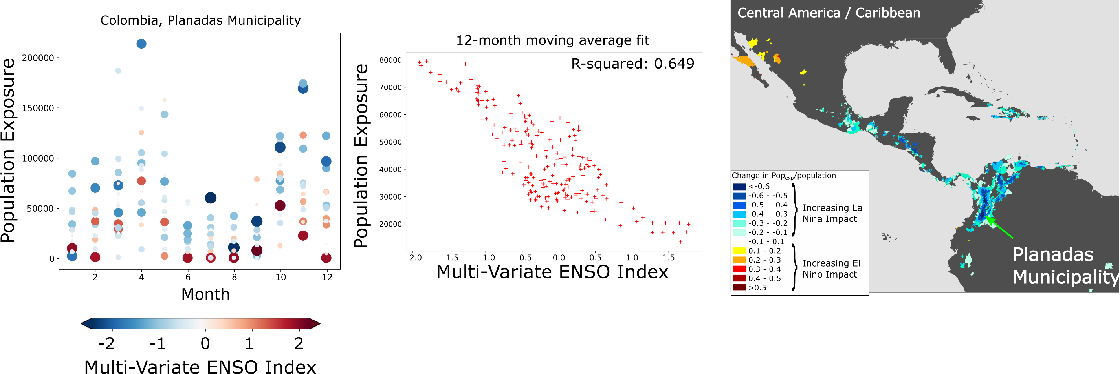
Novel Estimates of Global Exposure to Landslide Hazards Robert Emberson^{1,2} Dalia Kirschbaum¹, Thomas Stanley^{1,3}
¹GSFC Hydrological Sciences Laboratory 617 ²NASA Postdoctoral Program ³USRA
Figure 2
Figure 1a
Figure 1b
El Nino Southern Oscillation (ENSO) cycles modulate precipitation differently around the globe, resulting in changes to the occurrence of rainfall-triggered landslide activity. Using a global landslide model, we consider how changing landslide hazard as a result of El Nino and La Nina cycles may affect population exposure. We have modelled this estimated change in landslide exposure from 2001-2019 and summarized results from 40,000 counties/municipalities to show how exposure changes by month over the period of record (Figure 1a) and how this correlates with Multi-Variate ENSO Index for the example area in Colombia (Figure 1b). We have also mapped these values globally to highlight zones where El Nino drives changes in exposure; blue areas have higher landslide exposure during La Nina, and Red during El Nino (Figure 2).
Earth Sciences Division – Hydrosphere, Biosphere, and Geophysics

Slide 6
Name: Robert Emberson, 617 NASA GSFC / NPP Fellow E-mail: robert.a.emberson@nasa.gov Phone: 301-614-5815
References:
Emberson, R., Kirschbaum, D., Stanley, T. Global connections between El Nino and landslide impacts. Under review at Nature Communications.
Additional information: Emberson, R., Kirschbaum, D., and Stanley, T.: New Global Characterization of Landslide Exposure, Natural Hazards and Earth System Science Discussions, https://doi.org/10.5194/nhess-2019-434
Data Sources: Data sources: NASA IMERG v06B product (2001-2019 data); GPW v4 population estimates (2015); OpenStreetMap data on critical infrastructure; NOAA Multi-Variate El Nino Southern Oscillation Index (MVEI) v2 monthly data.
Technical Description of Figures:
Figure 1a (left): monthly exposure of population (calculated as person-days exposed to elevated landslide hazard) in the example location (Planadas Municipality, Colombia) for years 2001-2019. Size of point is determined by magnitude of Multivariate El Nino Southern Oscillation Index v2 (MVEI, NOAA data), and color by the sign of the MVEI index. Figure 1b (center): 12-month moving average population exposure compared with 12-month moving average MVEI index for each month 2001-2019, again for the example location (Planadas Municipality). The strong negative relationship between MVEI ENSO index and population exposure indicates that El Nino years are drier, with less extreme rainfall that leads to elevated landslide exposure. Figure 2 (right): Showing the regions where significant correlation is observed between MVEI and population exposure. Regions that are colored demonstrate a correlation (example in Figure 1b) with an R² value of greater than 0.2. The color scheme indicates how strongly ENSO affects population exposure; increasingly blue colors show areas where La Nina leads to increasing population exposure to landslides, while yellow-to-red colors indicate regions where El Nino conditions instead lead to higher population exposure to landslides.
Scientific significance, societal relevance, and relationships to future missions: This is the first time that the effects of El Nino on landslides have been mapped globally using satellite rainfall observations. In addition, we combine landslide hazard estimates with data on population to focus in on where people are significantly affected. These data provide an opportunity to define seasonal landslide exposure forecasts at local scales that are informed by ENSO estimates, which represents a first step to medium-term landslide impact forecasting. This is likely of great value to disaster mitigation and planning professionals.
Earth Sciences Division – Hydrosphere, Biosphere, and Geophysics
Notes:
6

Slide 7
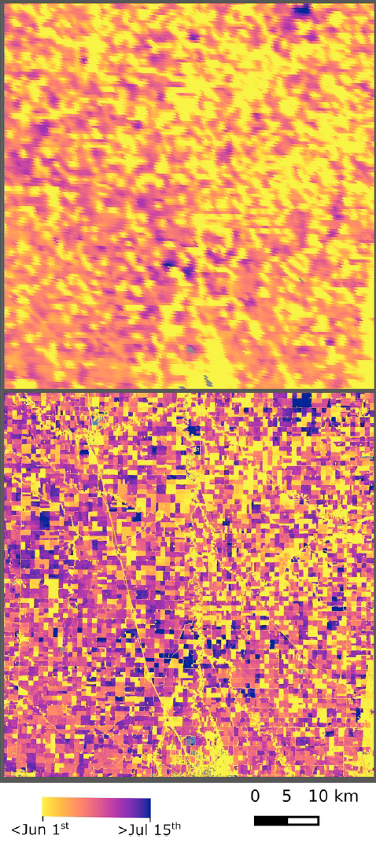
Global Harmonized Landsat/Sentinel-2 (HLS) Data Products Being Released
(Jeffrey Masek¹, Junchang Ju²)
¹NASA GSFC, Code 618; ²University of Maryland College Park
Phenology from the Moderate Resolution Imaging Spectroradiometer (MODIS) -
Day of 50% greenness
(250m resolution)
HLS
Phenology -
Day of 50% greenness
(30m resolution)
Global harmonized surface reflectance products from the NASA/USGS Landsat 8 and European Sentinel-2a/b missions are being processed by NASA beginning Summer 2020. HLS products support studies that require imagery every 2-3 days, including studies of vegetation phenology, as well as longer-term analysis of ecosystem changes. HLS global products are being produced by the Interagency Implementation and Advanced Concepts Team (IMPACT) cloud computing group at Marshall Space Flight Center and distributed by the NASA Land Processes Distributed Active Archive Center (LP-DAAC).
Earth Sciences Division – Hydrosphere, Biosphere, and Geophysics

Slide 8
Name: Jeffrey Masek, Code 618, NASA GSFC E-mail: Jeffrey.G.Masek@nasa.gov Phone: 301-614-6629
References:
Bolton, DK, J.M. Gray, E.K. Melaas, M. Moon, L. Eklundh, and M. Friedl. Continental-scale land surface phenology from harmonized Landsat 8 and Sentinel-2 imagery, Remote Sensing of Environment, 240, 2020. DOI: j.rse.2020.111685.
Claverie, M., J. Ju, J.G. Masek, J.L. Dungan, E.F. Vermote, J.C. Roger, S.V. Skakun, C. Justice. The Harmonized Landsat and Sentinel-2 surface reflectance data set, Remote Sensing of Environment., 219, 2018, 10.1016/j.rse.2018.09.002.
Additional collaborators:
Rahul Ramachandran, Brian Freitag – NASA Marshall Space Flight Center
Thomas Maiersperger – Land Processes Distributed Active Archive Center
Jean-Claude Roger, Sergii Skakun – University of Maryland
Data Sources: NASA/USGS Landsat 8, European Commission/European Space Agency Sentinel-2 a/b.
Technical Description of Figures:
Figure 1: 30-meter resolution North American vegetation phenology for 2018 from Boston University, generated using HLS products. (Left) North American growing season length and start of growing season (50% greenness point); (Right) zoom in from upper Midwest showing the greater resolution available from the HLS-derived mapping at 30-meter resolution, compared to Moderate Resolution Imaging Spectroradiometer (MODIS) data at 250-meter resolution. Both figures from Bolton et al., 2020.
Scientific significance, societal relevance, and relationships to future missions: HLS products provide the ability to track short-term (near daily) changes in land surface conditions by merging data from US and European satellites. This capability is critical for agricultural monitoring, assessing surface water quality, and other highly dynamic application areas.
Earth Sciences Division – Hydrosphere, Biosphere, and Geophysics
Notes:
8

Slide 9
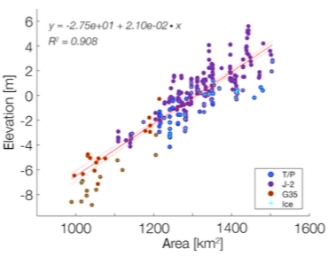
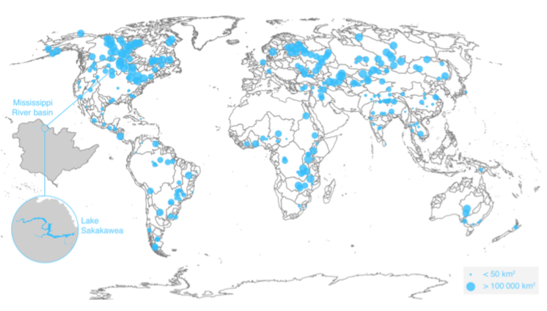
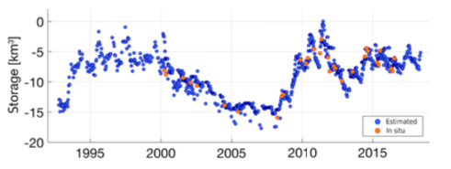
Satellite-based remote sensing data set of
global surface water storage change from 1992 to 2018 R. Tortini¹, N. Noujdina¹, S. Yeo¹, M. Ricko², C.M. Birkett³ , A. Khandelwal⁴, V. Kumar⁴, M.E. Marlier⁵, D.P. Lettenmaier¹
¹Department of Geography, University of California Los Angeles, CA, USA
²KBR at NASA/GSFC, MD, USA
³Geodesy and Geophysics Lab, NASA/GSFC, MD, USA
⁴Department of Computer Science and Engineering, University of Minnesota, MN, USA
⁵Institute of the Environment, University of California Los Angeles, CA, USA
Fig. 1: Continental distribution
Fig. 2:Lake Hypsometry
Fig. 3: Lake water storage variations
Monthly changes in terrestrial surface water storage for lakes and reservoirs are observed by radar altimeters and imaging radiometers for ~400 water bodies. Measurements are distributed across all continents (Fig. 1) and are limited by the altimetric orbit tracks and the spatial resolutions of the instruments. Lakes such as Lake Sakakawea are large enough to have their hypsometry recorded (Fig. 2) and water storage variations to be estimated over the ~26year period (Fig. 3).
Earth Sciences Division – Hydrosphere, Biosphere, and Geophysics

Slide 10
Name: Charon Birkett, Geodesy and Geophysics Lab, NASA GSFC E-mail: Charon.M.Birkett@nasa.gov Phone: 301.614.6464
References:
Tortini, R., Noujdina N., Yeo S., Ricko M, Birkett C.M., Khandelwal A., Kumar V., Marlier M.E., & Lettenmaier D.P. (2020). Satellite-based remote sensing data set of global surface water storage change from 1992 to 2018, J. Earth System Science Data, 12, 1141-1151. https://doi.org/10.5194/essd-12-1141-2020.
Data Sources: All lake surface water levels are derived from satellite radar altimeters using the NASA/CNES TOPEX/Jason series, the ESA ERS/ENVISAT series, and the ISRO SARAL mission. Lake water level products at 10-day or 35-day resolution were accessed from three operational on-line programs, GREALM, DAHITI, and HYDROWEB. Lake extent products were derived using 2000-2018 Terra/Aqua MODIS 500m 8-day composite optical imagery. Knowledge of lake hypsometry (water level versus extent relationship) allows water storage change to be estimated at monthly intervals across the entire 1992-2018 observation period. Lake level, extent and storage change products have been archived at PO.DAAC as part of the NASA MEaSUReS project.
Technical Description of Figures:
Figure 1: Location of the globally distributed lakes and reservoirs, and specifically Lake Sakakawea in the Mississippi Basin.
Figure 2: Water surface area and level relationship for Lake Sakakawea. Potential presence of lake ice is denoted by a blue cross in the symbol.
Figure 3: Time series of relative storage for Lake Sakakawea. Satellite-derived records are in blue. In situ estimates for cross-validation are in orange.
Scientific significance, societal relevance, and relationships to future missions: The set of lake water storage, elevation, and extent products serve both science projects and applied science programs. They are multi-decadal and therefore a useful earth data record set for long-term hydrological dynamics investigations or for interpretation of climatic variability. They also provide stakeholders with seasonal and interannual knowledge of water resources for municipal, agricultural or energy production considerations, and for observation of recurring drought or recharge conditions. The water storage data set also acts as an archive of measurements, a baseline for validation purposes with respect to the 2021 NASA/CNES/CSA/UKSA Surface Water and Ocean Topography (SWOT) mission which will make the first global survey of Earth’s surface water.
PO.DAAC: https://podaac.jpl.nasa.gov/dataset/PRESWOT_HYDRO_L4_LAKE_STORAGE_TIME_SERIES_V2?ids=&values=&search=lake
GREALM: https://ipad.fas.usda.gov/cropexplorer/global_reservoir/
DAHITI: https://dahiti.dgfi.tum.de/en/
HYDROWEB: http://hydroweb.theia-land.fr/?lang=en&
CNES= Centre National D’Etudes Spatiales, ESA=European Space Agency, ISRO= Indian Space Research Organization
CSA=Canadian Space Agency, UK Space Agency
MEaSUREs= Making Earth System Data Records for Use in Research Environments
Earth Sciences Division – Hydrosphere, Biosphere, and Geophysics
Notes:
10

