Slide 1



Radar Observations Discover Impact of Waves on Hurricane Secondary Eyewall Formation
Stephen Guimond (Code 612, NASA/GSFC and UMBC), P. Reasor (NOAA/HRD), G. Heymsfield (NASA/GSFC) and M. McLinden (NASA/GSFC)
Secondary Eyewall Forms Here
HIWRAP Ku-band Reflectivity and Wind Vectors 1 km Height
HIWRAP Data at Nadir
Vortex Rossby Waves
Vortex Rossby Waves
Radius (km)
Most mature hurricanes develop an outer, secondary eyewall that causes significant changes in overall storm intensity. Operational forecasts of these changes are fraught with errors and the science is not fully understood. Analysis of ground-based and airborne (NASA HIWRAP) radar data in Hurricane Matthew (2016) highlights the importance of “vortex Rossby waves” (VRWs) in the storm intensity/structure change. A new mathematical framework was developed that enables the first observational quantification of VRWs in the secondary eyewall formation process.

Slide 2
Name: Stephen R. Guimond, NASA/GSFC, Code 612 and UMBC
E-mail: stephen.guimond@nasa.gov
Phone: 301-614-5809
References:
Guimond, S.R., P. D. Reasor, G.M. Heymsfield and M. McLinden, 2020: The dynamics of vortex Rossby waves and secondary eyewall development in Hurricane Matthew (2016): New insights from radar measurements. J. Atmos. Sci., 77, 2349 – 2374, doi: 10.1175/JAS-D-19-0284.1
Guimond, S.R. L. Tian, G.M. Heymsfield, and S.J. Frasier, 2014: Wind retrieval algorithms for the IWRAP and HIWRAP airborne Doppler radars with applications to hurricanes. J. Atmos. Oceanic Technol., 31, 1189 – 1215, doi: 10.1175/JTECH-D-13-00140.1
Data Sources: NASA High-altitude Imaging Wind and Rain Airborne Profiler (HIWRAP) Doppler radar, NOAA WSR-88D ground-based radars, Air Force flight-level winds
Technical Description of Figures:
Graphic 1 (left): Horizontal cross section of HIWRAP data at ~ 1 km height between 1800 – 1900 UTC 7 October 2016 in Hurricane Matthew during a slow weakening trend and eyewall replacement cycle. The figure shows Ku-band reflectivity (dBZ) overlaid with perturbation horizontal wind vectors. This figure shows the structure of spiral bands breaking off the main eyewall of the storm in the down-shear-right quadrant [see gray arrow] and moving cyclonically in azimuth and outward in radius. Ground-based radar measurements and HIWRAP data identified these bands as convectively-coupled vortex Rossby waves (VRWs). These waves transport high angular momentum upward from low-levels to mid-levels and radially outward from the storm inner-core to the outer-core, leading to the development of an observed secondary wind maximum in the outer-core region. The projection of the wave kinematics onto the mean fields appears to control much of the large-scale dynamics, but nonlinear interactions between individual wave components leads to an enhancement of the overall forcing of the outer-core.
Graphic 2 (right): Vertical cross sections of HIWRAP data at nadir between 1306 – 1345 UTC 7 October showing the vertical structure of vortex Rossby wave spiral bands. The panels show (a) Ku-band reflectivity (dBZ), (b) storm-relative radial winds (m/s) and (c) vertical winds (m/s). Individual spiral bands are highlighted with dashed ovals and show positive momentum fluxes (i.e. u’w’ > 0). During this time period, flight-level data showed a secondary peak in tangential winds (secondary eyewall) located at 75 – 80 km radius in various azimuth locations.
Scientific significance, societal relevance, and relationships to future missions: The results of this work indicate that the convectively-coupled VRWs are leading to a direct spin-up of the outer-core tangential wind field and the development of a secondary eyewall. This is in contrast to studies that have described VRWs as playing an indirect role in the secondary eyewall formation by expanding the outer envelope of vorticity, which assists in the axisymmetrization of convective-scale vorticity anomalies. It was also determined with the airborne radar and satellite data that convective bursts formed in the inner-core of Matthew through the dynamic interaction between a VRW spiral band and a mesovortex circulation. Finally, a new dynamical budget methodology for the large-scale angular momentum field was designed in this study to allow an understanding of the storm dynamics with narrow swath radar measurements such as HIWRAP. This work has high societal impact since secondary eyewall formation and evolution is a common feature of hurricanes that can cause significant changes in storm intensity. Operational forecasts of these intensity/structure changes are poor, leaving coastal and inland populations without proper information to protect life and property. Understanding of the storm physics helps to guide improvements in predictive models. This work is highly relevant to the NASA Investigation of Microphysics and Precipitation for Atlantic Coast-Threatening Snowstorms (IMPACTS). One main goal of IMPACTS is to understand and improve predictions of banded snow structures. The methods and data analysis presented here can be extended to the IMPACTS campaign to address the science questions on winter storms.
Earth Sciences Division - Atmospheres
Notes:
2

Slide 3
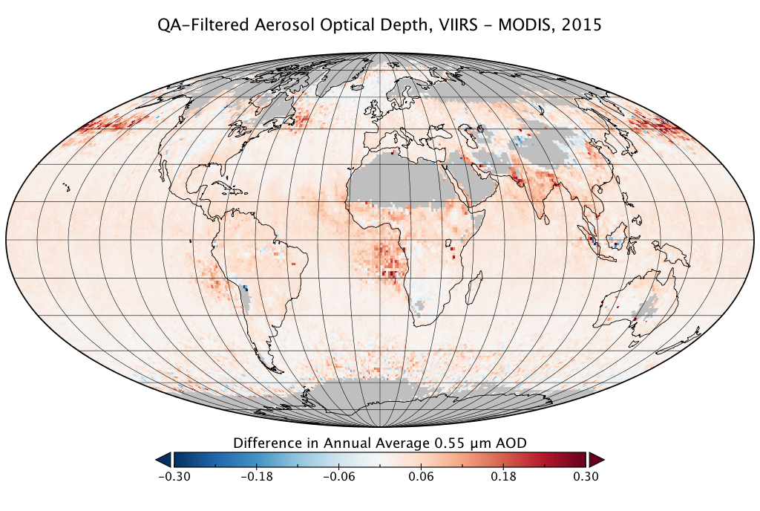
Using VIIRS SNPP to continue MODIS Aerosol as a Climate Data Record
Virginia Sawyer^{2,1}, Robert C. Levy¹, Shana Mattoo^{2,1}, Geoff Cureton³,
Yingxi Shi^{4,1}, Lorraine Remer⁴
¹NASA/GSFC Code 613, ²SSAI, ³CIMSS/SSEC UW-Madison, ⁴JCET/UMBC
We announce the release of a Dark Target aerosol retrieval product for VIIRS on Suomi-NPP, providing continuity with the nearly 20 year data record from MODIS Aqua. Values of aerosol optical depth (AOD) are highly correlated with MODIS Aqua, but are offset higher. Where both sensors retrieve on the same date, their AOD distributions are nearly identical. The offset comes from cases where only one of the two sensors chose to retrieve AOD. Both solo-sensor AOD distributions skew higher than the collocated values. Because VIIRS has a wider swath and finer resolution, most solo-sensor retrievals are VIIRS-only rather than MODIS-only, which contributes to the offset.

Slide 4
Name: Virginia Sawyer, NASA/GSFC Code 613 and SSAI
E-mail: virginia.r.sawyer@nasa.gov
Phone: 301-614-6184
References:
Sawyer, V.; Levy, R.C.; Mattoo, S.; Cureton, G.; Shi, Y.; Remer, L.A. Continuing the MODIS Dark Target Aerosol Time Series with VIIRS. Remote Sensing 2020, 12, 308.
Data Sources: The NASA Dark Target product for VIIRS SNPP can be found at LAADS (dx.doi.org/10.5067/VIIRS/AERDT_L2_VIIRS_SNPP.001), as can the MODIS Collection 6.1 Dark Target products used for comparison (Aqua, dx.doi.org/10.5067/MODIS/MYD04_L2.061; Terra, dx.doi.org/10.5067/MODIS/MOD04_L2.061). The ground-based validation uses NASA AERONET version 3 data from all sites during 2015 (https://aeronet.gsfc.nasa.gov/). This research was supported by NASA’s Earth Science Division using NNH17ZDA001N-MEaSUREs (Making Earth Science data Records for Use in Research Environments) and NNH17ZDA001N-TASNPP (The Science of Terra, Aqua and Suomi-NPP).
Technical Description of Figures:
Graphic 1: The top figures show the distribution of aerosol optical depth (AOD) at 0.55 μm for all daily average 1°×1° grid cells throughout 2015, where MODIS and VIIRS are collocated (dashed lines, blue and gold respectively) versus when only one of the two sensors had measurements from a particular grid cell (solid lines). The proportion of collocated to non-collocated grid cells is shown underneath: VIIRS has more retrieved grid cells than MODIS on any given day because of its wider swath, but many solo-sensor measurements are marginal and skewed high due to cloud contamination. Ocean and land retrievals are treated separately, and each is filtered by quality flag. The ocean retrievals included in the gridded average are QA>0, whereas the land retrievals are QA=3 to compensate for the uncertainty introduced by the land surface. Where VIIRS and MODIS collocate, their AOD results are very similar; most of the offset on the global average is because the non-collocated retrievals have different AOD distributions both from the collocated retrievals and from each other.
Graphic 2: The bottom figure shows the difference in annual average AOD for each 1°×1° grid cell in 2015, using the same quality flags for land and ocean data as above. The small positive offset over ocean seen in the global AOD distribution is not spatially uniform, but increases in areas subject to regional aerosol events with cloud contamination or sampling limited by cloud masking. Over land, the total offset is close to zero on the annual global average, but this results from regional offsets that may be positive or negative. Land offsets also vary through the year, both because of seasonal aerosol events and because the land area that is not retrieved due to snow masking changes with the seasons.
Scientific significance, societal relevance, and relationships to future missions: The effects of atmospheric aerosol on the global climate are among the largest remaining sources of uncertainty to the global radiative balance, and suspended particles also have serious implications for public health worldwide. The Global Climate Observing System has set criteria for creating climate data records (CDRs) to understand aerosol as a climate measurement. An aerosol CDR must have global coverage, spatial resolution 10 km or finer, temporal resolution every four hours, accuracy better than ±0.03 or 10%, drift less than 0.01 per decade, and at least 30 years record length. The MODIS Dark Target retrieval approaches all these requirements except for temporal resolution (set by their polar orbit) and length of record (Terra and Aqua both expected to stop measurements by the mid-2020s). Because the VIIRS instrument is similar in design but intended for several future launches as well as the two (SNPP and NOAA-20) already producing data, the VIIRS version of the Dark Target retrieval can be used to extend the record to the required 30 years as long as the differences between it and the existing MODIS product are sufficiently understood. At this point, we have evaluated several sources of AOD offsets and have released the VIIRS SNPP version for operational use. It can be considered as much in continuity with the existing MODIS product as a new MODIS launch would be, although users needing to extend the Aqua or Terra records specifically may need to make adjustments.
Earth Sciences Division - Atmospheres
Notes:
4

Slide 5
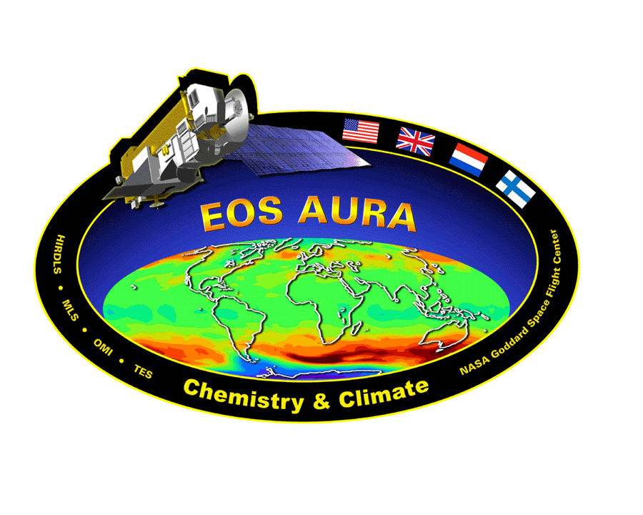
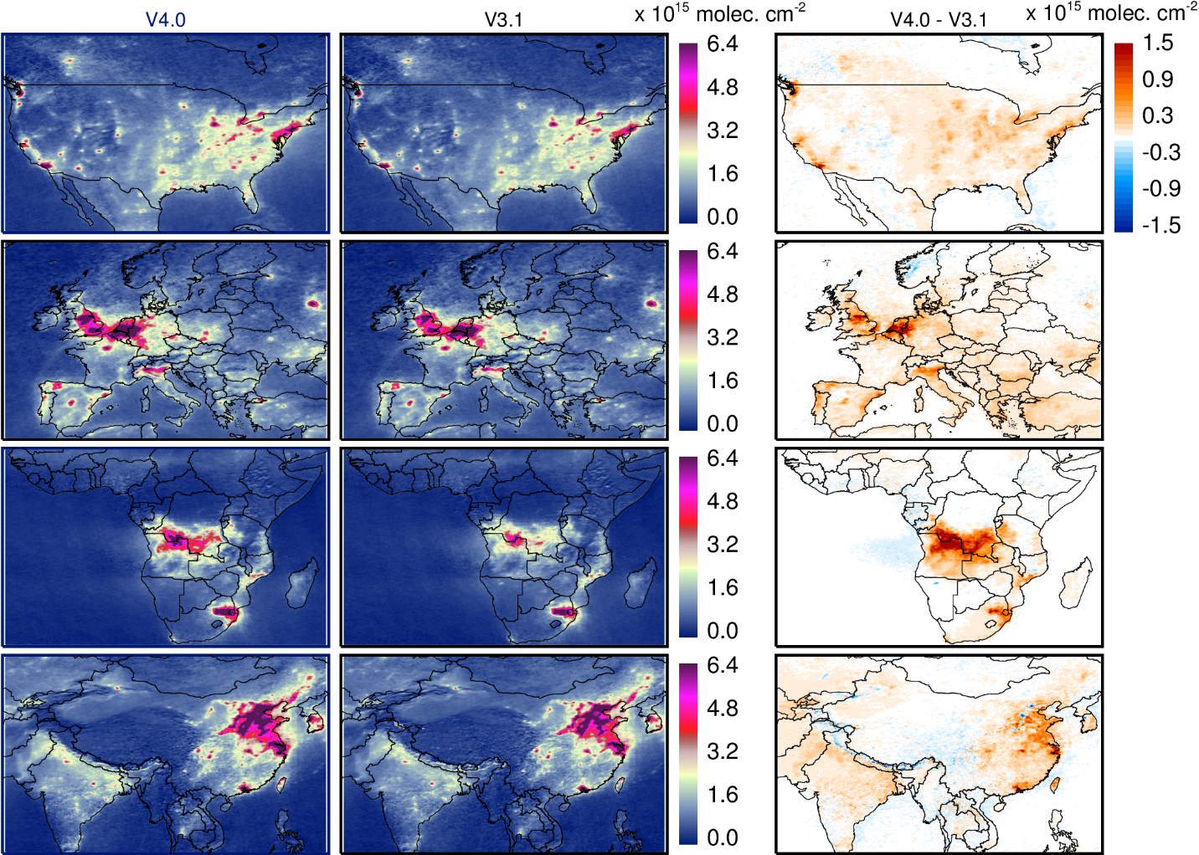

New Generation Aura OMI NO₂ Standard Product
Lok Lamsal, Nickolay Krotkov, Alexander Vasilkov, Sergey Marchenko, Wenhan Qin,
Eun-Su Yang, Zachary Fasnacht, Joanna Joiner, Sungyeon Choi, David Haffner,
William H. Swartz, Bradford Fisher, and Eric Bucsela
New (V4.0)
Old (V3.1)
V4.0-V3.1
New NASA NO₂ algorithm
First global satellite trace-gas retrieval with OMI-MODIS synergy accounting for surface reflectance anisotropy in cloud and NO₂ retrievals
Improved spectral fitting procedures for NO₂ and oxygen dimer (for cloud) retrievals
Retrievals based on high resolution field of view specific input information
Improved treatment over snow/ice surfaces
Biomass burning
Industrial pollution
The seasonal (June-July-August, 2005) mean cloud-free tropospheric NO₂ column data demonstrate that the updates implemented in the new OMI NO₂ algorithm yield 10-40% higher columns over polluted regions that are in improved agreement with independent observations.

Slide 6
Name: Lok Lamsal, USRA & NASA/GSFC, Code 614 & Nickolay Krotkov NASA/GSFC, Code 614
E-mail: lok.lamsal@nasa.gov Nickolay.a.Krotkov@nasa.gov
Phone: 301-614-5160 Phone: 301-614-5553
Reference: Lamsal, L.N., Krotkov, N.A., Vasilkov, A., Marchenko, S., Qin, W., Yang, E.-S., Fasnacht, Z., Joiner, J., Choi, S., Haffner, D., Swartz, W.H., Fisher, B., and Bucsela, J., OMI/Aura Nitrogen Dioxide Standard Product with Improved Surface and Cloud Treatments, Atmos. Meas. Tech., Submitted, 2020.
Data Availability: The new OMI NO2 V4.0 data and relevant documentation are publicly available from the NASA Goddard Earth Sciences Data and Information Services Center (GES DISC, https://disc.gsfc.nasa.gov/datasets/OMNO2_003/summary), and the Aura Validation Data Center (AVDC, https://avdc.gsfc.nasa.gov/pub/data/satellite/Aura/OMI/V03/) websites.
Technical Description of Figures:
Figure: Three-month (June-July-August) average tropospheric NO₂ column for low cloud conditions (cloud radiance fraction<0.5) in 2005 over North America (1st row), Europe (2nd row), southern Africa (3rd row), and Asia (4th row) from V4.0 (1st column), V3.1 (2nd column), and their difference (V4.0 – V3.1).
Scientific significance, societal relevance, and relationships to future missions: The NASA standard nitrogen dioxide (NO2) version 4.0 product for OMI Aura incorporates the most salient improvements and enhances the NO2 data quality in several ways. The retrieval algorithm is based on a conceptually new, geometry-dependent surface Lambertian equivalent reflectivity (GLER) data that are available on an OMI pixel basis. The GLER product is calculated using the VLIDORT model, which uses as input high resolution bidirectional reflectance distribution function (BRDF) information from Aqua MODIS instruments over land and the wind-dependent Cox–Munk wave-facet slope distribution over water, the latter with contribution from the water-leaving radiance. The GLER combined with consistently retrieved oxygen dimer (O2-O2) absorption-based cloud fractions and pressures provide high-quality data inputs to the new NO2 retrieval scheme. The updates implemented in V4.0 yield higher (∼10–40%) tropospheric NO2 columns in polluted areas, with less-pronounced (±10%) differences in background and low-column areas. While the updates are found to have less impact on studies focusing on trend, we anticipate that the improved NO2 data record will be beneficial for studies related to emission estimates of nitrogen oxides (NOx) and co-emitted gases such as carbon dioxide (CO2).
The algorithms developed for OMI are being implemented for other similar past and currently operating satellite spectrometers, and serve as foundation for future instruments, including geostationary instruments, such as TEMPO. The algorithms currently applied for NO2 retrievals can be applied to improve retrievals of other species such as formaldehyde, sulfur dioxide, and ozone.
Earth Sciences Division - Atmospheres

