Slide 1
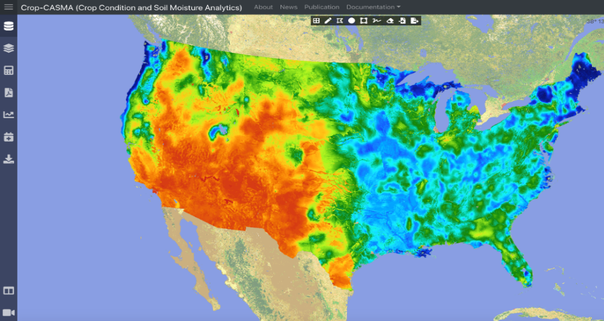
High Spatio-Temporal Soil Moisture for USDA Pang-Wei Liu^{1,2}, Rajat Bindlish¹, Peggy O’Neill¹, Zhengwei Yang³, and Venkat Lakshmi⁴
¹NASA GSFC, ²SSAI, ³USDA NASS, ⁴University of Virginia
ubRMSE (m³/m³)
USDA Crop-CASMA System
USDA Observations
NOAA Observations
Figure 1
Figure 2
Table 1
 | SMAP/Sentinel1 (1 km) |  |  |  | THySM (1 km)
 | ubRMSE (m³/m³) | RMSE (m³/m³) | Bias (m³/m³) | R | ubRMSE (m³/m³) | RMSE (m³/m³) | Bias (m³/m³) | R
Core Validation Sites | 0.059 | 0.093 | 0.003 | 0.61 | 0.049 | 0.082 | 0.003 | 0.69
Sparse Networks | 0.062 | 0.084 | -0.001 | 0.54 | 0.055 | 0.077 | 0.001 | 0.65
Thermal Hydraulic disaggregation of Soil Moisture (THySM) was developed to improve the spatio-temporal resolution of retrieved soil moisture to field scale at 1 km with full coverage over the continental US every 2-3 days. The resulting high-resolution data provide more detailed soil moisture information and are ingested into USDA’s Crop Condition and Soil Moisture Analytics (Crop-CASMA) system for improved decision making (https://cloud.csiss.gmu.edu/Crop-CASMA/). The new product outperforms the SMAP/Sentinel1 product when compared with in situ soil moisture measurements from SMAP Core Validation Sites (CVS), and USDA’s and NOAA’s observation networks based on Root Mean Square Error (RMSE), unbiased RMSE (ubRMSE), bias, and correlation coefficient (R).
Earth Sciences Division – Hydrosphere, Biosphere, and Geophysics

Slide 2
Name: Rajat Bindlish, Hydrological Science Lab, NASA GSFC E-mail: rajat.bindlish@nasa.gov Phone: 301-286-8753
References:
Liu, P.-W. (617), R. Bindlish (617), P. O’Neill (617), B. Fang, V. Lakshmi, and Z. Yang, 2020. Thermal Hydraulic Disaggregation of SMAP Soil Moisture. (In Preparation).
Liu, P.-W. (617), R. Bindlish (617), B. Fang, V. Lakshmi, P. O’Neill (617), Z. Yang, M. Cosh, T. Bongiovanni, D. Bosch, C. Holifield Collins, P. Starks, J. Prueger, M. Seyfried, and S. Livingston, 2020. Assessing Disaggregated SMAP Soil Moisture Product in the United States. IEEE Journal of Selected Topics in Applied Earth Observations and Remote Sensing. (Under Review).
Fang, B., V. Lakshmi, R. Bindlish (617), T. Jackson, and P.-W. Liu (617), 2020. Evaluation and Validation of a High Spatial Resolution Satellite Soil moisture Product over the Continental United States. Journal of Hydrology, Vol. 588, 125043.
Data Sources: The Soil Moisture Active Passive (SMAP) Level 2 Enhanced passive-only soil moisture product was disaggregated to 1 km spatial resolution using Thermal Hydraulic disaggregation of Soil Moisture (THySM). Land surface temperature (LST) and near-surface soil moisture from the North American Land Data Assimilation System (NLDAS) and NDVI from NOAA’s Advanced Very High Resolution Radiometer (AVHRR) were used to build the thermal inertia model. LST and NDVI from MODIS were used to estimate the soil moisture spatial variability. The State Soil Geographic – US (STATSGO) soil texture dataset was used to estimate soil moisture variability in the absence of MODIS data due to cloud cover. In situ soil moisture data from SMAP Core Validation Sites, USDA Soil Climate Analysis Network (SCAN), and NOAA Climate Reference Network (CRN) were used to evaluate the performance of the disaggregated soil moisture.
Technical Description of Figures and Table:
Figure 1 shows disaggregated SMAP soil moisture at 1 km in the continental US ingested into the USDA Crop Condition and Soil Moisture Analytics (Crop-CASMA) system. The Crop-CASMA portal facilitates generation of a weekly soil moisture report at field scale that shows higher spatial variability than the original SMAP products.
Figure 2 shows the unbiased Root Mean Square Error (RMSE) for Thermal Hydraulic disaggregation of Soil Moisture (THySM) retrievals using in situ data from USDA Soil Climate Analysis Network (SCAN), and NOAA Climate Reference Network (CRN).
Table 1 summarizes the performance statistics of disaggregated SMAP products compared with in situ stations from SMAP Core Validation Sites, USDA SCAN, and NOAA CRN. The Thermal Hydraulic disaggregation of Soil Moisture (THySM) 1 km product outperforms the SMAP/Sentinel 1 km product.
Scientific significance, societal relevance, and relationships to future missions: Soil moisture is a critical factor for monitoring agricultural drought and predicting crop growing processes. Even though the present NASA SMAP/Sentinel-1 product provides soil moisture at a spatial resolution of 1-3 km, low revisit frequency of Sentinel-1 satellites (~6-12 days) results in low temporal resolution that may not provide enough water dynamic information for agricultural field management and decision making. A soil moisture disaggregation approach incorporating ancillary datasets at high spatial resolution based on thermal inertia theory and water retention curves was implemented to improve the spatio-temporal resolution of soil moisture. The products have been ingested into the USDA Crop-CASMA system to support USDA National Agricultural Statistics Service (NASS). USDA NASS needs field scale (1 km) observations of soil moisture conditions to provide guidance on agricultural conditions and for making agricultural yield forecasts for food security.
Earth Sciences Division – Hydrosphere, Biosphere, and Geophysics
Notes:
2

Slide 3
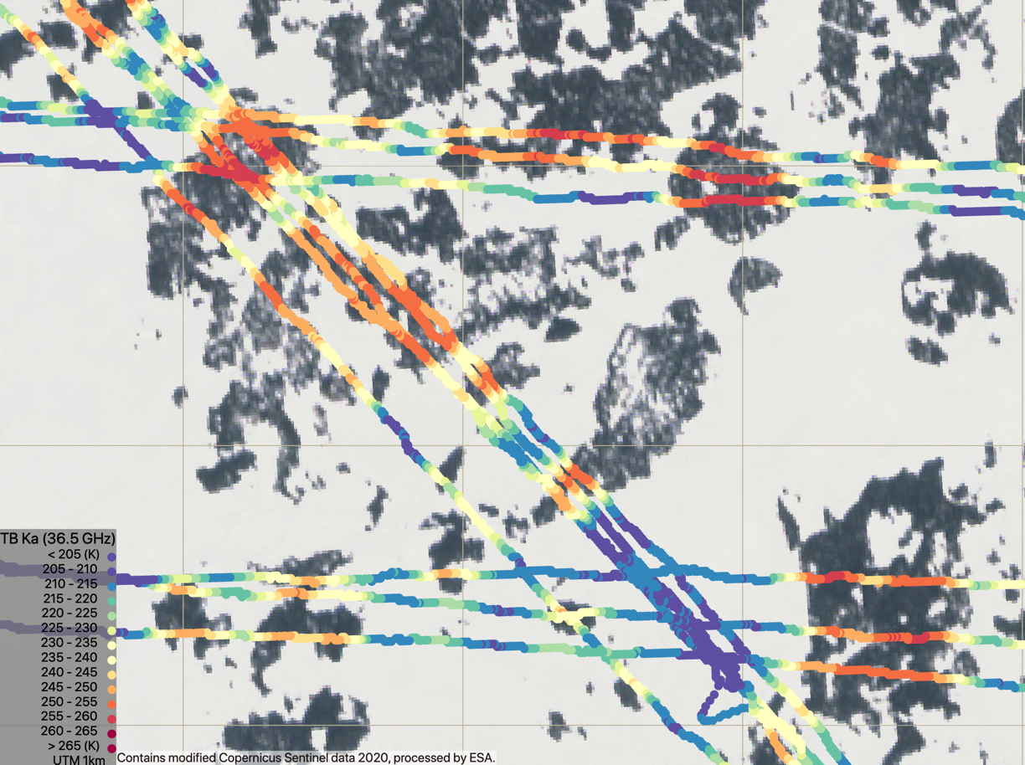
Airborne SWESARR Observations during SnowEx 2020 B. Osmanoglu¹, L. Brucker², R. Rincon¹, D. Hudson¹, M.Perrine³, P. Racette¹, A. Warren² (SWESARR et al.)
¹NASA GSFC, ²USRA GESTAR/NASA GSFC, ³UMD/NASA GSFC
2020-02-11 © PlanetScope
2020-02-11 SWESARR
X-VV
X-VH
Ku_{low} VV
Ku_{low} VH
2020-02-11
Ku_{high} VV
30
Ku_{high} VH
0 km 1
dB
-30
Snow Water Equivalent Synthetic Aperture Radar and Radiometer (SWESARR) is an experimental airborne instrument developed at GSFC. SWESARR's first science campaign was part of NASA's SnowEx, with two flight campaigns designed to obtain acquisitions (in fall) of a frozen soil with minimal snow presence, and (in winter) of a snow-covered environment. Left figure shows a complete set of radar observations at different frequency bands and polarizations. This figure demonstrates the radar’s high resolution imaging capability. Right figure shows the Ka band observations of the radiometer and demonstrates its stability over multiple flight lines, including at crossovers.
Earth Sciences Division – Hydrosphere, Biosphere, and Geophysics

Slide 4
Name: Batu Osmanoglu, Biospheric Sciences Lab., NASA GSFC E-mail: batuhan.osmanoglu@nasa.gov Phone: 301-614-6690
References:
Rincon et al., “Performance of SWESARR’s Multi-Frequency Dual-Polarimetry Synthetic Aperture Radar During NASA’s SnowEx Airborne Campaign”, IGARSS 2020
Osmanoglu, B., Rincon, R.F., Brucker, L., Racette, P. and Hudson, D.L., 2019. Preliminary results from SWESARR SnowEx Snow-off Flights. AGUFM, 2019, pp.C33E-1635.
Data Sources: SWESARR Radar and Radiometer data. © Planet Labs Inc. 2020 All Rights Reserved. Commercial Smallsat Data Acquisition Program (CSDAP).SWESARR team acknowledges the following funding sources: NASA Terrestrial Hydrology Program, NASA Earth Science Technology Office, Goddard Space Flight Center Earth Sciences Division
Technical Description of Figures:
Figure 1 (Left): SWESARR collects precise microwave backscatter imagery using its three band, dual polarization radar making up the six channels. The native resolution of these imagery are about a meter. Temporal and spatial variations in the backscattering amplitude relate to the changes in the amount of water stored in snow (a.k.a. snow water equivalent or SWE). These backscatter images are shown in logarithmic scale.
Figure 2 (Right): SWESARR radiometer observes microwave brightness temperature at three bands in horizontal polarization. At high frequencies, it becomes exponentially difficult to maintain instrument stability under changing environmental conditions such as temperature. This figure demonstrates the stability of the highest frequency channel at Ka-band. Variations in the brightness temperatures (TB) reflect changes in SWE, and canopy and ground properties. Grid shown is 1km. Combination of both radar and radiometer data result in superior algorithms to estimate SWE.
Scientific significance, societal relevance, and relationships to future missions: SWESARR is a new active and passive airborne instrument that makes quasi-simultaneous, co-located microwave observations of backscatter and brightness temperature for estimating the amount of snow. SWESARR contributes to two Earth science focus areas, a Decadal Survey targeted observable, an on-going airborne mission, and it has the potential to be the instrument that brings the necessary data to the scientists world-wide for algorithm development and a recommendation on a new satellite mission concept. SWESARR can lead to a future spaceborne mission through opportunities such as Earth Venture Instrument/Mission or Earth System Explorer as recommended by the 2017 Decadal Survey.
Earth Sciences Division – Hydrosphere, Biosphere, and Geophysics
Notes:
4

Slide 5
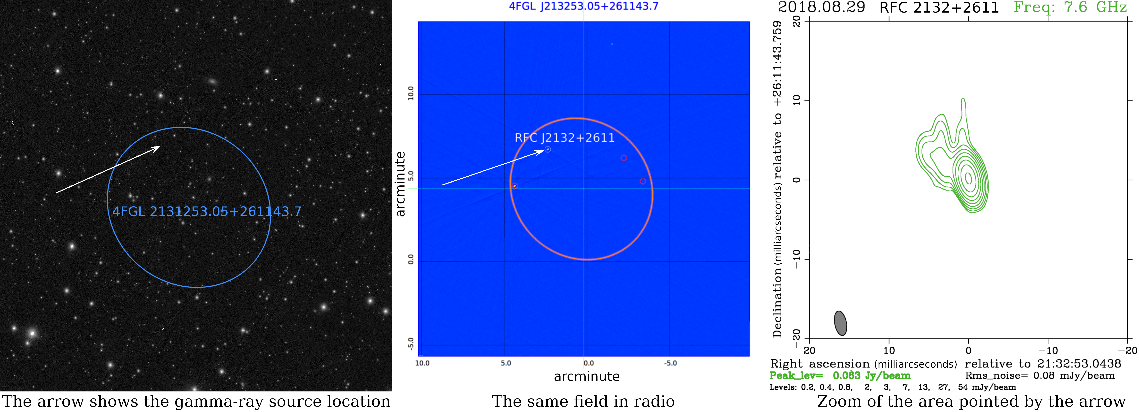
VLBI associates one half of gamma-ray sources discovered by Fermi Leonid Petrov NASA GSFC Code 61A
Arrow shows gamma-ray source within Fermi position error ellipse
Same field in radio image
Image of source identified by VLBI
The Fermi mission detection of gamma-ray sources has low position accuracy compared to optical telescopes such that hundreds of objects are within the Fermi position error ellipse precluding source identification (left Figure panel). Low resolution radio images help to narrow the number of possible counterparts to several objects (center Figure panel), but still do not uniquely identify the source position. A dedicated program of high resolution radio observations with VLBI provided unique associations (right Figure panel) for 54% of Fermi sources. These observations improved Fermi position accuracy by 5 orders of magnitude. Firm association allowed us to learn distances to 27% of gamma-ray objects.
There are hundreds of objects within the error ellipse each gamma-ray source discovered by Fermi mission. High resolution very long baseline radio interferometry (VLBI) allows to identify which of these objects is detected by Fermi. A program of dedicated VLBI observations associated 54% Fermi sources and thus, allowed to establish the nature of gamma-ray sources. Position accuracy improved by 5 orders of magnitudes. Firm association allowed us to learn distances to 27% Fermi objects.
Earth Sciences Division – Hydrosphere, Biosphere, and Geophysics

Slide 6
Name: Leonid.Petrov, 61A, NASA GSFC E-mail: Leonid.Petrov@nasa.gov Phone: 301-614-5611
References:
Abdollahi S. et al., "Fermi Large Area Telescope Fourth Source Catalog", 2020, ApJS, 247, 33. doi: 10.3847/1538-4365/ab6bcb.
Ajello, M., et al., "The Fourth Catalog of Active Galactic Nuclei Detected by the Fermi Large Area Telescope", 2020, ApJ, 892 (2): 105 10.3847/1538-4357/ab791e.
L. Petrov, E. K. Mahony, P. G. Edwards, E. M. Sadler, F. K. Schinzel, "Australia Telescope Compact Array observations of Fermi unassociated sources", 2013, MNRAS, 432, 1294, doi: 10.1093/mnras/stt550.
Data Sources: Fermi Large Area Telescope Fourth Source Catalog (4FGL); Radio Fundamental Catalogue (RFC).
Technical Description of Figures:
Figure 1: Left: the field of Fermi error ellipse (blue) in optic range from Panoramic Survey Telescope and Rapid Response System (Pan-STARRS) instrument. There are hundreds of objects within the Fermi error ellipse, but we do not know which one emits gamma-rays. It is shown with the white arrow. Central: the same field in low resolution radio observations at 3 GHz with Very Long Array (VLA). There are four objects shown with circles that are within the error ellipse, but only one, shown with the arrow, emits gamma-rays. Right: the only compact object in the Fermi error ellipse that has strong radio emission at parsec-scale. The image shows the base of the ultra-relativistic jet of the active galactic nucleus (AGN). It is associated with a gamma-ray source. Association is possible because a) radio emission at parsec-scale and gamma-ray emission are interrelated and b) spacial density of AGNs with strong radio emission is low.
Scientific significance, societal relevance, and relationships to future missions:
Establishing firm associations makes possible multi-frequency observations of gamma-ray sources. Such observations help us to understand the origin of gamma-ray emission and thus, significantly enhance the value of Fermi mission.
Earth Sciences Division – Hydrosphere, Biosphere, and Geophysics
Notes:
6

