Slide 1
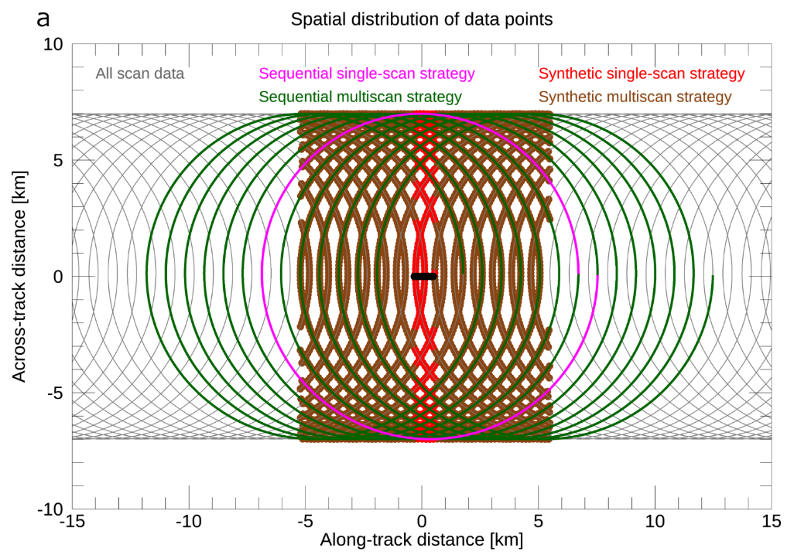
Innovative New Approach to Horizontal Wind Retrievals from NASA High-Altitude Airborne Radars Will Advance Understanding of Storm Dynamics
Charles N. Helms (Code 612, NASA/GSFC and USRA/NPP); Matthew L. W. McLinden (Code 555, NASA/GSFC); Gerald M. Heymsfield (Code 612, NASA/GSFC); Stephen R. Guimond (Code 612, NASA/GSFC and UMBC/JCET)
NASA ER-2 Flight Track
Velocity-azimuth display (VAD) retrievals of horizontal wind profiles from airborne radars typically only use data from the edge of the circle traced out by a single scan of the radar (left, pink curve, “sequential single-scan”). The large footprint and small number of data points makes this approach prone to contamination by error-inducing weather features (e.g., thunderstorm updrafts). Our improved method combines multiple scans to produce a much greater data density over a similarly-sized footprint (left, brown curve, “synthetic multiscan”). The greater data density reduces the influence of each individual data point, making the technique much more robust to error sources, as demonstrated in our error analysis (right).

Slide 2
Name: Charles N. Helms, NASA/GSFC, Code 612, and USRA/NPP E-mail: charles.n.helms@nasa.gov Phone: 301-614-5719
References:
C. N. Helms, M. L. W. McLinden, G. M. Heymsfield, and S. R. Guimond, 2020: Reducing errors in velocity-azimuth display (VAD) wind and deformation retrievals from airborne Doppler radars in convective environments. Journal of Atmospheric and Oceanic Technology, doi: 10.1175/JTECH-D-20-0034.1.
NTR #18544-1
Data Sources: The ER-2 X-band Radar (EXRAD) flown aboard the NASA ER-2 and the High-altitude Wind and Rain Airborne Profiler (HIWRAP) flown aboard the NASA Global Hawk were both incorporated into this study. The study relies on radar data collected by the NASA Global Hawk during the NOAA Sensing Hazards with Operational Unmanned Technology (SHOUT).
Technical Description of Figures:
Graphic 1: (Left) Example of the spatial distribution of data points in the four data selection strategies using the NASA ER-2 X-Band radar (EXRAD) scan geometry. The gray curve indicates the location of all scan data points observed from the aircraft flight track (black line). The data employed by a sequential single-scan retrieval is indicated in pink while the additional data employed by a sequential multiscan retrieval is indicated in green. The thick red points indicate data employed by a synthetic single-scan retrieval while the thick brown points indicate the additional data employed by a synthetic multiscan retrieval. The thick black bar in the center indicates the centers of curvature for the sequential single-scan strategy (i.e., the location of the aircraft at these times). Note, both the sequential multiscan and synthetic multiscan retrievals use the same data as their single-scan retrieval counterparts in addition to the data indicated by their respective colors.
Graphic 2: (Right) Cumulative frequency diagram for the horizontal wind speed percent absolute error due solely to violations of the wind-field assumption of the VAD technique. This assumption stipulates that the underlying horizontal wind field varies linearly and the vertical velocity field is constant over the ingested data points. Errors are computed based on simulated Doppler wind observations in a model depiction of a tropical disturbance and are restricted to model winds greater than 0.1 m s⁻¹.
Scientific significance, societal relevance, and relationships to future missions:
To reduce the errors in horizontal wind retrievals, our method first shrinks the footprint by sampling multiple scans of data (Graphic 1, red curve, “synthetic single-scan”) to isolate any error-inducing weather features (e.g., thunderstorm updrafts) to a minimum number of retrievals. We then combine data from several of these synthetic single-scan retrievals to increase the resilience of the retrieval to any remaining error-inducing data points (Graphic 1, brown curve, “synthetic multiscan”). Our error analysis, performed using a model depiction of a tropical depression, demonstrates that our approach provides a considerable reduction in the overall error characteristics (Graphic 2).
This work improves the ability to observe horizontal winds in the vicinity of deep convection and other environments that are typically considered challenging for VAD wind retrievals. The retrievals provide horizontal wind vectors and deformation fields at high vertical resolution and enable improvements in the analysis of the dynamics of precipitation features. Our improved technique has strong applications for wind retrievals in large convectively active weather systems such as hurricanes and winter storms. The improved VAD technique described here is being actively used to retrieve horizontal winds from the radar data collected by the NASA ER-2 during the ongoing NASA Investigation of Microphysics and Precipitation for Atlantic Coast-Threatening Snowstorms (IMPACTS). Plans are underway to attempt to perform these retrievals in real-time to support mission operations during both the upcoming second- and third-year IMPACTS deployments as well as the deployments for future field campaigns.
Earth Sciences Division - Atmospheres
Notes:
2

Slide 3
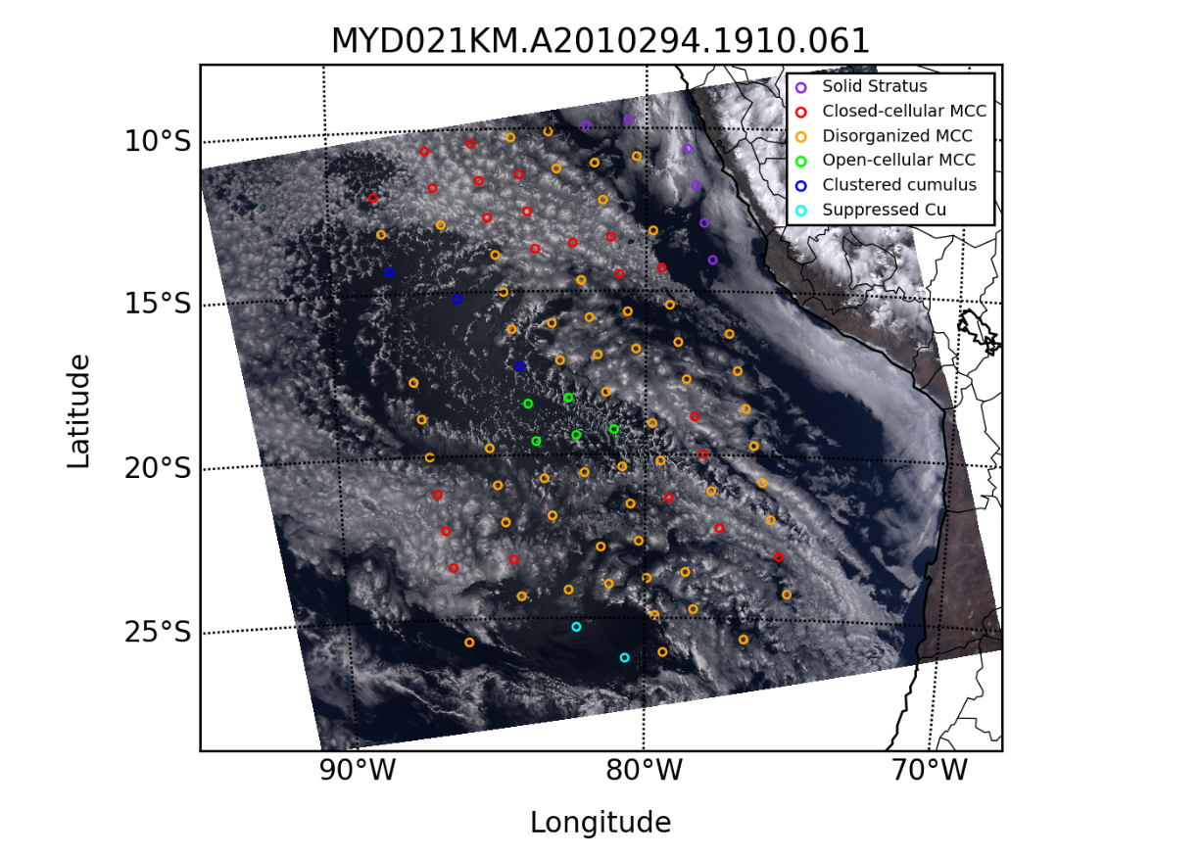
Detecting cloud morphology in NASA MODIS data with deep learning Tianle Yuan^{1,2}, Hua Song^{1,3}, Robert Wood, Johannes Mohrmann, Kerry Meyer¹
Lazaros Oreopoulos¹, Steven Platnick¹, Code 613, ¹NASA/GSFC, ²UMBC/JCET, ³SSAI
We developed a deep learning model that combines domain expertise and machine learning to detect marine boundary layer cloud mesoscale morphology with high accuracy and efficiency as part of NASA’s “Making Earth System Data Records for Use in Research Environments” (MEaSUREs) program. The model’s performance enables the study of cloud morphology at unprecedented scales.

Slide 4
Name: Tianle Yuan, NASA/GSFC, Code 613, and UMBC JCET E-mail: tianle.yuan@nasa.gov Phone: 301-614-6195
References:
Yuan, T., Song, H., Wood, R., Mohrmann, J., Meyer, K., Oreopoulos, L., and Platnick, S.: Applying Deep Learning to NASA MODIS Data to Create a Community Record of Marine Low Cloud Mesoscale Morphology, Atmospheric Measurement Techniques, https://doi.org/10.5194/amt-2020-61, in press, 2020.
Data Sources: NASA MODIS radiance, which can be found here (https://ladsweb.modaps.eosdis.nasa.gov/missions-and-measurements/modis/). We would like to acknowledge funding support from the NASA MEaSUREs program and computational support by NASA’s High-Performance Computing (HPC) infrastructure (NCCS Discover and ADAPT platforms).
Technical Description of Figures:
Graphic (Left): An example of our deep learning algorithm applied to a granule of MODIS data. The algorithm detects marine boundary layer cloud morphology for each 128x128 pixel box. The full MODIS record can be processed in about two weeks clock time using ADAPT GPU nodes towards a long-term community record of marine boundary layer cloud morphology. Graphic (Right): The performance of our machine learning algorithm expressed as a confusion matrix on test data, i.e. data not used in algorithm training. Our algorithm detects the correct cloud morphology with average accuracy above 94%.
Scientific significance, societal relevance, and relationships to future missions: Cloud morphology goes beyond individual pixels and two-point statistics and can be defined in terms of a few systematically occurring cloud patterns. Critical physical processes underpin cloud morphologies and understanding them is a key to reducing uncertainties in a range of important open questions related to low cloud feedback, low cloud modeling and aerosol-cloud interactions that future Decadal Survey missions will pursue. Being able to efficiently and accurately detect cloud morphology provides a solid framework for further study and analysis.
Earth Sciences Division - Atmospheres
Notes:
4

Slide 5
NDACC Stratospheric Transport Trends from 1994-2018 show Hemispheric Asymmetry Susan Strahan (Code 614), Dan Smale (NIWA), Anne Douglass and Luke Oman (Code 614), and NDACC PIs from around the world, NASA/GSFC, USRA, and more
Negative Trend in Interhemispheric Anomalies from Observations
Observed column HNO₃ and HCl data (black, blue), sensitive to variations in lower stratospheric transport, have nearly identical interhemispheric linear anomaly trends (dotted lines). This is strong evidence of a significant transport trend. Age of air from MERRA2 (red) affirms the observations are a proxy for transport changes.
The Age of Air (AoA), a measure of the average time air spends in the stratosphere, has been getting younger in the SH relative to the NH at a rate of 1 month/decade since 1994 (right axis). The shorter satellite data records from MLS (dashed lines) are consistent with the NDACC findings.
NDACC is the ground-based Network for the Detection of Atmospheric Composition Change

Slide 6
Name: Dr. Susan E. Strahan, NASA/GSFC, Code 614, GESTAR
Email: Susan.e.strahan@nasa.gov
Phone: 301-614-5995
Reference:
Strahan, S. E., Smale, D., Douglass, A.R., Blumenstock, T., Hannigan, J. W., Hase, F., et al. (2020). Observed hemispheric asymmetry in
stratospheric transport trends from 1994 to 2018. Geophysical Research Letters, 47, e2020GL088567. https://doi. org/10.1029/2020GL088567
Data Sources:
Total columns of HNO₃ and HCl were measured by Fourier Transform Infrared (FTIR) spectrometers operated under the auspices of the Infrared Working Group (IRWG, https://www2.acom.ucar.edu/irwg) of the Network for the Detection of Atmospheric Composition Change (NDACC, http://www.ndacc.org). The nine stations used in this study provide FTIR data year-round, under clear sky conditions, except at high latitudes sites during polar night.
NASA Aura Microwave Limb Sounder (MLS) v4.3 Level 2 HCl and HNO₃, 2005-2018, were used to calculate stratospheric columns in order to test the ability of NDACC station columns to represent hemispheric composition and variability.
The NASA Global Modeling & Assimilation Office (GMAO) Modern Era Retrospective for Research and Applications 2 (MERRA2) reanalysis was use to integrate the GMI chemical transport model and tracer model (for Age of Air) from 1980-2019.
Technical Description of Figure:
Graphic 1. The interhemispheric difference (Southern-Northern hemisphere) in HNO₃ and HCl anomaly trends determined from 24-yr NDACC FTIR data records are shown in solid blue and black lines. Both gases have tropospheric trends in their source gases (i.e., N₂O and the CFCs), but these contributions to trends are eliminated by calculating the difference in each species’ hemispheric anomalies. Each anomaly time series is fit to a line: both species show the same trend, increasing confidence in the results. We link these trace gas trends to changes in transport through the AoA, calculated by the GMI simulation integrated with MERRA2 (red). The trace gas anomalies and AoA variations are highly correlated (0.9). Similar variability is found in the shorter MLS data records (dashed lines).
Scientific Significance, societal relevance, and relationships to future missions: Chemistry climate models predict that the stratospheric age of air will decrease this century due to increasing greenhouse gases, but the expected rate of change is small. It will be hard to detect because observed year-to-year variations in transport and composition are large This analysis uses 24-yr records of long-lived stratospheric trace gases to tease out the small signal of transport change. The results were surprising because the observed hemispheric asymmetry was opposite of what models predict. They were also surprising because they revealed previously unrecognized large amplitude variability with a 5-7 yr period. We show evidence that this variability is caused by interactions between the annual cycle of the circulation and the Quasi-biennial Oscillation in tropical wind regimes. This variability is not produced by chemistry climate models and thus represents an area where model improvement is needed to increase confidence in stratospheric ozone recovery predictions.
Changes in the transport circulation affect how long manmade ozone depleting substances stay in the atmosphere and therefore can change the expected rate of recovery of ozone. The results from the analysis of this 24-yr long data record stand in opposition to the model predictions. We do not yet understand why.
Earth Sciences Division - Atmospheres

