Slide 1


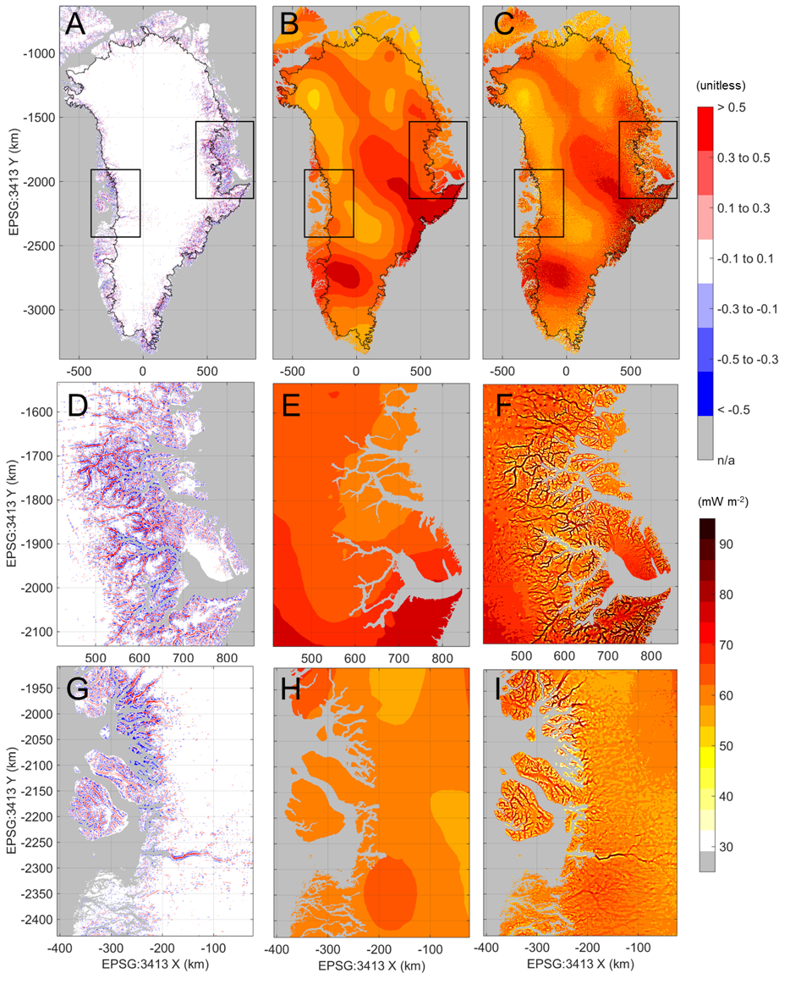
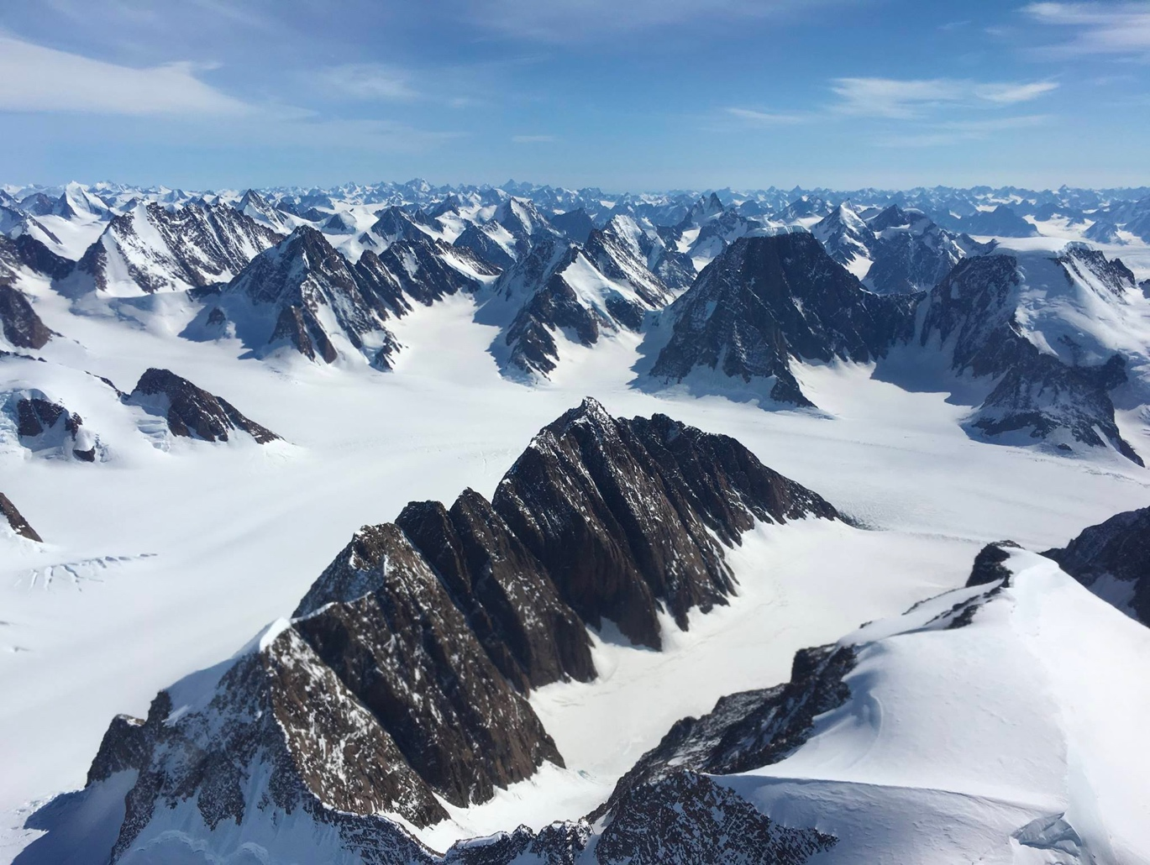

Topographic correction of geothermal heat flux in Greenland
William Colgan ¹, Joseph A. MacGregor ², Kenneth, D. Mankoff ¹, Ryan Haagenson ³, Harihar Rajaram ⁴, Yasmina M. Martos ⁵,
Mathieu Morlighem ⁶, Mark A. Fahnestock ⁷ and Kristian K. Kjeldsen ¹
¹ Geological Survey of Denmark and Greenland, ² Cryospheric Sciences Lab (615), NASA/GSFC; ³ Cooperative Inst. For Research in Environmental Sciences, Univ. Colorado; ⁴ Dept. of Earth and Planetary Sciences, Johns Hopkins Univ.; ⁵ Planetary Magnetospheres Lab (Code 695), NASA/GSFC; ⁶ Dept. of Earth System Science, Univ. California Irvine; ⁷ Geophysical Inst., Univ. Alaska Fairbanks
correction
original
corrected
The relatively small amount of heat that rises from Earth’s interior (geothermal heat flux) has an outsized role in controlling the temperature of ice sheets at their base. Warmer ice is softer and flows faster.
We developed an empirical model that reconciles geothermal heat flux inferred from from magnetic data syntheses at scales of tens of kilometers with sub-ice topography that is much better known from NASA airborne radar sounding, credibly improving spatial resolution by two orders of magnitude.
The presence of valleys deeply incised by glaciers can double the local geothermal heat flux beneath the Greenland and Antarctic ice sheets. The magnitude of the topographic correction often exceeds existing uncertainty in geothermal heat flux.
Relative
correction
due to
topography
(0.5 = +50%)
Absolute
value of geothermal heat flux
(milliwatts per square meter)
Earth Sciences Division – Hydrosphere, Biosphere, and Geophysics

Slide 2
Name: Joseph A. MacGregor, Cryospheric Sciences Lab (Code 615), NASA GSFC
E-mail: joseph.a.macgregor@nasa.gov
Phone: 301-614-5876
References:
Colgan, W., J.A. MacGregor, K.D. Mankoff, R. Haagenson, H. Rajaram, Y.M. Martos, M. Morlighem, M.A. Fahnestock and K.K. Kjeldsen (2020), Topographic correction of geothermal heat flux in Greenland and Antarctica, Journal of Geophysical Research Earth Surface, 125, doi:10.1029/2020JF005598.
Martos, Y.M., T.A. Jordan, M. Catalán, T.M. Jordan, J.L. Bamber and D.G. Vaughan (2018), Geothermal heat flux reveals the Iceland hotspot track underneath Greenland, Geophysical Research Letters, 45, 8214–8222, doi:10.1029/2018GL078289.
Data Sources: NASA BedMachine v3; British Antarctic Survey 2018 Greenland Geothermal Heat Flux Map
Technical Description of Figures:
Figure 1: (​A,D,G)​ Relative topographic correction for geothermal heat flux for the island of Greenland, based on BedMachine v3. (​B,E,H) Geothermal heat flux estimated by Martos et al. (2018). ​(C,F,I) Topographically-corrected geothermal heat flux. The ice-sheet margin is denoted with a black line.
Scientific significance, societal relevance, and relationships to future missions: This study includes several scientific firsts: 1. The first modern meta-analysis of the effect of topography upon terrestrial geothermal heat flux in deglaciated terrains; 2. The first simple, tractable empirical relation between two-dimensional topographic relief and geothermal heat flux, validated against existing boreholes and a three-dimensional numerical model of heat flow; 3. The first ice-sheet-wide application of a topographic correction to independently inferred geothermal heat flux, which dramatically improves the spatial resolution of geothermal flux estimates. The combination thereof can be applied to future models of subglacial topography and geothermal flux, and it can also be applied to terrains not covered by ice. This study paves the way for a refined understanding of Earth’s geothermal heat flux not only in the regions where it matters the most (beneath ice sheets), but anywhere where its value is poorly constrained by limited borehole measurements (most places on Earth). This study represents further motivation for NASA airborne and satellite missions to constrain subglacial topography, as such measurements now lead directly to improved constraints on geothermal heat flux, and it may also influence future missions to extraterrestrial bodies seeking to understand the thermal evolution thereof.
Earth Sciences Division – Hydrosphere, Biosphere, and Geophysics
Notes:
2

Slide 3
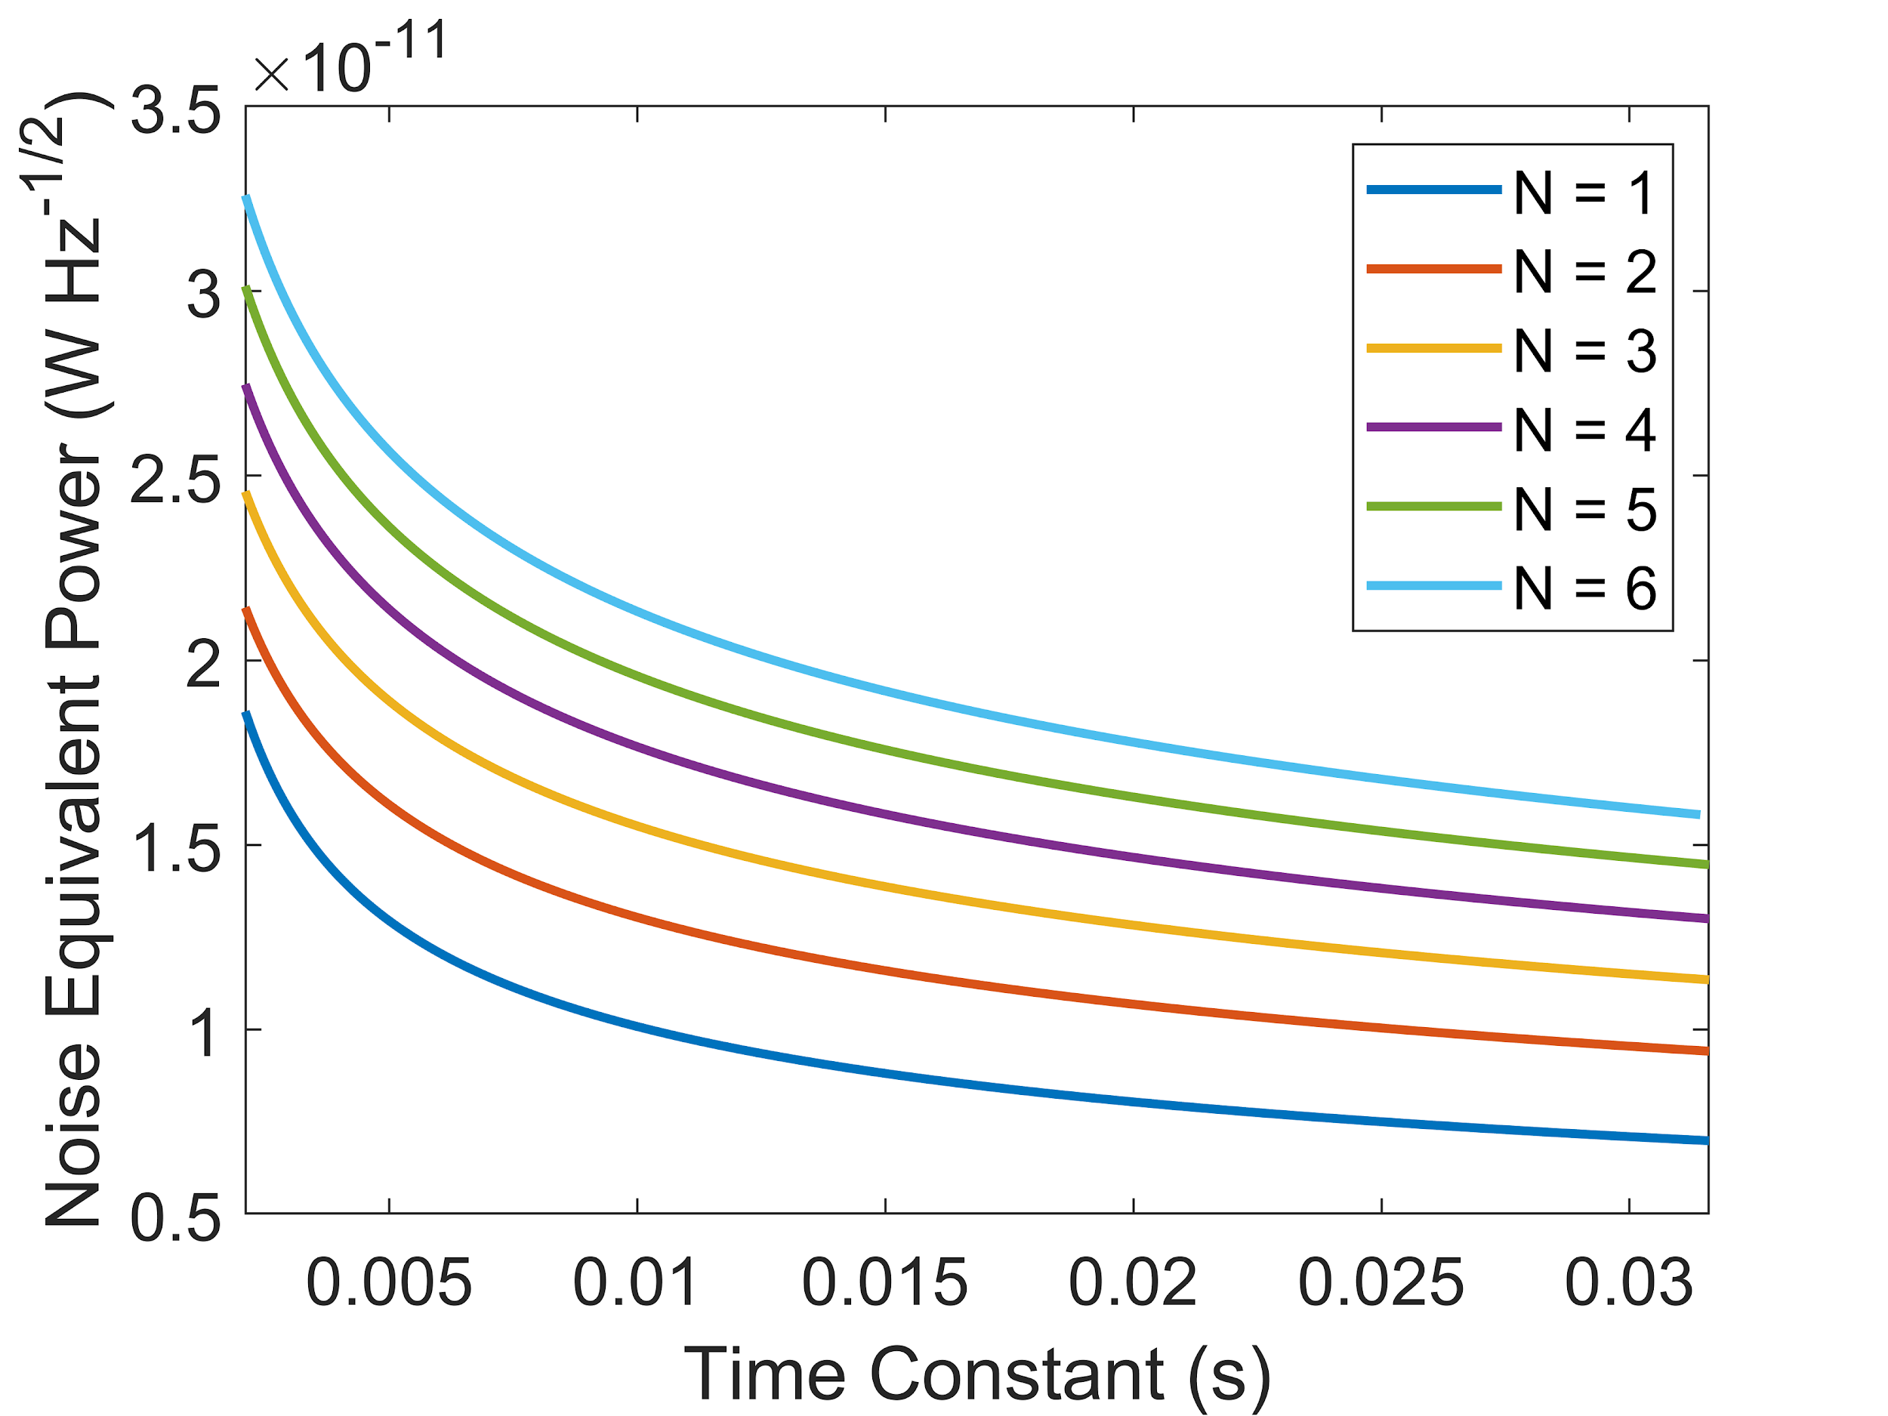
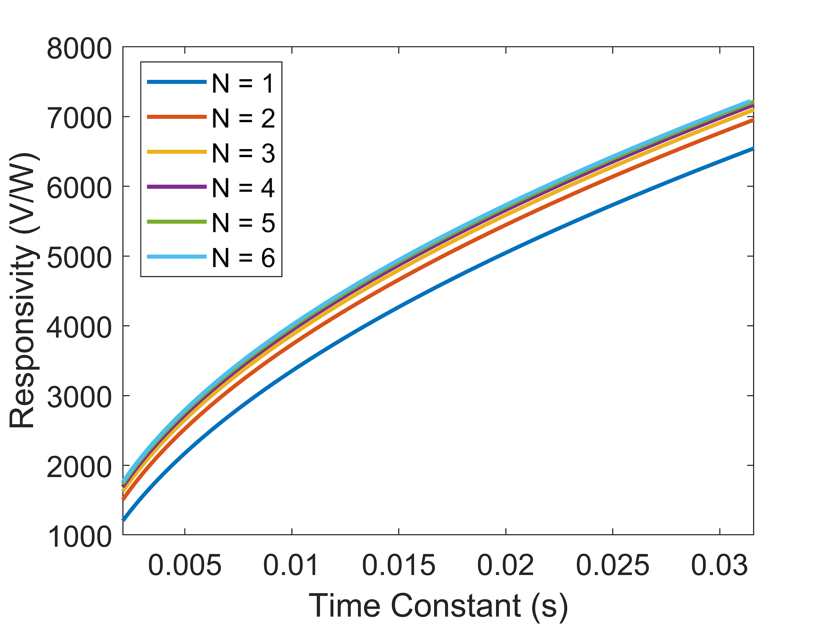
Uncooled Doped-Si Thermopile Detectors
for a New Generation of Thermal Land Imaging Instruments: Absorber Study
Alicia Joseph¹, Emily Barrentine², Ari Brown², Carl Kotecki², Vilem Mikula², Kavya Devgun^{1,2,3}
¹Hydrological Sciences Laboratory, NASA/GSFC , ²Detector Systems Branch, NASA/GSFC , ³St.Olaf College
Figure 1
Figure 2
Responsivity of the detector
Figure 3
N is the parameters for the number of thermocouples in the design
Sustained and enhanced land imaging is crucial for providing high-quality science data on change in land use, forest health, environment, and climate. To address the need for cost-effective land imaging missions, which will not require cryocooler technology, we are developing novel uncooled doped-silicon thermopile detector arrays that will offer superior performance in terms of customizability, sensitivity, and time response, when compared to uncooled commercial-off-the-shelf (COTS) detector technology.
Earth Sciences Division – Hydrosphere, Biosphere, and Geophysics

Slide 4
Name: Alicia Joseph, NASA/GSFC, Hydrological Sciences Laboratory
E-mail: alicia.t.joseph@nasa.gov
Phone: 301-614-5804
References:
1. Lakew, Brook, Emily M. Barrentine, Shahid Aslam, and Ari D. Brown. "Concept Doped-Silicon Thermopile Detectors for Future Planetary Thermal Imaging Instruments." In AAS/Division for Planetary Sciences Meeting Abstracts, vol. 48. 2016.
2. Aslam, Shahid, et al. “Dual-Telescope Multi-Channel Thermal-Infrared Radiometer for Outer Planet Fly-by Missions.” Acta Astronautica, vol. 128, 2016, pp. 628–639., doi:10.1016/j.actaastro.2016.08.009.
3. Barrentine, Emily M., et al. “Uncooled Doped-Si Thermopiles for Thermal Land Imaging Applications.” Image Sensing Technologies: Materials, Devices, Systems, and Applications VI, 2019, doi:10.1117/12.2522298.
4. Graf, A., Arndt, M., Sauer, M., & Gerlach, G. (2007). Review of micromachined thermopiles for infrared detection. Measurement Science and Technology, 18(7). doi:10.1088/0957-0233/18/7/r01
Data Sources: N/A
Technical Description of Figures:
Fig. 1: An apparatus used to measure the Seebeck Coefficient, S, and electrical resistivity, ρ, using an apparatus that allows heating of one end of the sample in a controlled manner, while measuring the voltage differential.
Fig. 3: Plot of the responsivity of the detector at different values of τ (Time constant plotted on x-axis, N is the parameters for the number of thermocouples in the design).
Fig. 4: Plot of the noise equivalent power of the detector at different values of τ .
Plots 3 and 4 are showing the optimization process to find the optimal detector geometry/design for each absorber approach. An optimal design (minimum noise equivalent power NEP) occurred for N=1 thermocouples. There is a trade-off between minimizing NEP and obtaining a fast time constant (as shown on NEP vs tau plot). A design was chosen that provided ~8 msec time constant, a requirement for the instrument concept we developed for an IIP proposal. The conclusions of the study were the absorber implementation choice did not have a significant effect on the NEP. We found Study #3 (the 100% efficiency broadband implementation) however offered the minimum NEP as well as broadband performance. This implementation was the carbon nanotube absorbers, which seems ultimately the direction we would like to go for this technology.
Scientific significance, societal relevance, and relationships to future missions:
Sustained and enhanced land imaging is crucial for providing high-quality science data on change in land use, forest health, environment, and climate. Future thermal land imaging instruments operating in the 10-12 micron band will provide essential information for furthering our hydrologic understanding at scales of human influence and producing field-scale moisture information through accurate retrievals of evapotranspiration (ET). To address the need for cost-effective future thermal land imaging missions we are developing novel uncooled doped-silicon thermopile detectors. These doped-Si thermopile detectors have the potential to offer superior performance in terms of sensitivity, speed and customizability, when compared to current commercial-off-the-shelf uncooled detector technologies. Because cryocooling technology does not need to be fielded on the instrument, these and other uncooled detectors offer the benefit of greatly reduced instrument cost, mass, and power at the expense of some acceptable loss in detector sensitivity. This allows future thermal imaging instrument to be fielded on board a low-cost platform, e.g., a CubeSat. In addition, it would enable capitalizing on the greater number of launch opportunities available for launch vehicles.
Earth Sciences Division – Hydrosphere, Biosphere, and Geophysics
Notes:
4

Slide 5
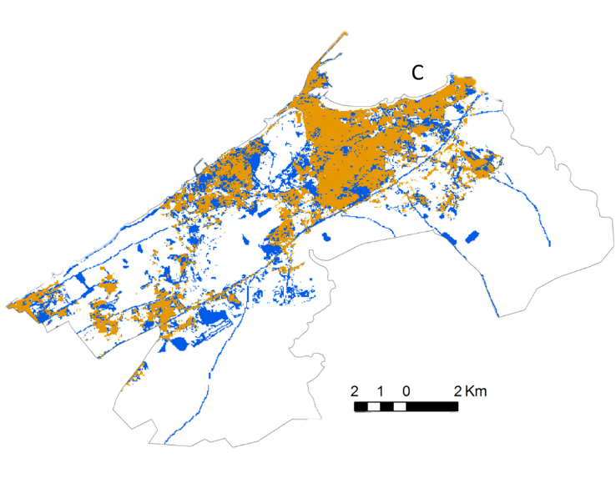
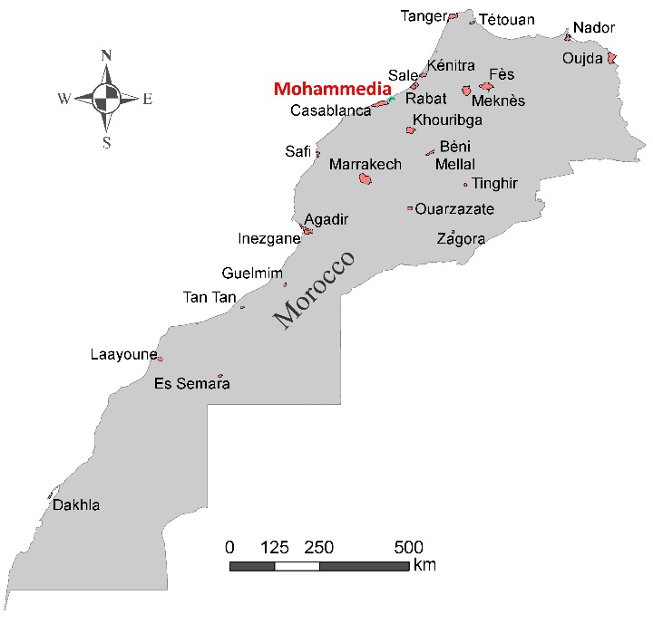
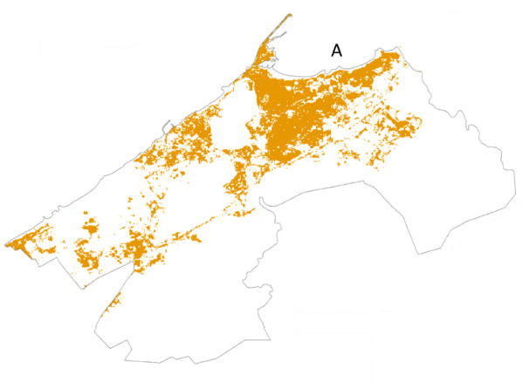
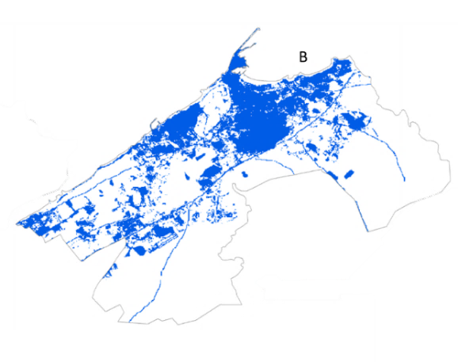
Earth Observation for Monitoring U.N. Sustainable Development Goals
Lahouari Bounoua¹, Joseph Nigro^{1,2}, and Mohammed Messouli³
¹NASA GSFC, Code 618; ²Science Systems and Applications, Inc., ³Cadi Ayyad University
A
C
Mohammedia
Urban Surface
Area 2003
B
25 largest
cities by
population
2003-2013
Urban Surface
Area 2013
In 2016, the United Nations established 17 Sustainable Development Goals (SDGs) to reach by 2030. Earth Observations (EO) present a unique opportunity to assess and monitor these SDGs. Using EO, the urban sustainability Indicator was evaluated for the 25 largest Moroccan cities between 2003 and 2013. Although no systematic growth pattern was found, disparate sustainability levels were identiﬁed based on city size and appear to be related to rapid economic growth. Population growth continued along the periphery of existing cities with land consumption increasing faster than population growth.
Earth Sciences Division – Hydrosphere, Biosphere, and Geophysics

Slide 6
Name: Lahouari Bounoua, Biospheric Sciences Lab, NASA GSFC
E-mail: lahouari.bounoua-1@nasa.gov
Phone: 301-614-6631
References:
Bounoua, L., N. Fathi, M. El Berkaoui, L. El Ghazouani, N. and M. Messouli, 2020. Assessment of Sustainability Development in Urban Areas of Morocco. Urban Science 4 (2), 18, https://doi.org/10.3390/urbansci4020018
Bounoua, L., J. Nigro, K. Thome, P. Zhang, N. Fathi, and A. Lachir, 2018. A Method for Mapping Future Urbanization in the United States.
Urban Science 2 (2), 40, https://doi.org/10.3390/urbansci2020040
URL reference: https://unstats.un.org/sdgs/metadata/files/Metadata-11-03-01.pdf
Data Sources: Landsat 7 and Landsat 8 (NASA/USGS); Morocco country boundary (ESRI, HERE, Garmin, OSM); Morocco cities (HAUT-COMMISSARIAT AU PLAN ou Cadastre)
Technical Description of Figures:
Figure 1: Urban surface area change for cities in Morocco between 2003-2013. (Left) map of Morocco showing the 25 largest cities based on population size with the city of Mohammedia indicated in red; (Center) Landsat-based 1 km²-aggregated urban surface area classification for the city of Mohammedia for 2003 (top) and 2013 (bottom); (Right) urban surface area classifications superimposed to show urban growth in Mohammedia from 2003 to 2013.
Scientific significance, societal relevance, and relationships to future missions: This study utilizes Earth observation data to better understand the effects of population growth and land consumption on urban development and sustainability. It is the first study to use satellite data to conduct a countrywide assessment of the United Nations SDG 11.3.1 in an area where land observations are not readily available. The results provide important insights into land transformation that can be useful for developing more effective land management practices and ensuring urban sustainability into the future (Bounoua et. al, Urban Sci. 2020, 4(2), 18).
Earth Sciences Division – Hydrosphere, Biosphere, and Geophysics

Slide 7
Ionospheric Total Electron Content from Satellite Altimetry
Richard D. Ray
Geodesy & Geophysics Lab, NASA GSFC
Dual-frequency satellite altimeters, such as those flown on the TOPEX/Poseidon, Jason-1, Jason-2, and Jason-3 missions, are capable of monitoring the total electron content (TEC) of the ionosphere. This study examines the diurnal (S1) and semidiurnal (S2) variations in TEC during times of moderate to high ionospheric activity. These direct altimeter TEC measurements are capable of assessing errors in GPS-based and other models of TEC, and they offer a possible path toward improved ionosphere monitoring.
Earth Sciences Division – Hydrosphere, Biosphere, and Geophysics

Slide 8
Name: Richard Ray, Code 61A, NASA GSFC
E-mail: Richard.ray@nasa.gov
Phone: 301-614-6102
References:
Ray, R. D. (2020). Daily harmonics of ionospheric total electron content from satellite altimetry, Journal of Atmospheric and Solar-Terrestrial Physics, 209, 105423. https://doi.org/10.1016/jastp.2020.105423
Data Sources: Ionospheric path delay data from satellites TOPEX/Poseidon, Jason-1, Jason-2, and Jason-3. GPS-based TEC data are from the International GNSS Service. The NOAA NIC-09 model of TEC is from Scharroo and Smith (JGR, 2010) and available via the Radar Altimeter Database System (RADS) maintained by NOAA and the Technical University of Delft.
Technical Description of Figures:
Figure 1: The maps depict diurnal harmonics of total electron content (TEC), parameterized in terms of altimeter path delay in mm. Left column shows the amplitudes of the daily TEC harmonics, with frequencies once per day (S1) and twice per day (S2). These are based on the dual-frequency altimeter data from the TOPEX and Jason missions. Middle column shows the error in TEC as determined by inversion of GPS data. The GPS errors are caused primarily by sparse station networks over the oceans. Right column shows the error in the NOAA Ionosphere Climatology NIC-09 model of Scharroo & Smith (2010). Dotted white lines in all maps mark the location of the geomagnetic equator.
Scientific significance, societal relevance, and relationships to future missions: The motivation of this work was to understand the errors associated with using single-frequency radar altimeters for ocean tide studies. Unlike dual-frequency altimeters, single-frequency altimeters require a model to correct altimeter ranges for ionospheric path delay. GPS-based models are typically used, and the results here show the resulting errors from such models. More generally, dual-frequency altimetry provides a rich data source for studying temporal and spatial variability of the ionosphere’s electron content. The published study, for example, highlights the seasonal variations in TEC, caused by the motion of the sun north and south of the equator. GPS-based TEC monitoring is used in many applications, not just altimetry, so understanding GPS-associated errors has widespread interest.
Earth Sciences Division – Hydrosphere, Biosphere, and Geophysics
Notes:
8

