Slide 1


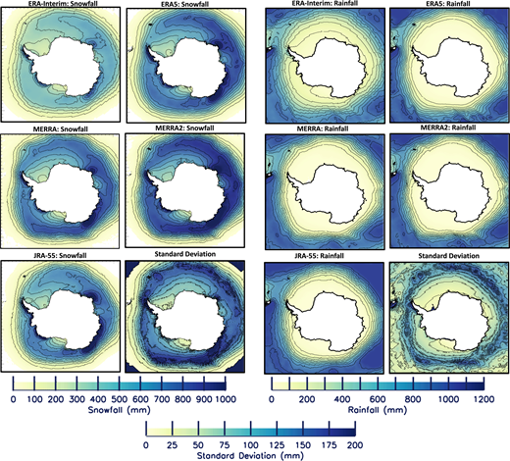
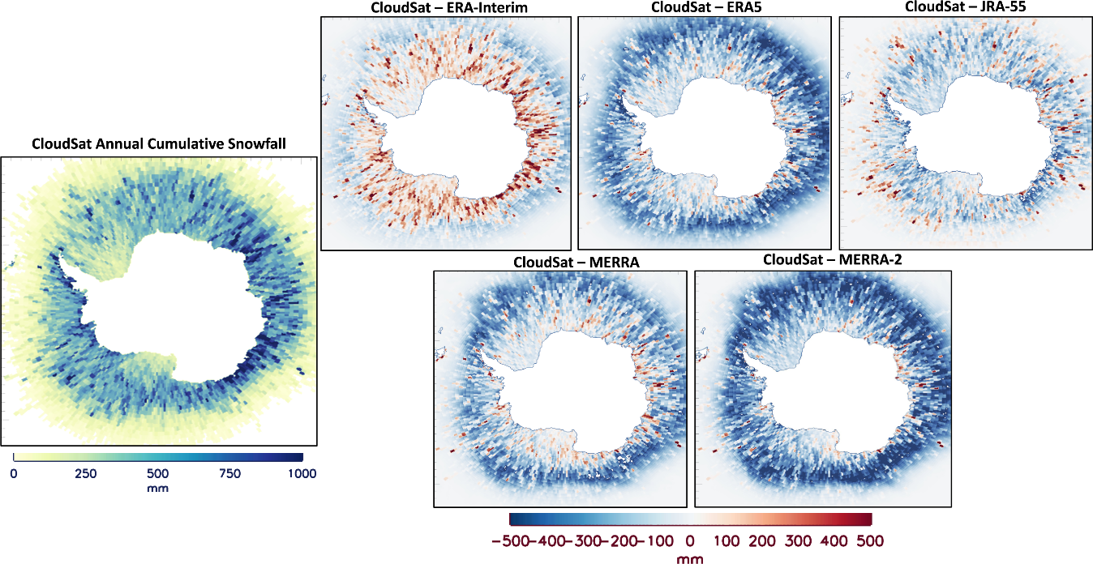

Intercomparison of Precipitation Estimates over the Southern Ocean from Atmospheric Reanalyses
Linette Boisvert¹, Melinda Webster², Alek Petty^{1,3}, Thorsten Markus⁴, Richard Cullather^{3,5}, and David Bromwich⁶
¹ Cryospheric Sciences Lab (615), NASA/GSFC; ² University of Alaska Fairbanks, ³ Earth System Science Interdisciplinary Center (ESSIC), University of Maryland; ⁴ NASA Headquarters; ⁵ Goddard Modelling and Assimilation Office, NASA/GSFC; ⁶ Byrd Polar and Climate Research Center, The Ohio State University
Figure 2
Eight global reanalysis precipitation (and when available, snowfall and rainfall) products were compared over the Southern Ocean between 2000-2016.
Large differences between the magnitude of snowfall and rainfall exist between the products (Figure 1) and is largely driven by the microphysics scheme employed. When compared with CloudSat snowfall, large differences occur at lower latitudes where the sea ice cover is most variable (Figure 2).
Figure 1
Earth Sciences Division – Hydrosphere, Biosphere, and Geophysics

Slide 2
Name: Linette Boisvert, Cryospheric Sciences Lab (Code 615), NASA GSFC
E-mail: linette.n.boisvert@nasa.gov
Phone: 301-614-5710
References:
Boisvert, L. N., M. A. Webster, A. A. Petty, T. Markus, R. I. Cullather, and D. H. Bromwich, 2020: Intercomparison of Precipitation Estimates over the Southern Ocean from Atmospheric Reanalyses. J. Climate, 33, 10627–10651, https://doi.org/10.1175/JCLI-D-20-0044.1.
Data Sources: : ERA5 reanalysis data [Hersbach et al., 2020]; ERA-Interim reanalysis data [Dee et al., 2011]; NCEP R2 data [Kanamitsu et al., 2002]; CFSR data [Saha et al., 2010]; JRA-55 data [Kobayashi et al., 2015]; MERRA data [Rienecker et al., 2011]; MERRA-2 data [Gelaro et al., 2017]; NOAA-CIRES data [Compo et al., 2009] and CloudSat snowfall (2C-SNOW-PROFILE) [Milani et al., 2018].
Technical Description of Figures:
Figure 1: Average 2000–10 annual cumulative (left) snowfall and (right) rainfall (mm yr⁻¹). The standard deviation (mm) is shown on the bottom right for both snowfall and rainfall. Contour lines in the figures represent the contour lines on the color bars.
Figure 2: Comparisons of monthly averaged CloudSat 2007–10 snowfall with five reanalyses’ snowfall averaged monthly between 2007–10. (top left) The average 2007–10 snowfall from CloudSat. Other panels shown are average 2007–10 snowfall differences between CloudSat and ERA-Interim, ERA5, MERRA, MERRA-2, and JRA-55.
Scientific significance, societal relevance, and relationships to future missions: Precipitation is a major component of the hydrologic cycle and plays a significant role in the sea-ice mass balance in the polar regions. Over the Southern Ocean, precipitation is particularly uncertain due to the lack of direct observations in this remote and harsh environment. Here we demonstrate that precipitation estimates from 8 global reanalyses produce similar spatial patterns between 2000-2010, although their annual means vary by about 250 mm yr⁻¹ (or 26 percent of the median values) and there is little similarity in their representation of interannual variability. While similarities in spatial patterns among the reanalyses suggest a convergence, the large spread in magnitudes points to issues with the background models in adequately reproducing precipitation rates, and the differences in the model physics employed. A better understanding of cloud microphysics, phase, rate and frequency of precipitation in the polar regions is needed and could be improved with future NASA satellite missions such as ACCP.
Earth Sciences Division – Hydrosphere, Biosphere, and Geophysics
Notes:
2

Slide 3

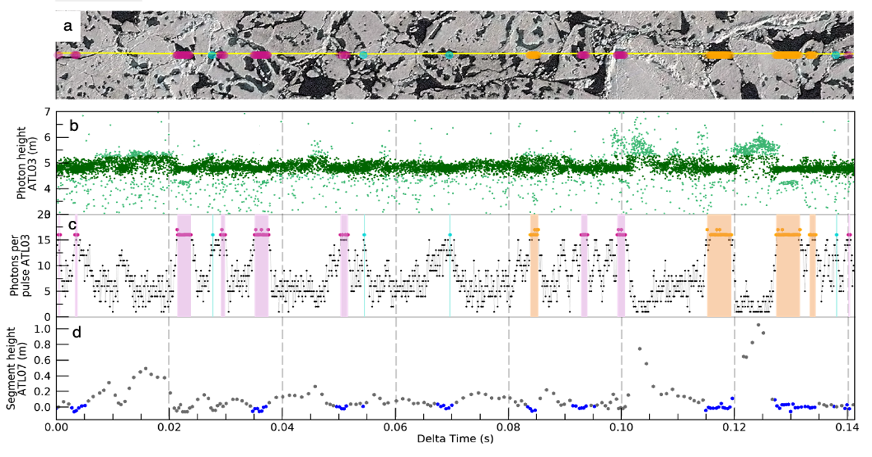
Detection of Melt Ponds on Arctic Summer Sea Ice from ICESat-2
R. Tilling^{1,2}, N. T. Kurtz¹, M. Bagnardi^{1,3}, A. A. Petty^{1,2}, R. Kwok⁴
¹ NASA GSFC, ² ESSIC, University of Maryland, ³ ADNET Systems, Inc., ⁴ APL, University of Washington
Melt pond
Drained melt pond/Lead
Ambiguous
Melt ponds are formed by melting snow on Arctic sea ice
By finding patterns in NASA’s ICESat-2 photon heights and photon rates (a metric for reflectivity), we developed a method to detect melt ponds on the ice surface
This new ability to detect melt ponds is a step towards automating retrievals of melt pond width, fraction, and depth, and improving ICESat-2 summer sea ice freeboard products
Earth Sciences Division – Hydrosphere, Biosphere, and Geophysics

Slide 4
Name: Rachel Tilling, Cryospheric Science Lab, NASA GSFC/ESSIC, University of Maryland
E-mail: Rachel.l.tilling@nasa.gov
Phone: 301-614-6120
References:
Tilling, R., Kurtz, N. T., Bagnardi, M., Petty, A. A., & Kwok, R. (2020). Detection of melt ponds on Arctic summer sea ice from ICESat‐2. Geophysical Research Letters, 47, e2020GL090644. https://doi.org/10.1029/2020GL090644
Data Sources: The NASA ICESat-2 ATL03, ATL07 and ATL10 release 3 products are publicly available at https://nsidc.org/data/icesat-2/data-sets. ICESat-2 reference ground track data are available from https://icesat-2.gsfc.nasa.gov/science/specs. High-resolution WorldView-2 imagery is copyrighted by DigitalGlobe, Inc. (https://www.digitalglobe.com/products/satellite-imagery) and licensed to federal Polar Geospatial Center users through the National Geospatial-Intelligence Agency’s NextView license. Sentinel-2 imagery was derived from Copernicus data obtained at https://scihub.copernicus.eu/.
Technical Description of Figures:
Figure 1: ICESat-2 and WorldView-2 over small Arctic melt ponds (<20 m along-track). (a) 1 km WorldView-2 image scene overlaid with ICESat-2 track (yellow line) and the location of specular pulses; melt pond (pink), drained pond/lead (orange), ambiguous (turquoise). (b) ICESat-2 ATL03 photon heights for signal (dark green) and background (light green) photons. (c) Number of photons returned per pulse. Shading shows melt pond groups, drained pond/lead groups, and ambiguous pulses. (d) ICESat-2 ATL07 segment heights for sea ice/pond mixture (grey) and lead or pond (blue). Imagery © 2019 DigitalGlobe, Inc.
Scientific significance, societal relevance, and relationships to future missions: In summer, surface melt water forms ponds that can cover up to half of the Arctic sea ice surface. Because melt ponds reduce the reflective and insulative properties of sea ice, they can alter the Arctic energy budget and ecosystem. The presence of melt ponds also complicates satellite altimeter estimates of sea ice freeboard (the height of the ice above the ocean) and thickness. By utilizing the unprecedented resolution of NASA's ICESat-2 laser altimeter we can locate individual melt ponds on Arctic sea ice. Characterizing the complex photon backscatter signals of melt ponds on sea ice is a first step towards automating retrievals of key scientific parameters including melt pond width, fraction and depth. We will also be able to improve the publicly available higher-level ICESat-2 sea ice products of height and freeboard.
Earth Sciences Division – Hydrosphere, Biosphere, and Geophysics
Notes:
4

Slide 5

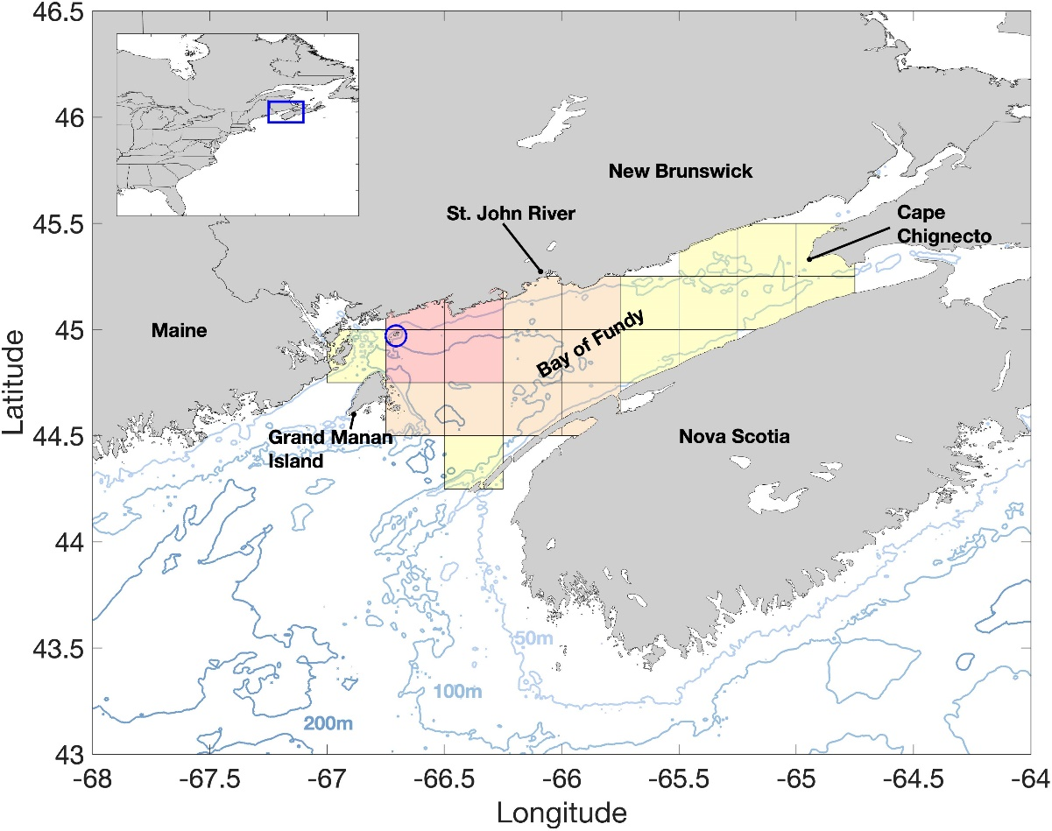
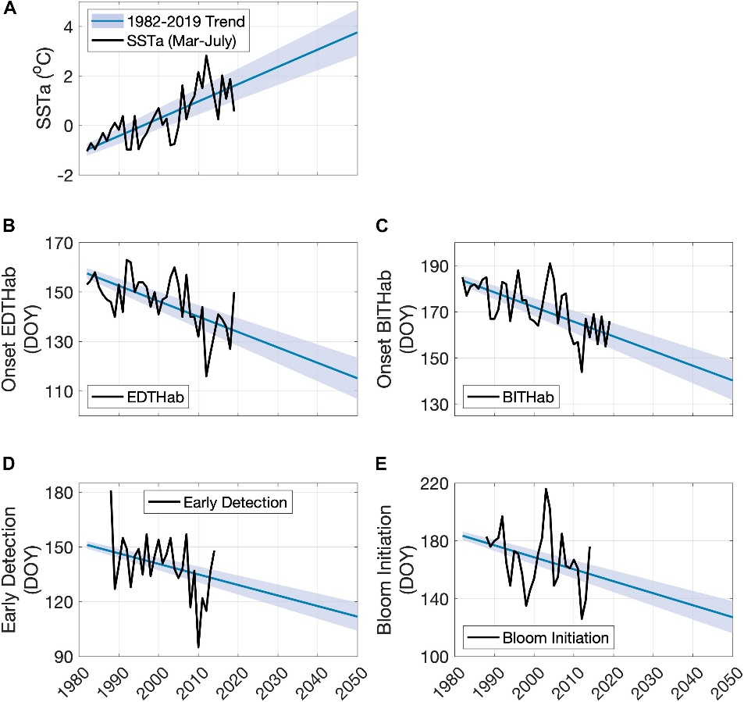
Interannual Variability in the Thermal Habitat of Alexandrium catenella in the Bay of Fundy and the Implications of Climate Change
Andre F. Bucci¹, Andrew C. Thomas¹ and Ivona Cetinić,^{2,3}
¹School of Marine Sciences, University of Maine; ² Ocean Ecology Laboratory, NASA GSFC; ³GESTAR/USRA
1
2
Sea Surface
Temperature (°C)
Onset EDTHab
(Day of Year)
Onset BITHab
(Day of Year)
(Day of Year)
(Day of Year)
Globally, harmful algal blooms (HABs) are an increasing problem. In the Gulf of Maine and Bay of Fundy, one of the most rapidly warming areas of the ocean, blooms of the toxic dinoflagellate Alexandrium catenella are recurring annually. A combination of 27-year long observation of this HAB and satellite-measured sea surface temperature, freshwater discharge, and wind-driven turbulence demonstrated that the projected arrival dates of Alexandrium bloom thermal surroundings (EDTHab and BITHab) and bloom timing metrics are to shift 1–2 months earlier in the season by 2050.
Earth Sciences Division – Hydrosphere, Biosphere, and Geophysics

Slide 6
Name: Ivona Cetinić, Ocean Ecology Laboratory (Code 616.0), NASA GSFC/USRA
E-mail: ivona.cetinic@nasa.gov
Phone: 301-286-1514
References:
Andre F. Bucci, Andrew C. Thomas, Ivona Cetinić, 2020. Interannual variability in the thermal habitat of Alexandrium catenella in the Bay of Fundy and the implications of climate change, Frontiers in Marine Science, doi: 10.3389/fmars.2020.587990.
Data Sources: (1) Optimum Interpolated Sea Surface Temperature (OISST), NOAA National Centers for Environmental Information. (2) Daily Cross-Calibrated Multi-Platform Wind, Remote Sensing Systems. (3) St. John River water level, Environment Canada, (4) cell counts of Alexandrium catenella from the Wolves Islands station Department of Fisheries and Oceans Canada technical reports. We thank Dr. Jennifer L. Martin (retired, Department of Fisheries and Ocean Canada) for providing the cell counts data of A. catenella, Dr. Michael Alexander (NOAA ESRL Boulder, CO, United States) for assistance with CMIP5 SST time series, Environmental Canada for providing St. John River water height data, NOAA NCEI for providing OISST data and Remote Sensing Systems (Santa Rosa, CA, United States) for making wind data available. We thank the reviewers for their valuable remarks and comments, which significantly contributed to the quality of this work.
Technical Description of Figure: On left (1), the study area showing major geographic locations and bathymetry (m), with the sampling site for Alexandrium catenella cell counts in the Bay of Fundy at Wolves Islands is denoted by the blue circle. The OISST domain is denoted by the gridded area with shades representing the different areas used in the analysis. On right (2) observed and projected metrics associated with appearance of A. catenella in the Bay of Fundy; (A) SST, (B) early detection thermal habitat, (C) bloom initiation thermal habitat, (D) early detection, (E) and bloom initiation (E). The black solid line in each plot corresponds to the observed data. The blue line represents the projected data using the full extent of available Sea Surfacet Temperature (1982–2019) ± 1 standard deviation (shaded blue area).
Scientific significance, societal relevance, and relationships to future missions: This paper demonstrates that are links between metrics of bloom phenology and surface temperature anomalies such that climate-driven regional warming is driving the date of occurrence of thermal habitats earlier. Moreover, freshwater discharge also impacts the temporal occurrence of the thermal habitats and bloom phenology, and regional precipitation is projected to increase in a warming climate. These shifts, not only bring disturbance to the oceanic ecosystem, but have a strong impact on economy and livelihood of surrounding states – as toxin produced by this algae causes paralytic shellfish poisoning, and its presence causes mariculture and fisheries closures. These changes in the phenology of A. catenella blooms will need to be incorporated into both monitoring strategies and forecasting models for the region. Additionally, with launch of NASA PACE (Plankton, Aerosol, Clouds, ocean Ecosystem), studies such as this one can be improved with additional, hyperspectral information about the HABs habitat or HABs presence.
Earth Sciences Division – Hydrosphere, Biosphere, and Geophysics
Notes:
6

Slide 7

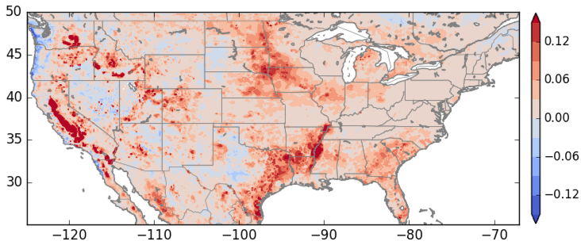
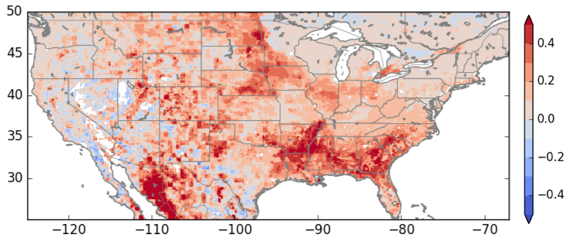
Vegetation information from SMAP improves water and carbon flux simulations
Sujay Kumar¹, Thomas Holmes¹, Rajat Bindlish¹, Richard de Jeu², Christa Peters-Lidard³
¹Hydrological Sciences Lab, NASA GSFC, ²Vandersat Inc, ³Earth Sciences Division, NASA GSFC
Evapotranspiration
Gross Primary
Productivity
better
Change in Correlation
vs ALEXI ET
vs FLUXCOM
worse
In addition to soil moisture, the Soil Moisture Active Passive (SMAP) mission can also provide information on vegetation. In this study, vegetation optical depth retrievals from SMAP are used within a numerical model to improve water and carbon fluxes. The results show that use of SMAP data significantly improves evapotranspiration and gross primary productivity. Vegetation information from microwave sensors, therefore, can be used to augment similar information from optical sensors, which are often affected by coverage gaps from clouds.
Earth Sciences Division – Hydrosphere, Biosphere, and Geophysics

Slide 8
Sujay V. Kumar, 617, NASA GSFC
E-mail: Sujay.V.Kumar@nasa.gov
Phone: 301-286-8663
References:
Kumar, S.V., T.R. Holmes, R. Bindlish, R. de Jeu, and C.D. Peters-Lidard, 2020: Assimilation of vegetation optical depth retrievals from passive microwave radiometry, Hydrol. Earth Syst. Sci., 24, 3431-3450, doi:10.5194/hess-24-3431-2020
Data Sources: Level-2 enhanced SMAP data (SPL2SMP_E) from the National Snow and Ice Data Center (NSIDC), surface meteorological data from the North American Land Data Assimilation System (NLDAS2) obtained from NASA GES-DISC.
Technical Description of Figures:
Figure 1: shows the differences in correlation (R) in evapotranspiration (ET) and gross primary productivity (GPP), computed as R (data assimilation) – R (no data assimilation), from the assimilation of SMAP vegetation optical depth (VOD) retrievals. R values for ET are computed using the thermal infrared-based ET estimates from the Atmosphere-Land Exchange Inverse (ALEXI) model, whereas GPP is evaluated using the upscaled measurements from the FLUXNET stations, developed by the FLUXCOM project. Warm colors indicate locations of improvements and cool colors denote areas of degradations from data assimilation. Strong patterns of improvements are noted over the Midwest, central California, lower Mississippi, areas with significant agricultural activity.
Scientific significance, societal relevance, and relationships to future missions: The primary focus of the Soil Moisture Active Passive (SMAP) mission (https://smap.jpl.nasa.gov) is to provide global estimates of soil moisture states. SMAP also provides estimates of VOD, an analog of above ground canopy biomass, as a by product of soil moisture retrieval. Soil moisture retrievals over areas with dense vegetation are considered unreliable due to the difficulty of retrieving soil moisture when canopy is thick. Over such areas, the use of VOD provides an alternative way to incorporate information from microwave sensors such as SMAP. The results also capture the utility of SMAP VOD in detecting features of agriculture (Midwest, central California, lower Mississippi). Typically, optical sensors are used to develop estimates of vegetation conditions. Despite their fine spatial resolution, they suffer from coverage gaps due to cloud obscuration. This study shows that the VOD from microwave sensors can be used an alternative source of vegetation coverage, not subject to the sensing limitations of the optical sensors.
Earth Sciences Division – Hydrosphere, Biosphere, and Geophysics
Notes:
8

Slide 9

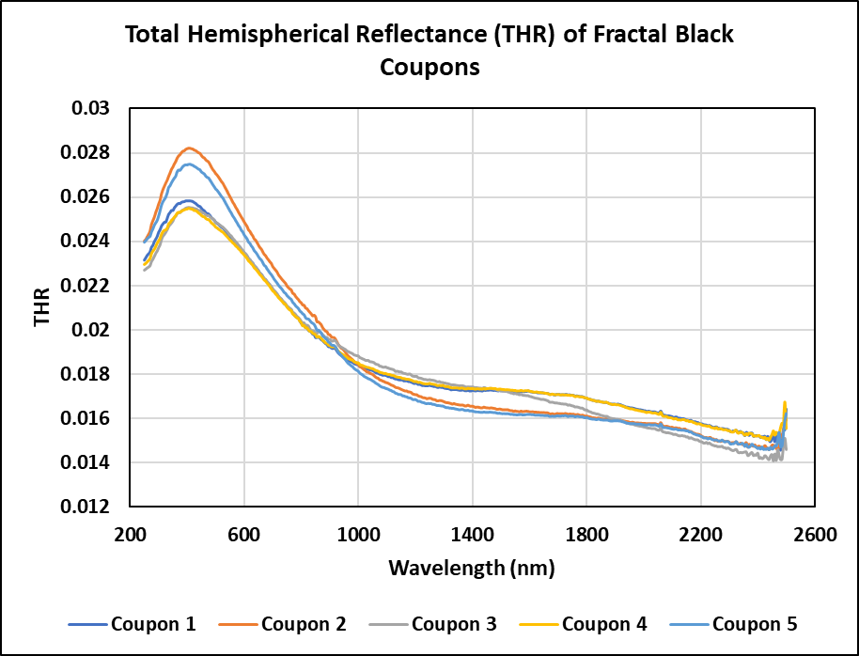
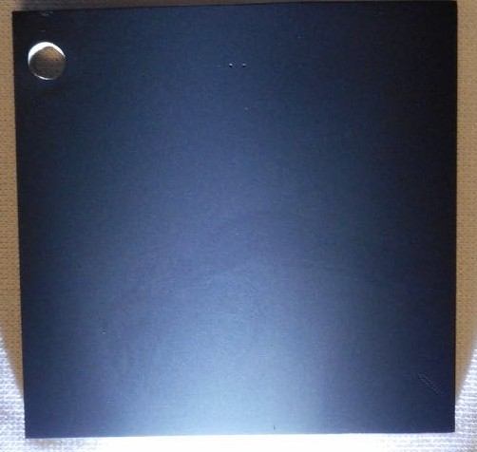
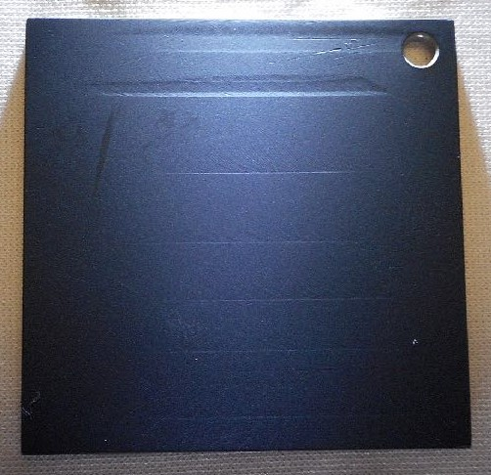
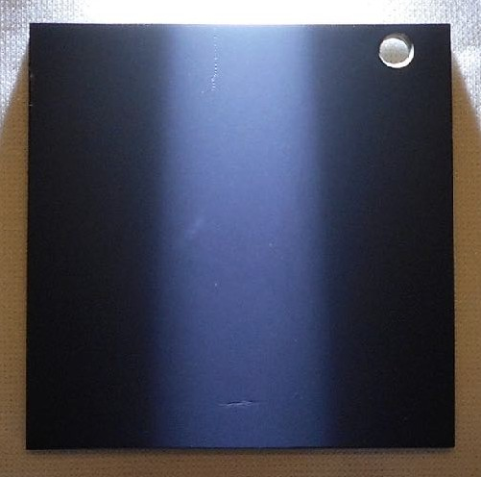
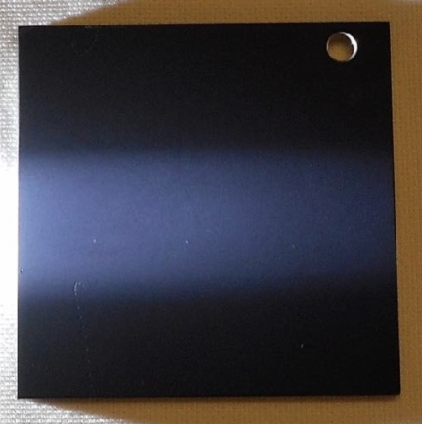
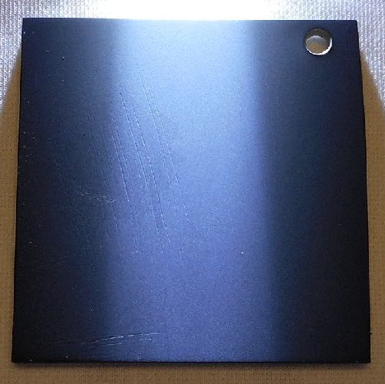
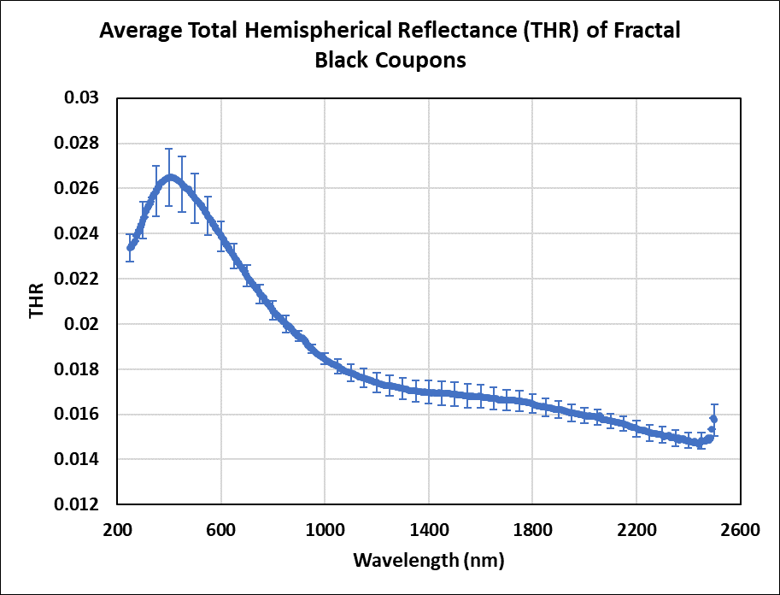
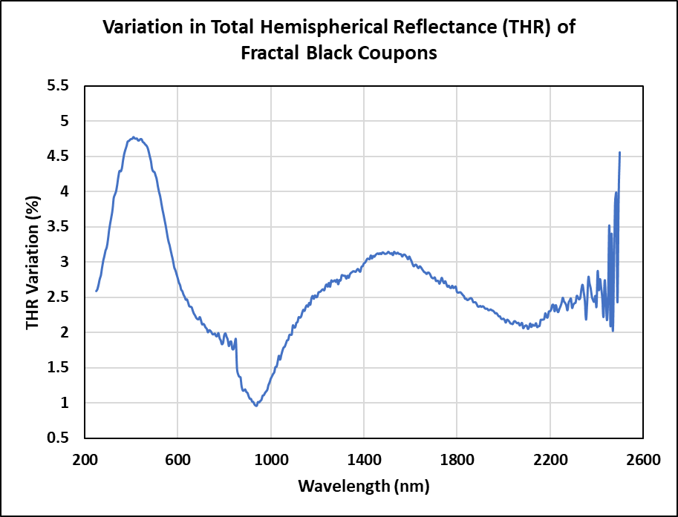
Optical Qualification Testing of Fractal BlackTM for Satellite Instrument On-orbit Radiometric Calibration
of NASA’s PACE Ocean Color Instrument (OCI)
James J. Butler, Code 618, Biospheric Sciences Laboratory, NASA GSFC,
Nathan Kelley, SSAI, Inc., and Jinan Zeng, Fibertek, Inc.
PACE OCI Instrument
Fractal BlackTM Coupons:
-Polished aluminum coupons coated with
Fractal BlackTM at the same time as the
OCI flight polished aluminum diffusers
Coupon #1
Coupon #2
Coupon #3
Coupon #4
Coupon #5
Figure 1
Figure 2
The NASA PACE Ocean Color Instrument (OCI) will be the first satellite instrument to fly a fractal black diffuser to perform on orbit monitoring of instrument linearity and radiance responsivity. The NASA GSFC Code 619 Diffuser Calibration Lab (DCL) has performed initial optical characterization testing of 5 fractal black coupons to determine their sample-to-sample variation and anticipated non-uniformity of the reflectance of fractal black on polished aluminum. The 5 coupons measured to date showed a sample-to-sample variation of 1% to 4.75% in reflectance as a function of wavelength.
Note: Fractal BlackTM is a trademark of Acktar, Inc.
Earth Sciences Division – Hydrosphere, Biosphere, and Geophysics

Slide 10
Name: James J. Butler, Code 618 Biospheric Sciences Laboratory, NASA GSFC
E-mail: james.j.butler@nasa.gov
Phone: 301-614-5942
References:
J. Zeng, J.J. Butler, X. Xiong, W. Cook, and N. Kelley, “The Effect of UV and Solar Wind Exposure on the Reflectance of Two Black Diffuse Materials,” J. Zeng, J.J. Butler, X. Xiong, W. Cook, and N. Kelley, SPIE Proceedings on Earth Observation Systems XXV, vol. 11501, 115010W-1-11501W-14 (2020) https://doi.org/10.1117/12.2569293.
J. Zeng and J.J. Butler, “Optical Studies of Low Reflectance Materials at Solar Reflective Wavelengths in Support of Remote Sensing Instrument Development and Calibration,” SPIE Proceedings on Earth Observation Systems XXIV, vol. 11127, 111270G-1-111270G-10 (2019) https://doi.org/10.1117/12.2528533.
Data Sources: All data were acquired using instrumentation in the NASA GSFC Code 618 Diffuser Calibration Laboratory (DCL), a class 10,000 cleanroom facility.
Technical Description of Figures:
Figure 1: The PACE Ocean Color Instrument (OCI) will fly a three-sided Solar Calibration Assembly (SCA) for purposes of on-orbit radiometric calibration and instrument linearity characterization. The SCA will hold 2 quasi-volume diffuse bright calibration targets and one black calibration target. The black target is comprised of polished aluminum coated with Fractal BlackTM , a very low reflectance material.
Figure 2: Initial optical testing was performed in the DCL on 5 Fractal BlackTM coupon samples to determine sample to sample reflectance variability and to gain insight into potential flight model reflectance non-uniformity. The top right plot shows the total hemispherical reflectance (THR) of the 5 coupons from 250 nm to 2500 nm. The bottom left plot shows the average THR of the 5 samples with error bars representing the reflectance range of the 5 samples. The bottom left plot shows the variation in THR of the 5 samples ranging from 1% to 4.75%.
Scientific significance, societal relevance, and relationships to future missions: The PACE OCFI will be the first satellite instrument to deploy a black diffuser for purposes of on-orbit instrument linearity monitoring and radiometric calibration. The need for space qualified, gray to black instrument calibration and characterization targets has been long desired by the remote sensing community in general and more particularly by the ocean color remote sensing community. Various gray to black materials have been flown on missions such as the Long Duration Exposure Facility (LDEF) from 1984 to 1990 and the Materials International Space Station Experiment (MISSE) from 2001 to present. However, the materials on those missions were never characterized for pre- and post-deployment reflectance change at the ~1% accuracy levels typically required by remote sensing instruments. The NASA GSFC Code 618 Calibration Facility’s Diffuser Calibration Laboratory (DCL) is a leading center of excellence in the reflectance calibration and characterization of gray-scale to black diffuse materials (see relevant references above). NASA GSFC’s PACE OCI instrument has requested the DCL perform both total hemispherical and bidirectional reflectance calibrations on their flight, flight spare, and flight Fractal BlackTM diffusers. Initial optical reflectance calibration and characterization results are presented in the accompanying slide.
The unique capability of the DCL to measure materials exhibiting a large range of reflectance, the results reported here on Fractal BlackTM being but one example, is a key capability towards enabling the deployment of low reflectance targets in satellite remote sensing instruments for purposes of on-orbit radiometric calibration and linearity characterization. The DCL has worked closely with the NASA GSFC Solar Exposure Facility in the space qualification testing of gray to black samples with the DCL performing all optical measurements and analyses. This work will enable solar-based, on-orbit satellite reflectance calibrations over the signal range corresponding to viewing bright clouds, snow and ice to dark oceans.
Earth Sciences Division – Hydrosphere, Biosphere, and Geophysics
Notes:
10

Slide 11
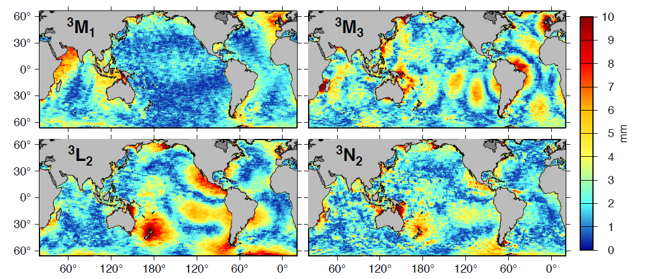
First Satellite Observations of “Third-degree” Ocean Tides
Richard D. Ray
Geodesy & Geophysics Lab, NASA GSFC
A family of very small ocean tides, called third-degree tides, is caused by a small asymmetry in the moon’s tidal potential. These tides have been occasionally seen when many years of tide-gauge measurements are carefully studied, but they have never before been observed on a global scale. We now have over three decades of precise sea-surface height measurements from the Topex/Poseidon and Jason missions, and the massive averaging afforded by this large database allows these tiny coherent tide signals to be extracted and mapped for the first time.
Earth Sciences Division – Hydrosphere, Biosphere, and Geophysics

Slide 12
Name: Richard Ray, Code 61A, NASA GSFC
E-mail: Richard.ray@nasa.gov
Phone: 301-614-6102
Reference:
Ray, R. D. (2020). First global observations of third-degree ocean tides, Science Advances, 6, eabd4744. https://doi.org/10.1126/sciadv.abd4744
Data Sources: Altimeter data from Topex/Poseidon, Jason-1, Jason-2, and Jason-3, distributed by JPL PO.DAAC. In shallow seas these data were supplemented with data from other altimeter satellites: ERS-2, Envisat, SARAL, Sentinel-3A, Geosat Follow-On, available via the Radar Altimeter Database System (RADS) maintained by NOAA and the Technical University of Delft.
Technical Description of Figure:
Figure 1: The maps depict amplitudes (in mm) of four third-degree tidal constituents, estimated from three decades of satellite altimetry. Shown are one diurnal constituent (M1), two semidiurnal constituents (L2 and N2), and one terdiurnal constituent (M3). Noise levels are fairly high, owing to the very small amplitudes of the waves; noise arises not only from instrument noise but also from real non-tidal oceanographic signals. The color scale saturates in a few near-coastal resonances, most notably along the southern coast of Australia where M3 reaches 10 cm.
Scientific significance, societal relevance, and relationships to future missions: The maps look nothing like conventional tide maps, because the astronomical forcing of these waves is completely different from the forcing of conventional ocean tides. The results thus present an opportunity to study the ocean’s response to a precisely known, but hitherto unexplored, large-scale force. One surprising example involves the two semidiurnal constituents, where the smaller lunar force is found to generate the larger ocean tide; an explanation leads to new information about an ocean normal mode that is excited by the third-degree astronomical potential (e.g., its period and dissipation, and indeed its existence). The maps also lead to a small improvement in our ability to predict ocean tides in the open ocean, which is important for many oceanographic and geodetic applications.
Earth Sciences Division – Hydrosphere, Biosphere, and Geophysics
Notes:
12

