Slide 1
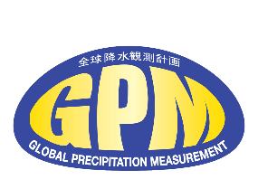
1998-2014 Winters (December, January, February)
High Resolution, Altitude-Corrected Monthly Satellite
Precipitation Product Improves Estimates in Mountain Regions
George J. Huffman (Code 612, NASA/GSFC) Hossein Hashemi (Lund U., Sweden)
Jessica Fayne (UCLA)
Venkat Lakshmi (U. of Va.)
TMPA
mm
300
0
HRAC
The High-Resolution Altitude-Corrected Precipitation (HRAC-Precip) dataset spatially downscales, and then applies altitude-dependent bias corrections to NASA’s Tropical Rainfall Measuring Mission (TRMM) Multi-satellite Precipitation Analysis (TMPA). Correcting these biases is particularly important for water management, because the snowpack that accumulates in in high mountain regions around the world (the Sierra Nevada Mountains in California and the Rocky Mountains in Colorado for the continental U.S.) is critical for summer water supplies.
HRAC – TMPA
mm
75
0

Slide 2
Name: George J. Huffman, NASA/GSFC, Code 612 E-mail: george.j.huffman@nasa.gov Phone: 301-614-6308
References:
Hashemi, H.; Fayne, J.; Lakshmi, V.; Huffman, G.J. (2020) Very High Resolution, Altitude-Corrected, TMPA-Based Monthly Satellite Precipitation Product over the CONUS. Sci. Data, 7, article 74, doi: 10.1038/s41597-020-0411-0
Data Sources: The Tropical Rainfall Measuring Mission (TRMM) Multi-satellite Precipitation Analysis (TMPA), Parameter-elevation
Regressions on Independent Slopes Model (PRISM; from NOAA), Global Historical Climatology Network (GHCN; from NOAA)
Technical Description of Figures:
The monthly datasets were accumulated by season for 1998-2014. Here, Winter (December, January, February) is shown for (top) TMPA, (middle) HRAC-Precip, and then (bottom) the difference as (HRAC-Precip – TMPA).
Scientific significance, societal relevance, and relationships to future missions: Satellite precipitation products provide a key input to environmental applications and global water and energy cycle studies. However, there remain limitations to spatial resolution and accuracy, particularly in mountainous terrain. Working specifically with the TMPA, its native spatial resolution of 0.25° (~27 km near the Equator) smooths precipitation peaks within the grid cell that are key to water management and flood estimation at the small basin scale (~1 km). Further, the passive microwave retrievals on which TMPA depend lack skill in the orographic enhancement in the liquid phase in complex terrain, generally leading to underestimation. This altitude correction starts at 1,500 meters above mean sea level (amsl) and increases nearly linearly. The correction is larger when the precipitation type is snowfall, which passive microwave retrievals currently handle poorly. The correction model for TMPA uses the Parameter-elevation Regressions on Independent Slopes Model (PRISM) as a reference, which incorporates seasonality and topographically dependent corrections, such as coastal proximity, aspect, vertical layer, and topographic position. In the last stage of the study, TMPA was downscaled to the 1 km grid then the elevation-dependent adjustment was applied on the Global 30 Arc-Second Elevation (GTOPO30) DEM dataset, resulting in the High-Resolution Altitude-Corrected Precipitation (HRAC-Precip) dataset. HRAC-Precip is free and publicly available at NASA’s Goddard Earth Science Data Information Services Center (GES-DISC) https://disc.gsfc.nasa.gov/datasets/HRAC_Precip_V1/. The current HRAC-Precip product covers the conterminous United States at the monthly scale for 1998–2014. For the future, it is necessary to expand this concept to cover the entire globe and to shift to sub-monthly time periods. Both of these are challenging research areas.
Improving the bias of satellite precipitation estimates has an important impact on hydrological modeling; HRAC-Precip provides improvements in mountainous regions, where flash flooding is very sensitive to high-intensity precipitation events. As well, the water that is stored in high-altitude snowfields during the winter provides a critical water resource for downstream regions, and the TMPA biases in wintertime high-altitude regions are rather large.
HRAC-Precip is considered a proof of concept for possible application to additional and future datasets. In particular, the successor to the TMPA, which has now ended, is the integrated Multi-sattelitE Retrievals for the Global Precipitation Measurement (GPM) mission (IMERG). IMERG is also known to have biases in regions with complex terrain and snowy/icy surfaces. IMERG employs zonal-average adjustments to the Global Precipitation Climatology Project (GPCP) to address these deficiencies, but the HRAC-Precip concept points to one approach that will provide a finer-scale adjustment that will render IMERG more useful in these problematic situations.
Earth Sciences Division - Atmospheres
Notes:
2

Slide 3
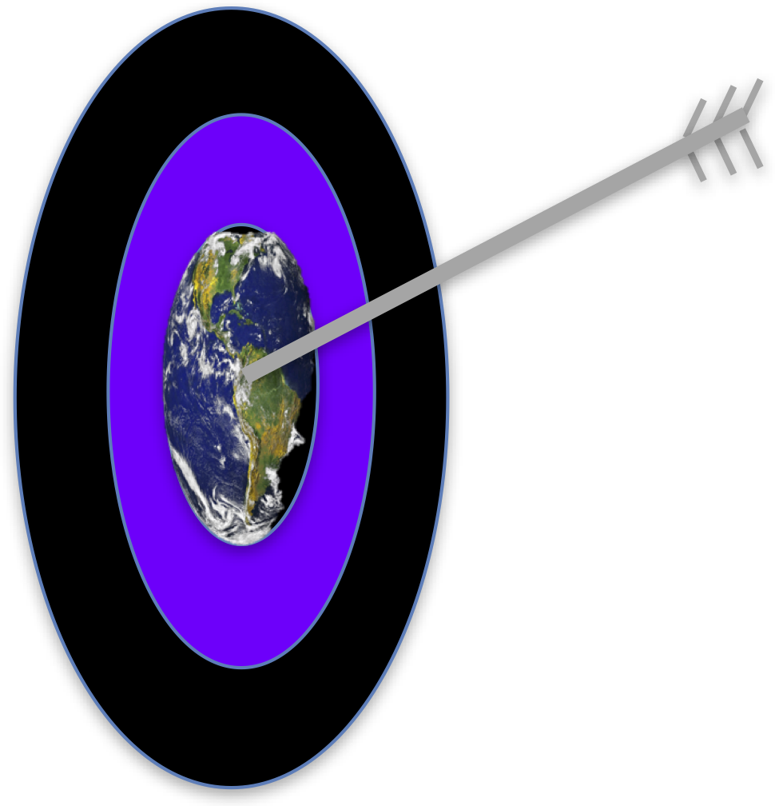
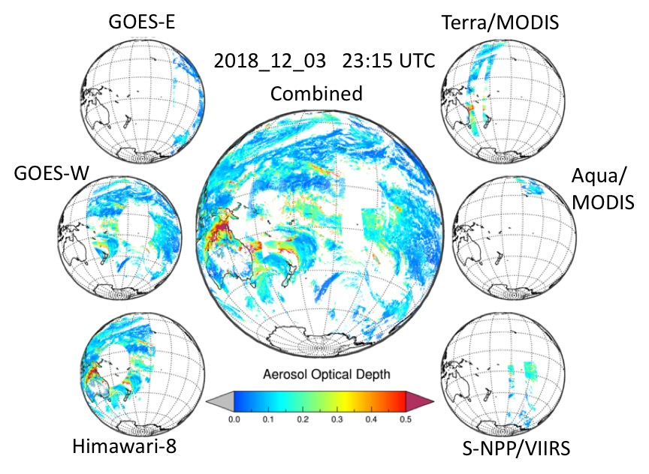
The Dark Target algorithm for observing the global aerosol system
Past, present and future
Lorraine A. Remer (JCET and Physics, UMBC), Robert C. Levy (Code 613, NASA/GSFC)
Shana Mattoo (Code 613, SSAI)
and many members of the Dark Target aerosol retrieval team (past and present)
During the 1990s, the Dark Target aerosol algorithm was developed for MODIS.
Today it is applied to a constellation of satellite sensors.
The 30-year effort has been instrumental in characterizing the global aerosol system, contributing to new science and new applications.

Slide 4
Name: Robert C. Levy, NASA/GSFC, Code 613 E-mail: Robert.c.levy@nasa.gov Phone: 301-614-6123
Reference: Remer, L.A.; Levy, R.C.; Mattoo, S.; Tanré, D.; Gupta, P.; Shi, Y.; Sawyer, V.; Munchak, L.A.; Zhou, Y.; Kim, M.; Ichoku, C.; Patadia, F.; Li, R.-R.; Gassó, S.; Kleidman, R.G.; Holben, B.N. The Dark Target Algorithm for Observing the Global Aerosol System: Past, Present, and Future. Remote Sensing, 2020, 12(18), 2900; https://doi.org/10.3390/rs12182900
Data Sources: Standard Dark Target products using data from: MODIS on Terra (https://doi.org/10.5067/MODIS/MOD04_L2.061), MODIS on Aqua (https://doi.org/10.5067/MODIS/MYD04_L2.061) and VIIRS on Suomi-NPP (https://doi.org/10.5067/VIIRS/AERDT_L2_VIIRS_SNPP.001).
Experimental DT products being developed under NASA-MEaSUREs (2017) using data from: AHI on Himawari-8 (https://www.data.jma.go.jp/mscweb/en/index.html), and ABI on NOAA GOES-East and GOES-West (https://www.goes-r.gov/spacesegment/abi.html).
Technical Description of Figures:
Left Image: Aerosol optical properties derived from an early version of the Dark Target (DT) algorithm applied to the Moderate-resolution Imaging Spectroradiometer (MODIS) on Terra, for 12 June 2001. The two-dimensional color bar describes both the total column loading known as aerosol optical depth (AOD; x-axis) and the fraction of the total that is contributed by small-sized particles (y-axis). Blue indicates low AOD. Increasing red tones indicate heavier loadings of smaller particles such as pollution and smoke, whereas increasing green tones indicate a greater percentage of larger particles such as desert dust and sea salt. This image is one frame of a multi-day animation developed by Reto Stockli of NASA’s Earth Observatory, which changed our perception of the global aerosol system and how satellites could quantify it. Right image: AOD at 0.55 µm, retrieved using the latest DT aerosol algorithm on multiple sensors/platforms. Along the perimeter, globes represent AOD retrieved from: Advanced Baseline Imager (ABI) on NOAA’s GOES-East and GOES-West, Advanced Himawari Imager (AHI) on Japan’s Himawari-8, MODIS on NASA’s Terra and Aqua, and the Visible Infrared Imaging Suite (VIIRS) on Suomi-NPP. The center globe is a (0.1° x 0.1° gridded) aggregate for 23:15 UTC ± 15 minutes on 03 December 2018. Applying the common DT algorithm to multiple sensors moves closer to our goal of creating a uniform global aerosol data set.
Scientific significance, societal relevance, and relationships to future missions: After 30 years, we have taken a step back to review the experience of the Dark Target aerosol algorithm and its contribution to science and applications. The impact is demonstrated by the hundreds of scientific papers that have used the product for climate, air quality, model development and other applications, as well as the papers that borrowed facets of the algorithm for developing new algorithms. The DT product was the first to be used by operational air quality forecasters, and the first to be used in a global assimilation system. We have learned many “lessons” while struggling to develop, implement, validate, and maintain consistency of the DT algorithm on 20+ years of MODIS data, as well as adapting the algorithm to new sensors. Our 30+ year long list of triumphs and failures could help guide algorithm development for future missions.
Earth Sciences Division - Atmospheres

Slide 5
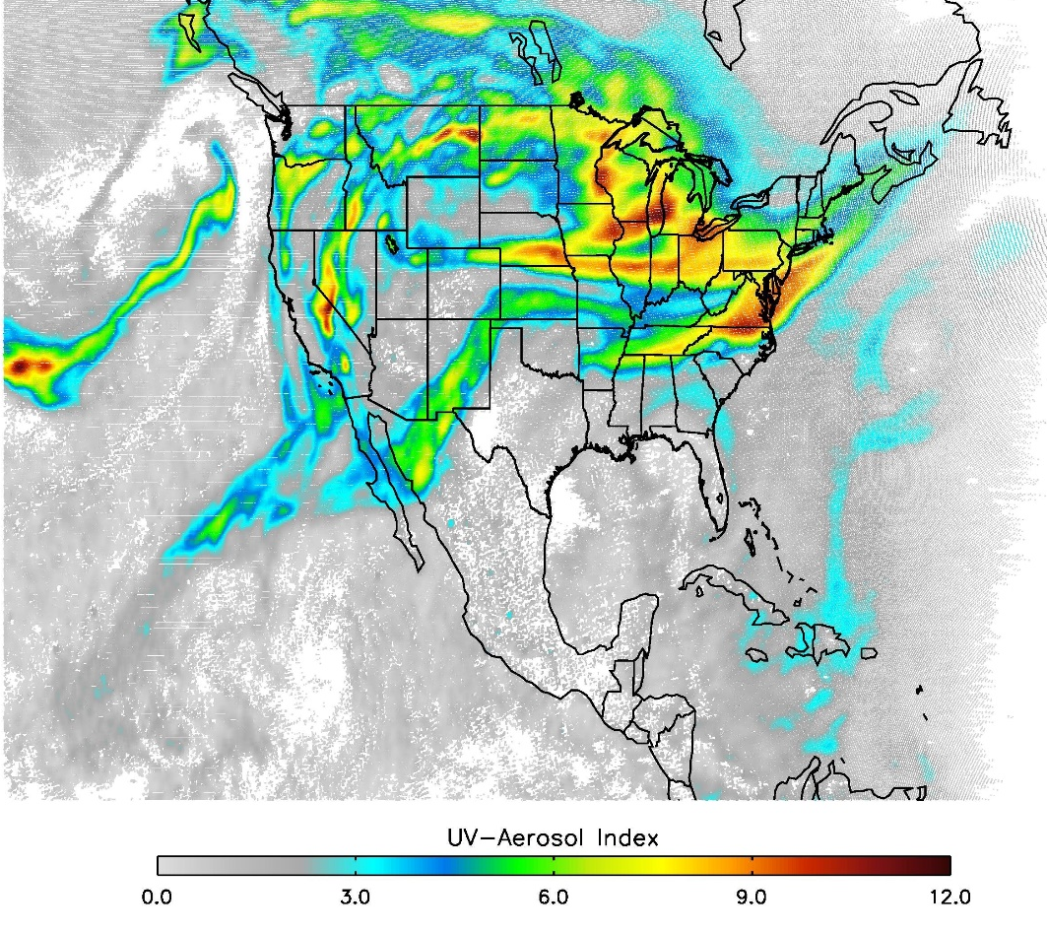
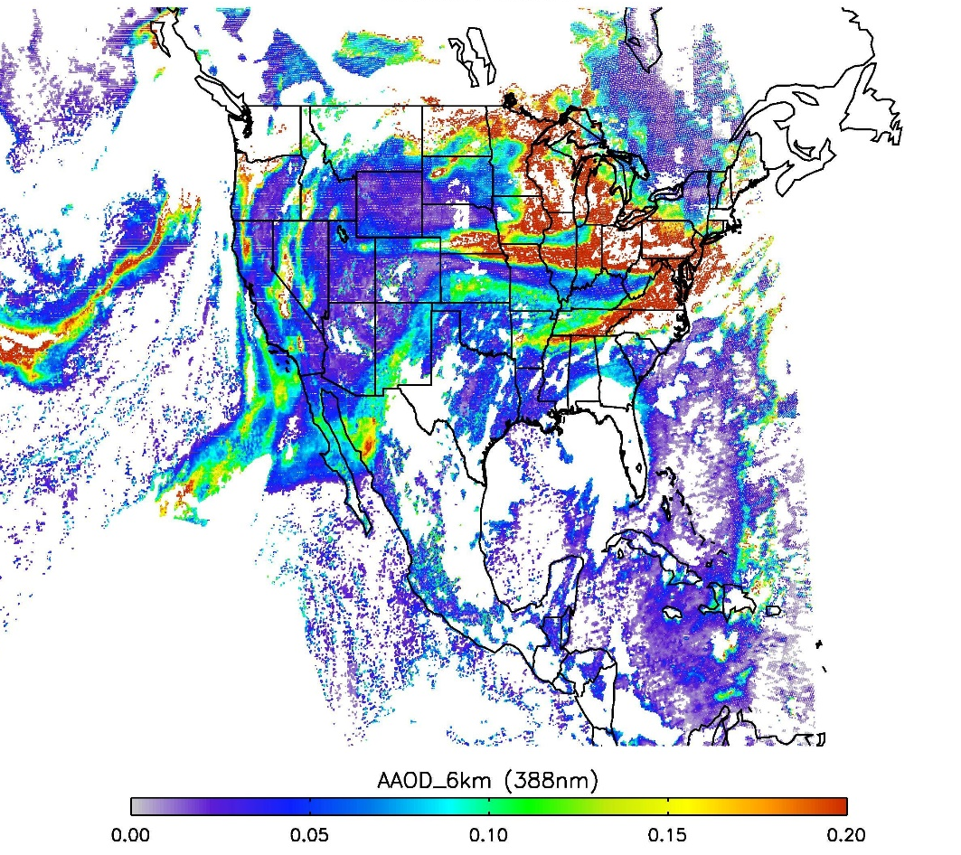
Unprecedented 2020 U.S. West Coast Wildfire Season:
A view from DSCOVR-EPIC using near UV observations
Omar Torres, Code 614, Code 614, NASA GSFC, and Changwoo Ahn, SSAI
Fig. 1 Spatial Extent of smoke plume on September 14, 2020 in terms of UV Aerosol Index using 340 and 388 nm radiances.
Fig. 2 Retrieved Aerosol
Absorption Optical Depth (388 nm)
EPIC observes a hemispheric scale smoke plume in terms of UV Aerosol Index (left) and aerosol absorption optical depth (right) on September 14, 2020. On this day, the plume spreads over the contiguous US, Northern Mexico, Southern Canada, and reaches both the Atlantic and Pacific Oceans.

Slide 6
Name: Omar Torres and Changwoo Ahn, NASA/GSFC, Code 614
E-mail: omar.o.torres@nasa.gov Phone: 301-614-6776 References:
Marshak, A., J. Herman, S. Adam, B. Karin, S. Carn, A. Cede, I. Geogdzhayev, D. Huang, L. Huang, Y. Knyazikhin, M. Kowalewski, N. Krotkov, A. Lyapustin, R. McPeters, K.G. Meyer, O. Torres, and Y. Yang, 2018: Earth Observations from DSCOVR EPIC Instrument. Bull. Amer. Meteor. Soc., 99, 1829–1850, doi:10.1175/BAMS-D-17-0223.1
Torres, Omar and Lorraine Remer (2011), History of passive remote sensing of aerosol from space, in Aerosol Remote Sensing, Jacqueline Lenoble, Lorraine Remer , and Didier Tanré, Editors, Springer, DOI 10.1007/978-3-642-17725-5, Springer Heidelberg, New York, Dordrecht London.
Torres, O., Bhartia, P. K., Taha, G., Jethva, H., Das, S., Colarco, N. Krotkov, A. Omar and C. Ahn ( 2020). Stratospheric Injection of Massive Smoke Plume from Canadian Boreal Fires in 2017 as seen by DSCOVR‐EPIC, CALIOP and OMPS‐LP Observations. Journal of Geophysical Research: Atmospheres, 125, e2020JD032579. https://doi.org/10.1029/2020JD032579
Data Sources: The EPIC level 2 UV aerosol products are available at the Atmospheric Science Data Center (ASDC) at NASA Langley Research Center at web portal https://asdc.larc.nasa.gov/project/DSCOVR/DSCOVR_EPIC_L2_AER_01
Technical Description of Figures:
Fig 1 This figure shows the spatial extent of multiple smoke plumes from fires in the US west coast on September 14 (20:44 UTC) in terms of the qualitative UV Aerosol Index (UVAI) calculated from measured 340 nm and 388 nm radiances. Observations were made by the Earth Polychromatic Imaging Camera (EPIC) onboard the Deep Space Climate Observatory at the Lagrangian (L1) point about one million miles away between the Earth and the Sun. The figure shows the spread of the plumes that covered, at least partially, almost the entire contiguous United States, except for Florida. They also reached northern Mexico, southern Canada and the Pacific Ocean. On the following days, the plume travelled across the Atlantic Ocean, and was detected as far as northern Europe. Double-digit UVAI values are associated with aerosol optical depth larger than about 4.0 for aerosol layers higher than 3 km above the surface.
Fig 2 Aerosol Absorption Optical Depth (AAOD) estimates, at 388 nm, for an aerosol layer at 6 km for the same time frame shown on Fig. 1. Retrieved AAOD values as large as 0.5, are associated with total aerosol optical depth (AOD) values of about 5 and higher.
Scientific significance, societal relevance, and relationships to future missions:
Unprecedented amounts of carbonaceous aerosols were produced by multiple fires over the USA west coast in September 2020. Continental scale smoke plumes from these wildfires were observed from EPIC’s unique vantage point [Marshak et al., 2018] multiple times a day, for about five weeks since the onset of the fires in early September. The intensity of the 2020 Pacific Northwest wildfire season has no precedent in this century, and it is only comparable to hemispheric scale megafires over thirty years ago such as the 1987 Yellowstone Park fires and the 1988 Great China Fire [Torres et al., 2011]. Although the 2020 US west coast wildfire season was significantly more intense than in recent years, it is consistent with an increasing trend in fire frequency and intensity in this region observed over the last few years. In addition to casualties and economic losses, as well as deterioration of air quality in the vicinity of the fires, smoke plumes associated with fires in the Pacific Northwest have been found to reach the lower stratosphere [Torres et al., 2020] where the residence time of carbonaceous aerosol particles is significantly longer, likely resulting in climate effects.
DSCOVR: EPIC
Earth Polychromatic Imaging Camera
Earth Sciences Division - Atmospheres
Notes:
6

