Slide 1

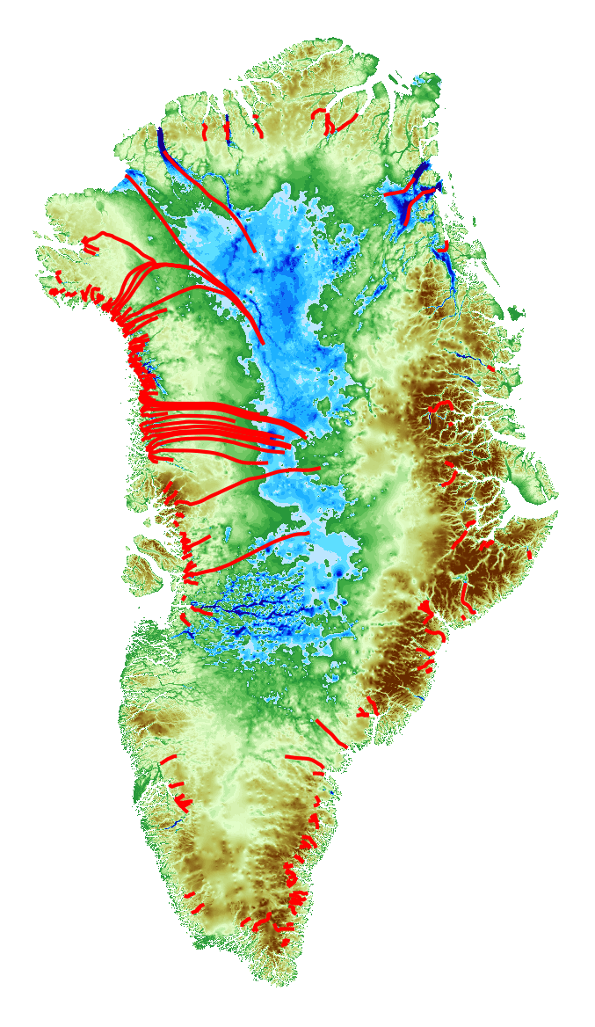
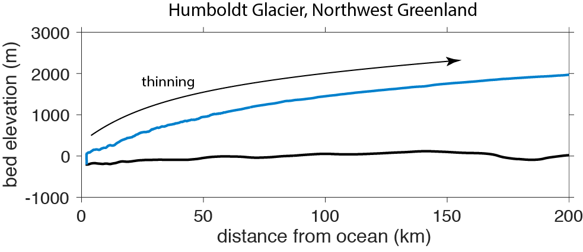
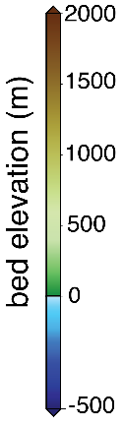
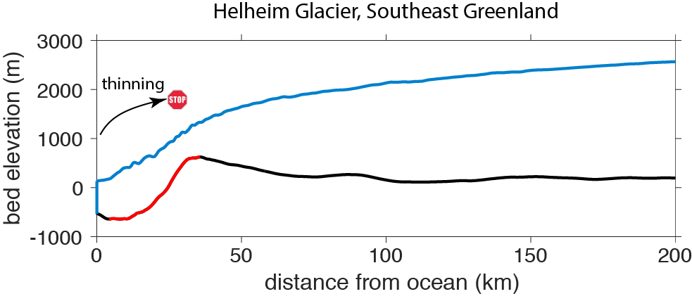

Steep glacier bed knickpoints mitigate inland thinning in Greenland
Denis Felikson^{1,2}, Ginny A. Catania^{3,4}, Timothy C. Bartholomaus⁵, Mathieu Morlighem⁶, Brice P. Y. Noël⁷
¹ Cryospheric Sciences Laboratory, NASA Goddard Space Flight Center, Greenbelt, MD, USA
² Universities Space Research Association, Columbia, MD, USA
³ University of Texas Institute for Geophysics, University of Texas at Austin, Austin, TX, USA
⁴ Department of Geological Sciences, University of Texas at Austin, Austin, TX, USA
⁵ Department of Geological Sciences, University of Idaho, Moscow, ID, USA
⁶ Department of Earth System Science, University of California, Irvine, Irvine, CA, USA
⁷ Institute for Marine and Atmospheric Research Utrecht, Utrecht University, Utrecht, The Netherlands
1
2
Thinning that starts at the terminus of Greenland outlet glaciers, where the ice meets the ocean, can spread into the interior over different distances, depending on the shape of the bed under each glacier. Glaciers in the mountains of East Greenland flow over steep drops in the bed called “knickpoints,” which prevent thinning from spreading far into the interior. Glaciers in the gentle topography of the Northwest don’t have steep knickpoints and can let thinning spread as far as the center of the ice sheet, meaning these glaciers can contribute over a longer time to sea-level rise.
3
predicted extent of thinning
Earth Sciences Division – Hydrosphere, Biosphere, and Geophysics

Slide 2
Name: Denis Felikson | Cryospheric Sciences Laboratory, NASA GSFC | GESTAR, Universities Space Research Association
E-mail: denis.felikson@nasa.gov
Phone: 301-614-6835
References:
Felikson, D., G. A. Catania, T. C. Bartholomaus, M. Morlighem, and B. P. Y. Noël (2020). Steep glacier bed knickpoints mitigate inland thinning in Greenland. Geophysical Research Letters, 48, e2020GL090112, https://doi.org/10.1029/2020GL090112.
Data Sources: IceBridge BedMachine Greenland, v3 (https://nsidc.org/data/idbmg4); Greenland 1978-1987 aerial photo DEM (https://www.ncei.noaa.gov/access/metadata/landing-page/bin/iso?id=gov.noaa.nodc:0145405); MEaSUREs Greenland Ice Mapping Project DEM (https://nsidc.org/data/nsidc-0645); Polar Geospatial Center ArcticDEM (https://www.pgc.umn.edu/data/arcticdem/).
This research was funded by NASA grant NNX12AP50G (NASA Cryospheric Sciences Program), the Gale White Fellowship at the University of Texas Institute for Geophysics, and the NASA Postdoctoral Program at the Goddard Space Flight Center, administered by Universities Space Research Association under contract with NASA.
Technical Description of Figures:
Figures: (1) Predicted extent of a diffusive, kinematic wave of thinning that starts at the edge of the ice sheet into the interior, showing that glaciers in the gentle bed topography of the northwest can allow thinning to spread far inland. Insets show profiles of Humboldt Glacier (2) and Helheim Glacier (3), end members of outlet glacier geometries. Helheim flows over a steep knickpoint (red) that stalls thinning from spreading further inland whereas the lack of a knickpoint beneath Humboldt allows thinning to spread far inland.
Scientific significance, societal relevance, and relationships to future missions: This research advances our understanding of ice sheet dynamics by showing that outlet glaciers in Greenland’s Northwest will discharge ice over a longer timespan than glaciers in the Southeast, helping to contextualize recent observations that the Northwest is the only region with increasing ice discharge (King et al., 2020). Our results show that Northwest ice discharge will continue to increase in the future, even without additional forcing. We highlight the importance of correctly modeling the smaller, often overlooked glaciers to better constrain sea-level rise projections, addressing Question C-1 in the 2017 NASA Decadal Survey: How much will sea level rise, globally and regionally, over the next decade and beyond, and what will be the role of ice sheets and ocean heat storage?
King, M. D., Howat, I. M., Candela, S. G., Noh, M. J., Jeong, S., Noël, B. P. Y., et al. (2020). Dynamic ice loss from the Greenland Ice Sheet driven by sustained glacier retreat. Communications Earth & Environment, 1–7. http://doi.org/10.1038/s43247-020-0001-2
Earth Sciences Division – Hydrosphere, Biosphere, and Geophysics
Notes:
2

Slide 3
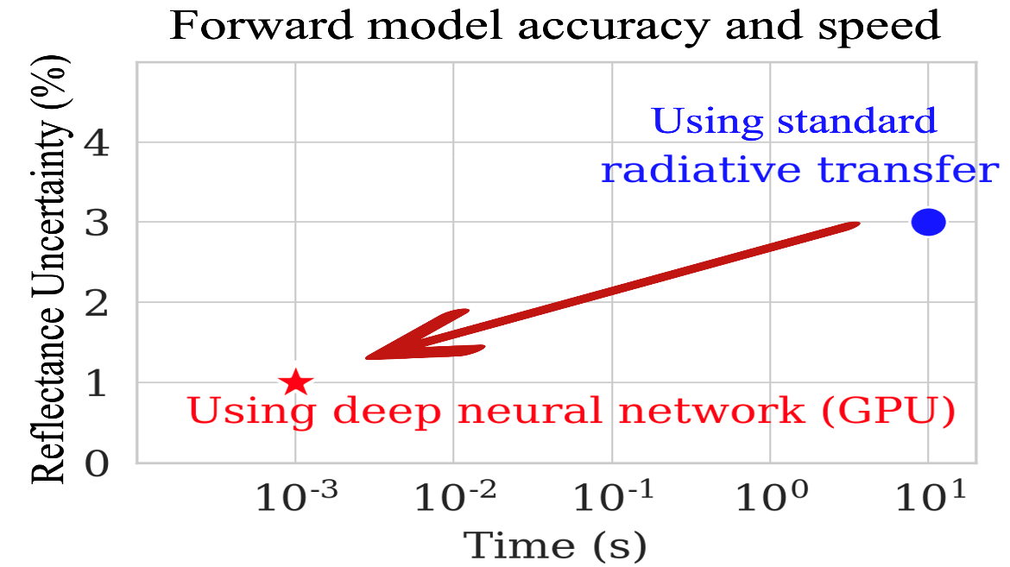
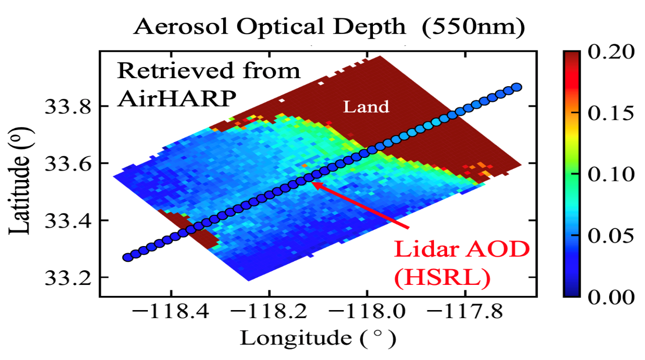
Accelerating PACE multi-angle polarimetric retrievals through deep learning
Meng Gao^{1,2}, Bryan A. Franz¹, Kirk Knobelspiesse¹
¹Ocean Ecology Lab, NASA GSFC , ²SSAI
Figure 1
Figure 2
NASA’s Plankton, Aerosol, Cloud, ocean Ecosystem (PACE) mission will carry a hyperspectral Ocean Color Instrument (OCI) and two Multi-Angle Polarimeters (MAP): the Hyper-Angular Rainbow Polarimeter (HARP2) and the Spectro-Polarimeter for Planetary EXploration one (SPEXone). MAP measurements contain rich information on the microphysical properties of aerosols and hydrosols, but pose challenges in algorithm performance and computational cost. We developed a fast and accurate neural network forward radiative transfer model to compute multi-angle polarimetric reflectance from ocean and atmosphere optical properties, which can be used to greatly reduce the computational cost of inverse retrieval algorithms. An algorithm using the neural network model has been developed, applied to airborne HARP measurements, and validated against Lidar measurements collected during the Aerosol Characterization from Polarimeter and Lidar (ACEPOL) field campaign.
Earth Sciences Division – Hydrosphere, Biosphere, and Geophysics

Slide 4
Name: Meng Gao, Ocean Ecology Lab, NASA GSFC
E-mail: meng.gao@nasa.gov
Phone: 301.286.2760
References:
Gao, M., Franz, B. A., Knobelspiesse, K., Zhai, P.-W., Martins V., Burton, S., Cairns, B., Ferrare, R., Gales, J., Hasekamp, O., Hu, Y., Ibrahim, A.,. McBride, B., Puthukkudy, A., Werdell, P. J., and Xu X.: Efficient multi-angle polarimetric inversion of aerosols and ocean
color powered by a deep neural network forward model. 2021, submitted to AMT.
Gao, M., Zhai, P.-W., Franz, B. A., Knobelspiesse, K., Ibrahim, A., Cairns, B., Craig, S. E., Fu, G., Hasekamp, O., Hu, Y., and Werdell, P. J.: Inversion of multiangular polarimetric measurements from the ACEPOL campaign: an application of improving aerosol property and hyperspectral ocean color retrievals, Atmos. Meas. Tech., 13, 3939–3956, https://doi.org/10.5194/amt-13-3939-2020, 2020.
Werdell, P. J., Behrenfeld, M. J., Bontempi, P. S., Boss, E., Cairns, B., Davis, G. T., Franz, B. A., Gliese, U. B., Gorman, E. T., Hasekamp, O., Knobelspiesse, K. D., Mannino, A., Martins, J. V., McClain, C. R., Meister, G., and Remer, L. A.: The Plankton, Aerosol, Cloud, Ocean Ecosystem Mission: Status, Science, Advances, Bulletin of the American Meteorological Society, 100, 1775–1794, https://doi.org/10.1175/BAMS-D-18-0056.1
Data Sources: Multi-angle polarimetric measurements from UMBC AirHARP instrument conducted in NASA/SRON ACEPOL field campaign are used to validate the algorithm. The neural network training data is simulated on the high-performance computing clusters of the Ocean Ecology Laboratory (GSFC, 616).
Technical Description of Figures:
Figure 1: Improvement in forward model accuracy and speed after replacing conventional radiative transfer simulation with a deep neural network forward model.
Figure 2: Retrieved aerosol optical depth using the retrieval algorithm powered by the neural network forward model.
The neural network forward model is trained with highly accurate radiative transfer simulated data. As shown in Figure 1, compared with the conventional approach of running a radiative transfer model iteratively in the retrieval, for which accuracy was intentionally degraded to improve computational performance, the new neural network forward model can be several times more accurate and several orders of magnitude faster. A retrieval algorithm using the neural network forward model has been developed to retrieve aerosol and ocean color properties simultaneously. Results of the retrieved aerosol optical depth from AirHARP field measurements are shown in Figure 2.
Scientific significance, societal relevance, and relationships to future missions:
Multi-angle polarimetric retrievals can better determine the aerosol properties, which then help to reduce uncertainties in the aerosol radiative forcing. The retrieved aerosol properties can also be used for atmospheric correction in ocean color remote sensing and therefore improve the observation quality of ocean leaving signals. The fast and accurate forward model developed through deep learning enables efficient operational processing of the large data volume obtained from satellite missions such as PACE.
Earth Sciences Division – Hydrosphere, Biosphere, and Geophysics
Notes:
4

Slide 5

The 2019-2020 Australian drought and bushfires altered the partitioning of hydrological fluxes
Sujay Kumar¹, Thomas Holmes¹, Christa Peters-Lidard² , S.P.P. Mahanama³ , K.R. Arsenault¹ , A. Getirana¹
¹Hydrological Sciences Lab, NASA GSFC, ²Earth Sciences Division, NASA GSFC, ²Earth Sciences Division, NASA GSFC
Satellite infrared imagery
In addition to soil moisture, the Soil Moisture Active Passive (SMAP) mission can provide information on vegetation. In this study, vegetation optical depth (VOD) retrievals from SMAP were found to capture the unprecedented nature of the vegetation disturbances from the 2019-2020 Australian bushfires and drought. Additionally, these vegetation alterations led to significant changes to the local water cycle by increasing runoff and bare soil evaporation and decreasing transpiration.
More
vegetation
SMAP VOD
Less
vegetation
Earth Sciences Division – Hydrosphere, Biosphere, and Geophysics

Slide 6
Sujay V. Kumar, 617, NASA GSFC
E-mail: Sujay.V.Kumar@nasa.gov
Phone: 301-286-8663
References:
Kumar, S.V., T.R. Holmes, N. Andela, I. Dharssi, Vinodkumar, C. Hain, C.D. Peters-Lidard, S.P.P. Mahanama, K.R. Arsenault, W. Nie, A. Getirana, 2021: The 2019-2020 Australian drought and bushfires altered the partitioning of hydrological fluxes, Geophysical Research Letters, 48, e2020GL091411, doi: 10.1029/2020GL091411
Data Sources: Level-2 enhanced SMAP data (SPL2SMP_E) from the National Snow and Ice Data Center (NSIDC), surface meteorological data from the Modern-Era Retrospective analysis for Research and Applications, version 2 (MERRA2) obtained from NASA GES-DISC.
Technical Description of Figures:
Figure 1: shows the false color images of Bands M11-I2-I1 from Visible Infrared Imaging Radiometer Suite (VIIRS)/Suomi National Polar-Orbiting Prototype (NPP) over Southeast Australia (top row) and maps of anomalies in SMAP VOD (-) for January 22 from years 2018 to 2020 (bottom row). The burn scars from the 2019-2020 Bushfires are visible in dark red color in the January 22, 2020 image, whereas those areas appear green representing vegetated land in prior years. The SMAP VOD anomalies show generally positive values in 2018 and 2019, indicating the increased vegetation activity during a typical Australian summer. In contrast, significant negative anomalies are observed in 2020 over large portions of eastern New South Wales and Victoria. These areas with significant negative SMAP VOD anomalies represent the combined impact of drought and burned scars, demonstrating that SMAP VOD retrievals are skillful in capturing these vegetation disturbances.
Scientific significance, societal relevance, and relationships to future missions: Remote sensing-based information is critical for monitoring and assessing the impact of vegetation changes from droughts and fires. Typically optical or thermal infrared sensors are used to develop assessments of burn scars, partly because of the fine spatial resolution of their measurements. Though coarser in their spatial resolution, passive microwave-based estimates are nearly all weather and could be used to improve the spatio-temporal coverage of optical vegetation remote sensing estimates. This study demonstrates that the VOD retrievals from SMAP, an analog of above ground canopy biomass, could be used to augment optical sensing estimates, particularly in cases where the spatial scale and extent of the vegetation disturbances is large.
Earth Sciences Division – Hydrosphere, Biosphere, and Geophysics
Notes:
6

Slide 7

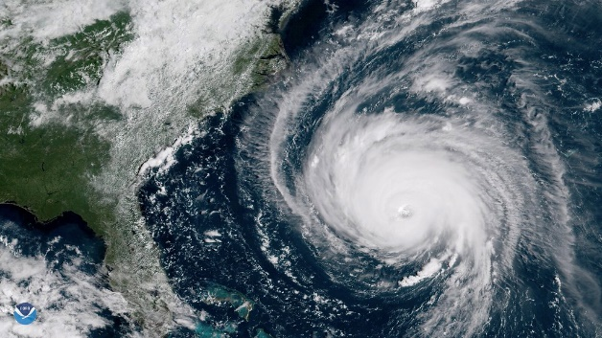
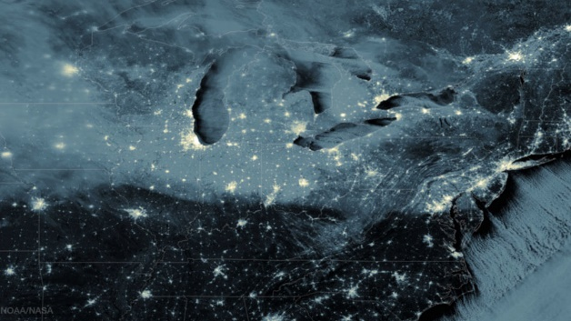
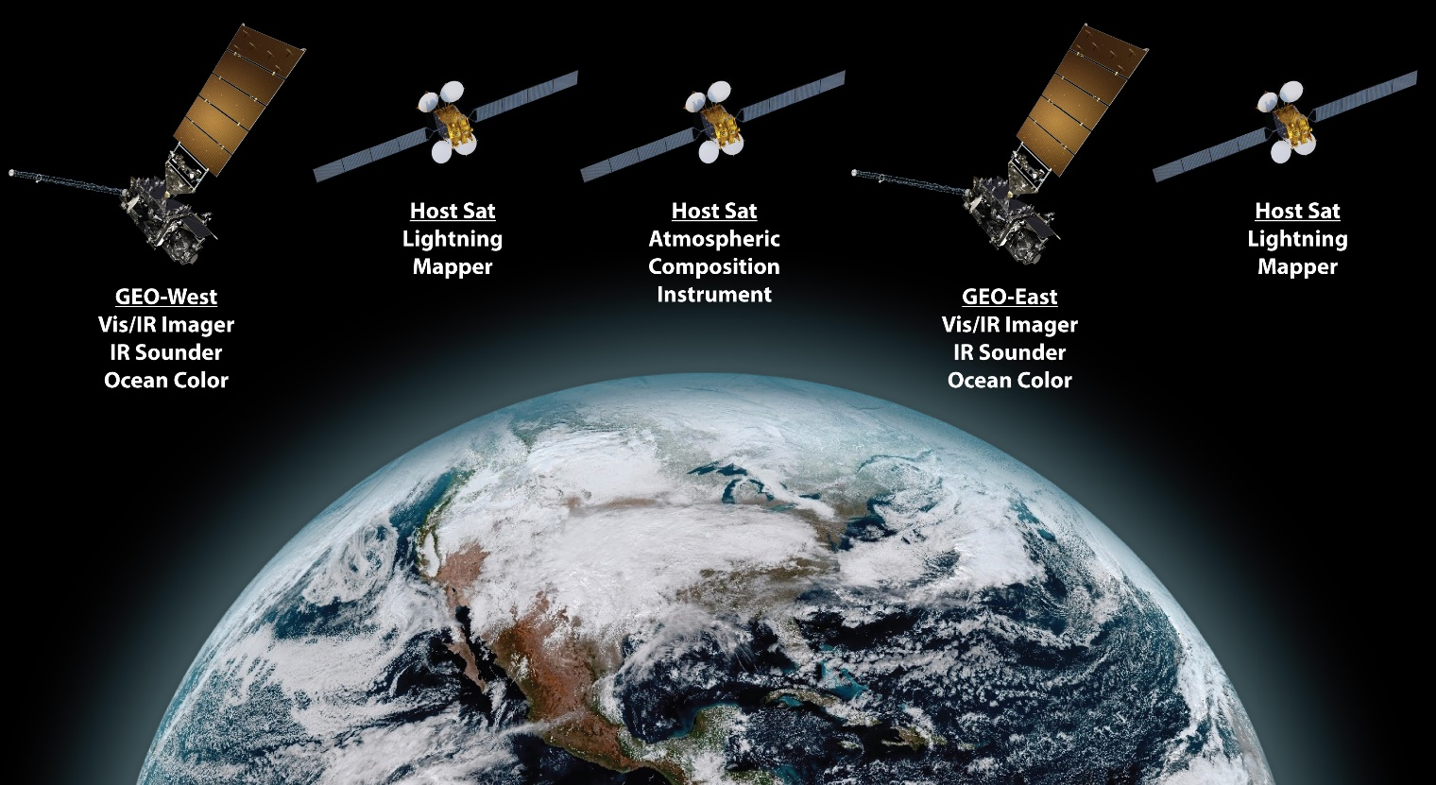
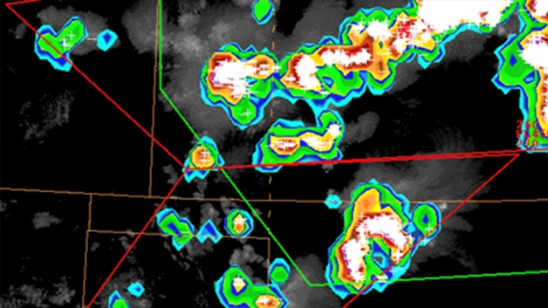
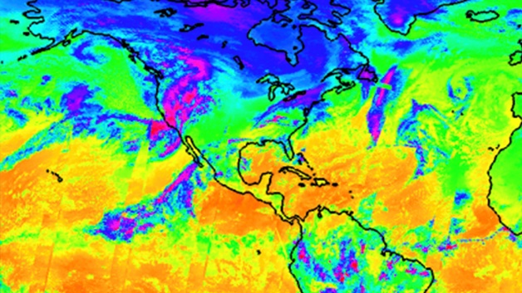
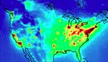
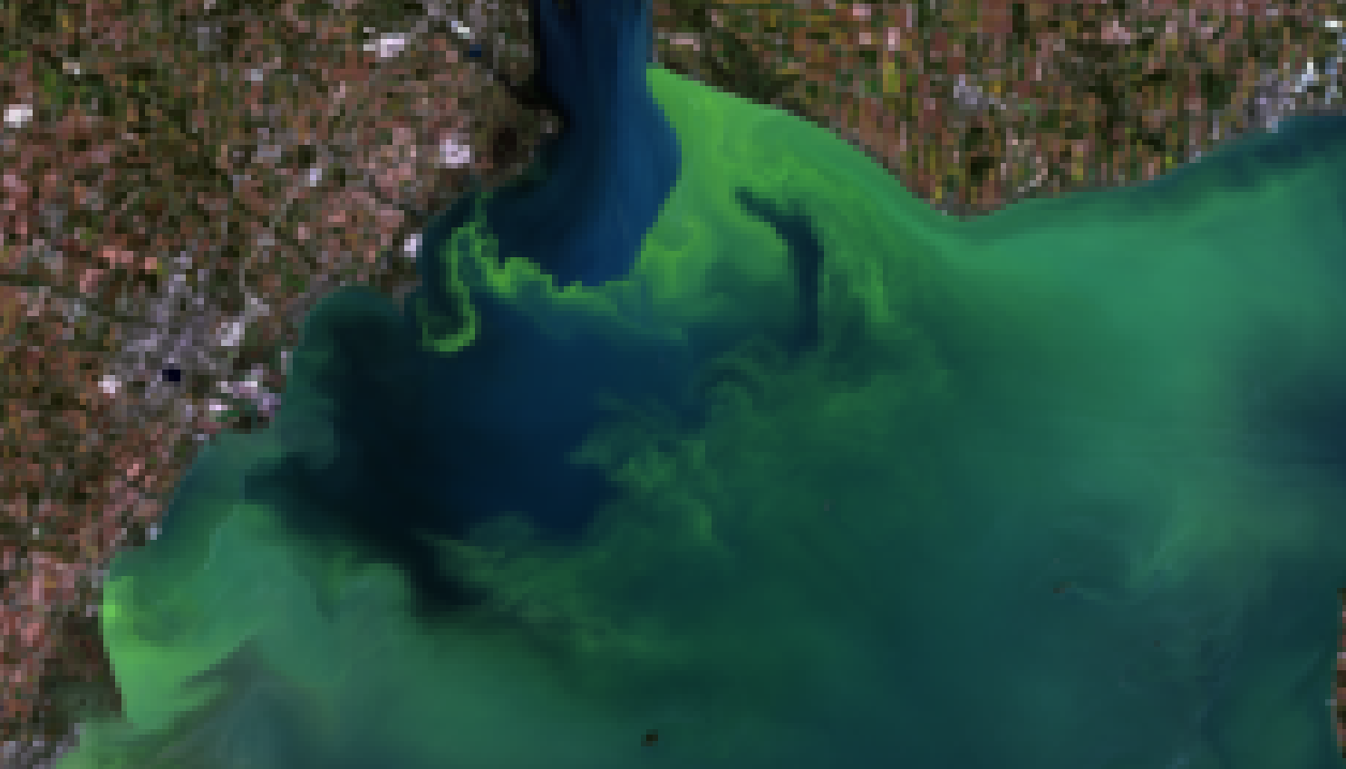
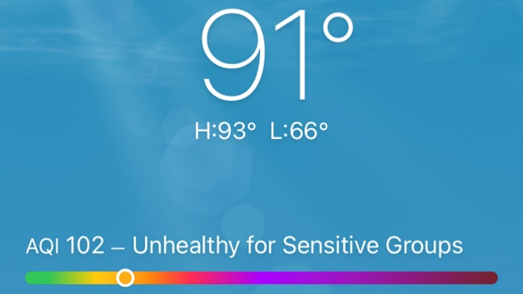
Introduction to the Geostationary Extended Observations (GeoXO) Mission
Joel McCorkel¹, Dan Lindsey², Jason Hair¹, Alexander Krimchansky¹, Ed Grigsby¹, Pam Sullivan²
¹NASA/GSFC, ²NOAA/NESDIS
Figure 1
Preliminary, pending program approval
Figure 2
Figure 3
High-resolution imagery
Day/night (low light) imagery
Figure 4
Figure 5
Lightning mapping
Hyperspectral infrared measurements
Figure 6
Figure 7
Atmospheric composition measurements
Ocean color measurements
Geostationary Extended Observations (GeoXO) is the mission following GOES-R to provide continuity for geostationary-based Earth observations. Planned for operations over the 2030-2050 timeframe, GeoXO will provide real-time, high-resolution visible and infrared (IR) imagery for monitoring Earth’s weather, oceans, and environment in addition to measurement capability for day/night visible imagery, hyperspectral infrared sounding, atmospheric composition, ocean color, as well as improved lightning mapping pending program approval.
Earth Sciences Division – Hydrosphere, Biosphere, and Geophysics

Slide 8
Name: Joel McCorkel, Biospheric Sciences Laboratory, NASA GSFC
E-mail: joel.mccorkel@nasa.gov
Phone: 301-614-6675
References:
Sullivan, P., “NOAA’s Geostationary Satellite System 2030–50,” 17th Annual Symposium on Operational Environmental Satellite Systems, American Meteorological Society Annual Meeting, 11 January 2021.
Lindsey, D., P. Sullivan, K. Schrab, J. Gerth, “Defining Requirements for NOAA’s Future Geostationary Satellite Observations,” 17th Annual Symposium on Operational Environmental Satellite Systems, American Meteorological Society Annual Meeting, 11 January 2021.
Krimchansky, A., M. Coakley, P. Jasper, J. McCorkel, D. Lindsey, J. Hair, E. Grigsby, P. Sullivan, “GEO-XO Architecture Trade Study: From Many to One,” 17th Annual Symposium on Operational Environmental Satellite Systems, American Meteorological Society Annual Meeting, 11 January 2021.
McCorkel, J., W. McCarty, L. Cucurull, K. Garrett, J. Li, T. Schmit, N. Prive, I. Morardi, J. Hair, D. Lindsey, A. Krimchansky, E. Grigsby, P. Sullivan, “Summary of OSSE Results Informing GEO-XO Formulation,” 17th Annual Symposium on Operational Environmental Satellite Systems, American Meteorological Society Annual Meeting, 11 January 2021.
Grigsby, E., F. Gallagher, P. Sullivan, D. Lindsey, V. Griffin, J. McCorkel, A. Krimchansky, M. Coakley, “The Value of a Hyperspectral Sounder to NOAA Operations,” 17th Annual Symposium on Operational Environmental Satellite Systems, American Meteorological Society Annual Meeting, 11 January 2021.
Technical Description of Figures:
Figure 1: NOAA is currently planning, pending approval, GeoXO operational constellation of several spacecraft and sensors. Spacecraft near the current GOES-East and GOES-West positions will carry an imager, infrared sounder, and ocean color instrument. Lightning mappers and an atmospheric composition sensor will be hosted by other spacecraft. The capabilities detailed in Fig 2-7 are pending program approval.
Figure 2: High-resolution imagery is the backbone of GeoXO Earth observations. The GeoXO imager will improve upon the GOES-R Advanced Baseline Imager by potentially providing additional spectral channels and higher resolution in select channels.
Figure 3: Low light measurements will provide nighttime imaging of severe weather and hazards in the visible spectrum. This will not be a separate instrument, but a capability of another instrument.
Figure 4: Lightning event mapping from geostationary orbit improves severe storm analysis, lightning hazard detection, hurricane intensity prediction, and improves aviation hazard classification.
Figure 5: Hyperspectral infrared measurements will provide real-time information about the vertical distribution of atmospheric temperature and water vapor which can better define initial conditions for numerical weather prediction models and improves short-term severe weather forecasting.
Figure 6: Atmospheric composition measurements from geostationary orbit will improve air quality monitoring to help mitigate health impacts from severe pollution and smoke events.
Figure 7: An ocean color imager will provide persistent measurements to help assess ocean productivity, ecosystem change, coast/inland water quality, and hazards like harmful algal blooms.
Scientific significance, societal relevance, and relationships to future missions:
Geostationary Extended Observations (GeoXO) is NOAA’s new satellite mission that will continue and expand observations provided by the Geostationary Operational Environmental Satellite (GOES) - R Series which is slated to end operational service in the mid 2030s. GeoXO will provide real-time, high-resolution visible and infrared imagery for monitoring Earth’s weather, oceans, and environment. Pending program approval, GeoXO will also bring new capabilities to address emerging environmental issues and challenges that threaten the security and well-being of every American: incorporation of day/night visible imagery, hyperspectral infrared sounding, atmospheric composition, and ocean color, as well as an improved lightning measurements. GeoXO is a NOAA program, supported by NASA. NASA will manage the development of the satellites and launch them for NOAA, which will operate them and deliver data to users worldwide. Industry partners are critical to meeting the mission. NOAA and NASA will work with commercial partners to design and build the GeoXO spacecraft and instruments. Instrument definition and design development studies are underway. For further reference: https://www.nesdis.noaa.gov/GeoXO
Earth Sciences Division – Hydrosphere, Biosphere, and Geophysics
Notes:
8

Slide 9
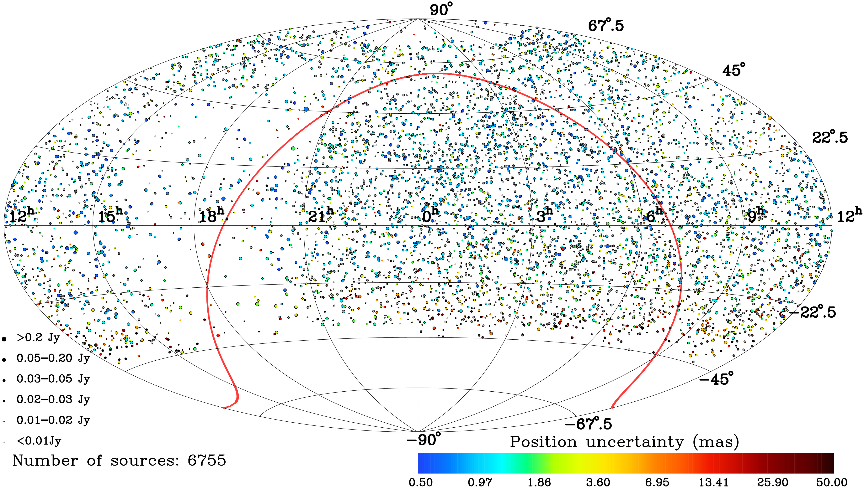
The wide-field VLBI survey reveals thousands of new compact extragalactic radio sources
Leonid Petrov NASA GSFC Code 61A
⁺
The active galactic nuclei (AGN) that host supermassive black holes are the most powerful objects in the Universe. When a jet powered by the matter falling to such a black hole points to the Earth, its radio emission can be seen virtually from any distance. Therefore, such objects are used as a reference for monitoring the Earth rotation, plate tectonic, and sea level changes, and well as for space navigation. These objects are rare. The new catalogue, based on Very Long Baseline Interferometry (VLBI) observations, reveals 6755 bright objects not known before – more than in all previous catalogues combined.
Earth Sciences Division – Hydrosphere, Biosphere, and Geophysics

Slide 10
Name: Leonid.Petrov, 61A, NASA GSFC
E-mail: Leonid.Petrov@nasa.gov
Phone: 301-614-5611
Reference:
Data Sources: Very Long Baseline Array.
Technical Description of Figures:
The figure shows the distribution of new discovered sources over the sky. The size of a circle is proportional to flux density – the source strength. The color represents the position uncertainty. The red line shows the Galactic plane.
Scientific significance, societal relevance, and relationships to future missions:
The catalogue of compact extragalactic radio sources lays the foundation of astronomy, astrophysics, and space geodesy. Most of these objects are located at distances over one billion light years. Due to enormous distance, their positions are very stable. They form the coordinate grid in space. Positions of other stars and galaxies are determined with respect to these reference objects. Continuous observations of active galactic nuclei are used by NASA for monitoring irregularities in the Earth rotation caused by redistribution of air and oceanic masses. Knowledge of these irregularities is necessary for correcting GPS orbits and for space navigation.
Petrov, L., "The wide-field VLBA calibrator survey -- WFCS," 2021, Astronomical Journal, 161(1), 15 (25pp). [10.3847/15383881/abc4e1]
Earth Sciences Division – Hydrosphere, Biosphere, and Geophysics
Notes:
10

