Slide 1
Analysis of GPM Microwave Imager Lake Effect
Snow Retrievals Provides Improvements to the
GPROF Operational Algorithm
Lisa Milani (Code 612, NASA/GSFC and UMD); M.S. Kulie (NOAA); D. Casella (ISAC-CNR); P.E. Kirstetter (NOAA); G. Panegrossi (ISAC-CNR); V. Petkovic (UMD); S.E. Ringerud (Code 612, NASA/GSFC and UMD; J-F. Rysman; P. Sanò (ISAC-CNR); N-Y. Wang (NOAA); Y. You (UMD); G. Skofronick-Jackson (NASA/HQ)
Quantitative precipitation estimates (QPE) of extreme lake-effect snow events are a big challenge for passive microwave remote sensing. The GPM Microwave Imager (GMI) high frequency channels can clearly detect intense shallow convective snowfall events over the United States lower Great Lakes region. However, GMI Goddard PROfiling (GPROF) QPE retrievals produce inconsistent results when compared against the Multi-Radar/Multi-Sensor ground-based radar reference dataset. More accurate surface classification and better representativeness of the GPROF a priori databases would represent an important step for improving lake-effect snow QPE.

Slide 2
Name: Lisa Milani, NASA/GSFC, Code 612 and UMD E-mail: lisa.milani@nasa.gov Phone: 301-614-5703
References:
Milani, L., et al. (2020). Extreme lake-effect snow from a GPM microwave imager perspective: Observational analysis and precipitation retrieval evaluation. Journal of Atmospheric and Oceanic Technology, doi: 10.1175/jtech-d-20-0064.1.
Data Sources: For performing this study, the 1C-R-GMI product (TBs) and the 2AGPROFGMI (precipitation rates and environmental information) have been used. These datasets are freely available through the NASA Precipitation Processing System (PPS) data archive (https://storm.pps.eosdis.nasa.gov/storm/). MRMS dataset is available online from the NASA Global Hydrology Center DAAC, Huntsville, Alabama, U.S.A. doi: http://dx.doi.org/10.5067/GPMGV/MRMS/DATA101 as cited by Kirstetter et al 2018. Snow depth and snowpack temperatures are available from the National Weather Service Snow Analysis at https://www.nohrsc.noaa.gov/nsa/ and the Lake Effect Snow Event Archive is available online at https://www.weather.gov/buf/lesEventArchive?season=2017-2018&event=A. Radiosondes data of National Weather Service Weather Forecast Office are available from the University of Wyoming College of Engineering website (http://weather.uwyo.edu/upperair/sounding.html) and the surface temperature analyses from NOAA Great Lakes Environmental Research Laboratory website (https://coastwatch.glerl.noaa.gov/glsea/glsea.html).
Technical Description of Figures:
Graphic: GPM orbit #4914 detecting and quantifying a lake effect snow event at 1226 UTC 9 January 2015 over Lakes Erie and Ontario. MRMS-GV snowfall rate (left), GPROF precipitation rate using SurfPrecip parameter from the standard product (center), and GPROF precipitation rate with ad hoc threshold and coastal application of snow-cover a priori database (right). The standard GPROF product does not detect the intense snow band and overproduces light snowfall rates over snow-covered regions, while the modified retrievals reproduce the observed MRMS snowfall rate more closely.
Scientific significance, societal relevance, and relationships to future missions: Lake-effect snow events have the potential to produce massive quantities of snow, severely impacting travel and commerce. Given the value of space-based observations of precipitation, especially in orographically complex regions, accurate quantification of snowfall is vital for local emergency management officials to ensure public safety; however, the shallow nature of these events and poorly characterized surface backgrounds present particular challenges for spaceborne precipitation sensors. This study focuses on the ability of the Global Precipitation Measurement (GPM) passive microwave sensors to detect and quantify extreme lake-effect snowfall events over the United States lower Great Lakes region. GPM Microwave Imager (GMI) high frequency channels can clearly detect intense shallow convective snowfall events. However, the GMI Goddard PROfiling (GPROF) retrievals produce inconsistent results when compared against the Multi-Radar/Multi-Sensor (MRMS) ground-based radar reference dataset. While GPROF retrievals adequately capture intense snowfall rates and spatial patterns of one event, GPROF systematically underestimates intense snowfall rates in another event. Furthermore, GPROF produces abundant light snowfall rates that do not conform with MRMS observations. Ad-hoc precipitation rate thresholds (PRT) are suggested to partially mitigate GPROF’s overproduction of light snowfall rates. The sensitivity and retrieval efficiency of GPROF to key parameters (2-meter temperature, total precipitable water, and background surface type) used to constrain the GPROF a-priori retrieval database are investigated. Results demonstrate that typical lake-effect snow environmental and surface conditions, especially coastal surfaces, are underpopulated in the database, adversely affecting GPROF retrievals. Using a snow-cover a-priori database in the locations originally deemed coastline improves retrieval. This study suggests that it is particularly important to have more accurate GPROF surface classification and better representativeness of the a-priori databases to improve intense lake-effect snow detection and retrieval performance. The results of this work will be particularly useful for the Aerosols, Clouds, Convection, and Precipitation Decadal Survey concept that will pair relevant radiometer bands with radars much more suited for observing snowfall than the current generation of spaceborne cloud and precipitation radars.
Earth Sciences Division - Atmospheres
Notes:
2

Slide 3
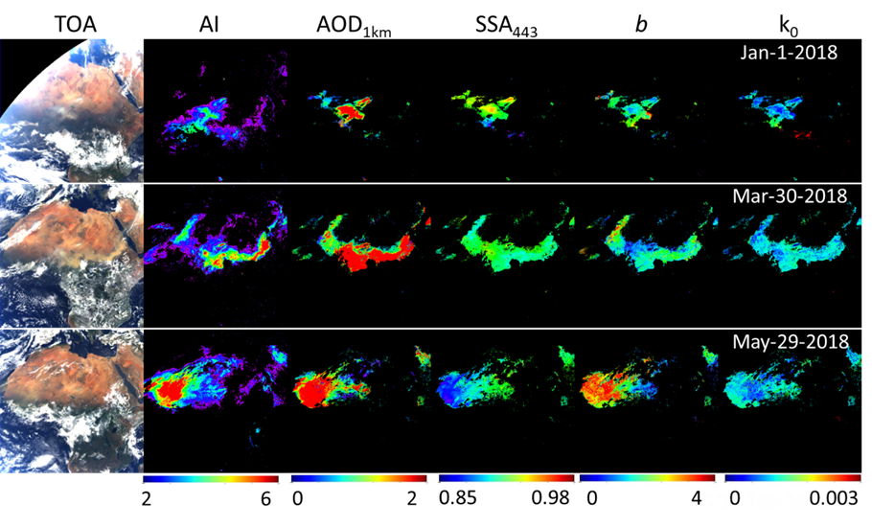
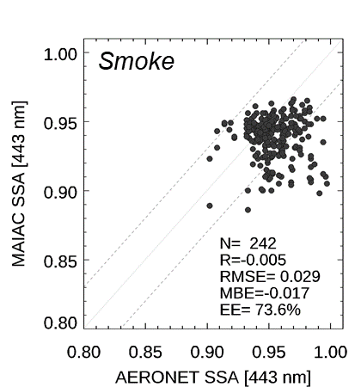
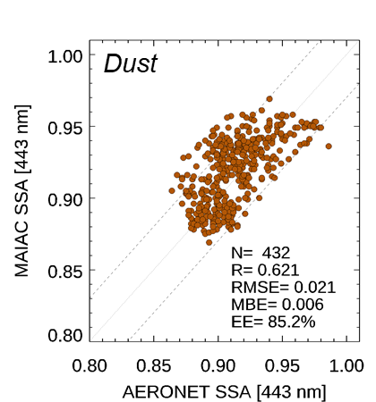
Spectral Aerosol Absorption from DSCOVR EPIC
A. Lyapustin, Code 613 NASA GSFC; S. Go, UMBC; Y. Wang, UMBC; S. Korkin, USRA
We developed a new capability for simultaneous retrieval of aerosol optical depth (AOD) and spectral absorption of biomass burning smoke and mineral dust from DSCOVR EPIC observations in the UV-Visible part of spectrum. It is integrated in version 2 (v2) MAIAC EPIC atmospheric correction algorithm which recently completed re-processing of the EPIC 2015-2020 data record. Besides AOD, spectral surface reflectance and BRDF, v2 MAIAC reports at 10km resolution aerosol single scattering albedo (SSA) at 443nm, imaginary refractive index at 680nm (k₀) and spectral absorption exponent (b) characterizing dependence k(λ).

Slide 4
Name: Alexei Lyapustin, NASA/GSFC Code 613 E-mail: Alexei.I.Lyapustin@nasa.gov Phone: 301-614-5998
References:
Lyapustin, A., S. Go, S. Korkin, Y. Wang, O. Torres, H. Jethva, A. Marshak: Retrievals of Aerosol Optical Depth and Spectral Absorption from DSCOVR EPIC, Frontiers Remote Sensing, in review, 2021.
Lyapustin, A., Wang, Y., Korkin, S., and Huang, D.: MODIS Collection 6 MAIAC Algorithm, Atmos. Meas. Tech., 11, 5741-5765, https://doi.org/10.5194/amt-11-5741-2018, 2018.
Torres, O., Ahn, C., & Chen, Z., Improvements to the OMI near-UV aerosol algorithm using A-train CALIOP and AIRS observations. Atmos. Meas. Tech., 6(11), 3257-3270, 2013.
Schuster, G., O. Dubovik, and A. Arola (2016), Remote sensing of soot carbon – Part 1: Distinguishing different absorbing aerosol species, Atmos. Chem. Phys., 16, 1565-1585, doi:10.5194/acp-16-1565-2016.
Data Sources: v2 MAIAC EPIC products are currently being released; v1 MAIAC EPIC (https://doi.org/10.5067/EPIC/DSCOVR/L2_MAIAC.001), AERONET dataset (https://aeronet.gsfc.nasa.gov).
Technical Description of Figures:
Images: (Center) Illustration of v2 MAIAC EPIC retrievals for Saharan dust storms originating from Bodele depression (Jan. 1, 2018), Arabian peninsula (Mar. 29, 2018) and west Africa (May 29, 2018). The panels show EPIC top of atmosphere (TOA) RGB image, and unitless Aerosol Index (AI) from 340 and 388nm, aerosol optical depth (AOD_{1km}) for effective height 1km, Single Scattering Albedo at 443nm (SSA₄₄₃), spectral absorption exponent (b) and imaginary refractive index at 680nm (k₀). (Right) AERONET-based validation of SSA₄₄₃ for the wildfire smoke over North America in 2018 (top) and for mineral dust over greater Sahara region in 2018 (bottom). Validation for smoke/dust is presented for an effective aerosol layer height of 4km and 1km, respectively.
Scientific significance, societal relevance, and relationships to future missions: Aerosol absorption has a high natural variability and is poorly constrained in models. This makes it one of the largest sources of uncertainty in assessments of aerosol direct radiative effects and in current climate projections [IPCC 2013]. Information on spectral dependence of aerosol absorption provides a pathway to the speciation of absorbing aerosol components [e.g., Schuster et al., 2016] – information required in climate modeling and in Air Quality research. In v2 MAIAC EPIC algorithm, we developed a capability to simultaneously retrieve AOD and spectral aerosol absorption using the following model for spectral imaginary refractive index k_{λ}= k₀ (λ/ λ₀)^{-b}, where λ₀ = 680nm. The Levenberg-Marquardt optimal minimization algorithm is used to find (AOD, b, k₀) by matching EPIC observations at 340, 388, 443 and 680nm. An initial validation of single scattering albedo over North America and northern Africa in 2018 shows good agreement with AERONET, typically within the AERONET uncertainty of ±0.03.
Earth Sciences Division - Atmospheres
Notes:
4

Slide 5
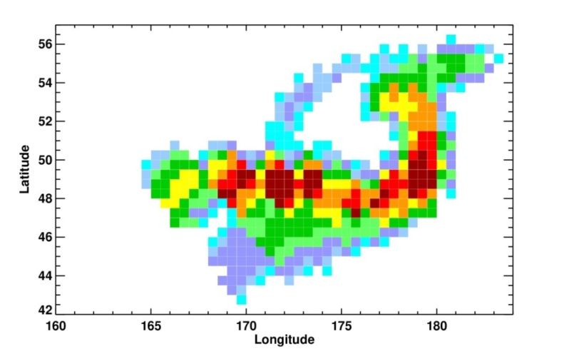
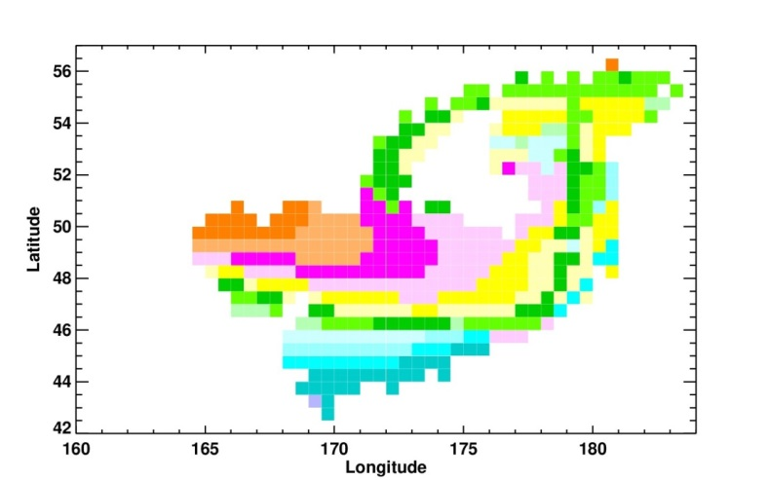
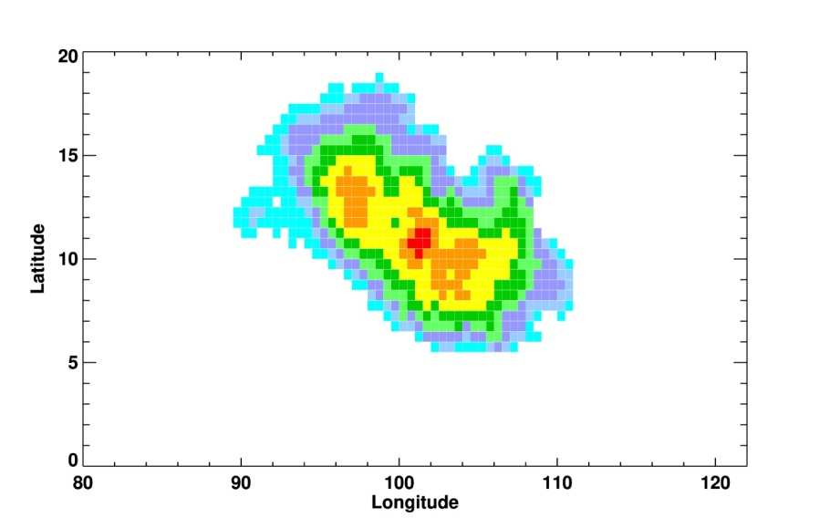
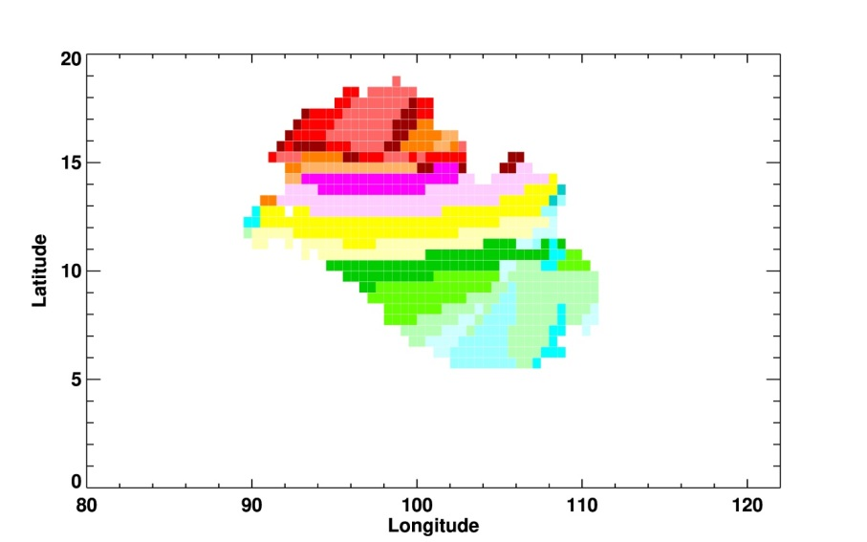
Calculating the Height of Volcanic Cloud SO₂ With a Lagrangian Trajectory Tool: Raikoke (2019) and Pinatubo (1991) Cases. Gorkavyi, N., Krotkov, N., Li, C., Lait, L., Vasilkov, A., Colarco, P., Joiner, J., Schoeberl, M., Carn, S., Fisher, B.
We developed a tool to reconstruct the altitude of SO₂ clouds ejected by a volcanic eruption. We obtained a distribution of SO₂ altitudes between 2 and 15 km in different parts of the SO₂ clouds (a-b) from the Raikoke eruption in June 2019. For the June 15, 1991 Pinatubo eruption, we similarly obtained a wide distribution of SO₂ heights from 10-25 km. To validate the plume heights we use independent sources of information such as the SNPP/OMPS Limb Profiler or CALIPSO/CALIOP lidar.
a
SO₂
OMPS/NM
b
H-solution
for Raikoke
Standard estimation
SO₂ with H=13 km: 1.19*10⁶ tn;
After recalculation of
SO₂ for the calculated distribution of heights:
1.40*10⁶ tn or
18% more.
Raikoke,
June 22, 2019
0 1 2 5 10 25 50 100 150
SO₂ (VCD)
50 75 100 150 200 250 300 350 400
c
SO₂, TOMS
d
H-solution
for Pinatubo
We found that the southern part of the Pinatubo plume is located in the troposphere, and the northern part is in the stratosphere.
Pinatubo, June 17, 1991

Slide 6
Nick Gorkavyi (nick.gorkavyi@ssaihq.com)
References: Gorkavyi, N., Krotkov, N., Li, C., Lait, L., Vasilkov, A., Colarco, P., Joiner, J., Schoeberl, M., Carn, S., Fisher, B. Calculating the Height of Volcanic Cloud SO₂ With a Lagrangian Trajectory Tool: Raikoke (2019) and Pinatubo (1991) Cases (presentations for AGU-2020 and AMS-2021; paper in preparation)
Data Sources:
The SO₂ data for OMI, OMPS, TOMPS and TROPOMI data are available at https://so2.gsfc.nasa.gov/ and GES DISC.
Technical Description of Figures:
Raikoke plume (30 h after eruption): Satellite retrieved SO₂ Vertical Column Density (VCD) in Dobson units (NASA/Suomi/OMPS/NM)
Raikoke plume: Estimated SO₂ height using a Lagrangian backward trajectories
Pinatubo plume (2 days after eruption): Satellite retrieved SO₂ Vertical Column Density (VCD) in Dobson units (NASA/TOMS)
Pinatubo plume: Estimated SO₂ height using a Lagrangian backward trajectories.
Scientific significance, societal relevance, and relationships to future missions:
We have developed a new trajectory tool to predict the position and heights of SO₂/aerosol clouds ejected by a volcanic eruption. We initialize the model using SO₂ or aerosol column 2D observations from nadir looking satellite UV spectrometers, such as SNPP/OMPS, Aura/OMI or Sentinel-5 Precursor (TROPOMI) within 1-2 days after a volcanic eruption. Next, we create a 3D model of the volcanic cloud at the overpass time, reconstructing the vertical distribution using backward trajectories to the volcano location.
For near real time cloud predictions (which is important for the protection of the population and aircraft), we use forward trajectory modeling with input wind fields from the Goddard Earth Observing System (GEOS) Earth system model. This allows us to create a short-term 4D concentration forecasts to improve SO₂/aerosol satellite retrievals and to assimilate into GEOS model. We demonstrate our tool for predicting the dispersion of SO₂ clouds after the June 21, 2019 Mt. Raikoke eruption. We create an initial 3D model of the cloud based on the SNPP/OMPS column SO₂ observations and then compare to the SO₂ observations by TROPOMI. Good agreement between the predicted and observed 2D distributions SO₂ shows that this method can be used for near real time prediction of the dispersion of volcanic gases and aerosols for air quality alerts and aviation avoidance.
Earth Sciences Division - Atmospheres

