Slide 1
Assessment of ICESat-2 sea ice surface classification with Sentinel-2 imagery: implications for freeboard and new estimates of lead and floe geometry Alek Petty^{1,2}, M. Bagnardi^{1,3}, N. Kurtz¹, R. Tilling^{1,2}, S. Fons^{1,4}, T. Armitage, C. Horvat⁵, Ron Kwok⁶
¹Code 615, NASA GSFC , ²ESSIC/UMD, ³ADNET, ⁴AOSC/UMD, ⁵Brown, PI, ⁶UW, WA
Sentinel-2 imagery (Arctic Ocean, 05/26/19)
lead
ICESat-2 gt2l (strong beam)
ice floe
S-2 reflectance
ICESat-2
lead estimate
We compared ~600 km of ICESat-2 laser altimetry data with coincident imagery collected by the Copernicus Sentinel-2 mission.
ICESat-2 specular leads (gaps between ice floes) show strong agreement with the S-2 imagery, with caveats.
We have produced new basin-scale estimates of lead fraction and ice floe size from ICESat-2.
Earth Sciences Division – Hydrosphere, Biosphere, and Geophysics

Slide 2
Name Alek Petty, Cryospheric Science Lab, NASA GSFC E-mail: alek.a.petty@nasa.gov
Phone: 301.614.6120
References:
Petty, A. A., Bagnardi, M., Kurtz, N., Tilling, R., Fons, S., Armitage, T., et al. (2021). Assessment of ICESat‐2 sea ice surface classification with Sentinel‐2 imagery: implications for freeboard and new estimates of lead and floe geometry. Earth and Space Science, 8, e2020EA001491. https://doi.org/10.1029/2020EA001491
Code Source: Our open-source sea ice state code is on GitHub (https://github.com/akpetty/ICESat-2-sea-ice-state)
Data Sources: Sentinel-2 imagery was derived from Copernicus data obtained at https://schihub.copernicus.eu. The ICESat-2 ATL07 (sea ice height and type) and ATL10 (freeboard) data products used here are available through the NSIDC (https://nsidc.org/data/atl07 & https://nsidc.org/data/atl10). The lead fraction and chord length estimates derived in this study are available on Zenodo: https://doi.org/10.5281/zenodo.4075390.
Technical Description of Figures:
Figure 1: (top panel) Sentinel-2 image collected over the Lincoln Sea of the Arctic Ocean on May 25th 2019 with ICESat-2 ATL07 profile (gt2l ground-track, strong beam in this spacecraft orientation) overlaid showing the sea surface flag (ssh_flag, red = ice, yellow = sea surface). (bottom) Surface reflectance calculated from the red band of the Sentinel-2 image from nearest neighbor pixels to the ICESat-2 profile. Vertical lines show sea surface height (SSH) classified ICESat-2 segments. Distance between SSH estimates provide an estimate of ice floe size.
Scientific significance, societal relevance, and relationships to future missions:
NASA's ICESat-2 mission was launched in September 2018 with the primary goal of monitoring our rapidly changing polar regions. The sole instrument onboard is a highly precise laser which is now providing routine, very high-resolution, surface height measurements across the globe, including over the Arctic and Southern Oceans. The coincident Sentinel-2 (S-2)/ICESat-2 scenes provide crucial validation of the ICESat-2 sea ice classification procedure, with the caveat that these represent only a small fraction of the available sea ice data produced from ICESat-2 to-date. The specular lead classification in the sea ice products shows strong agreement with the imagery across all beams, while the reliability of the smaller quantity of dark leads found in these profiles was more questionable. more work is needed to improve and refine the ICESat-2 sea ice data.
Earth Sciences Division – Hydrosphere, Biosphere, and Geophysics
Notes:
2

Slide 3
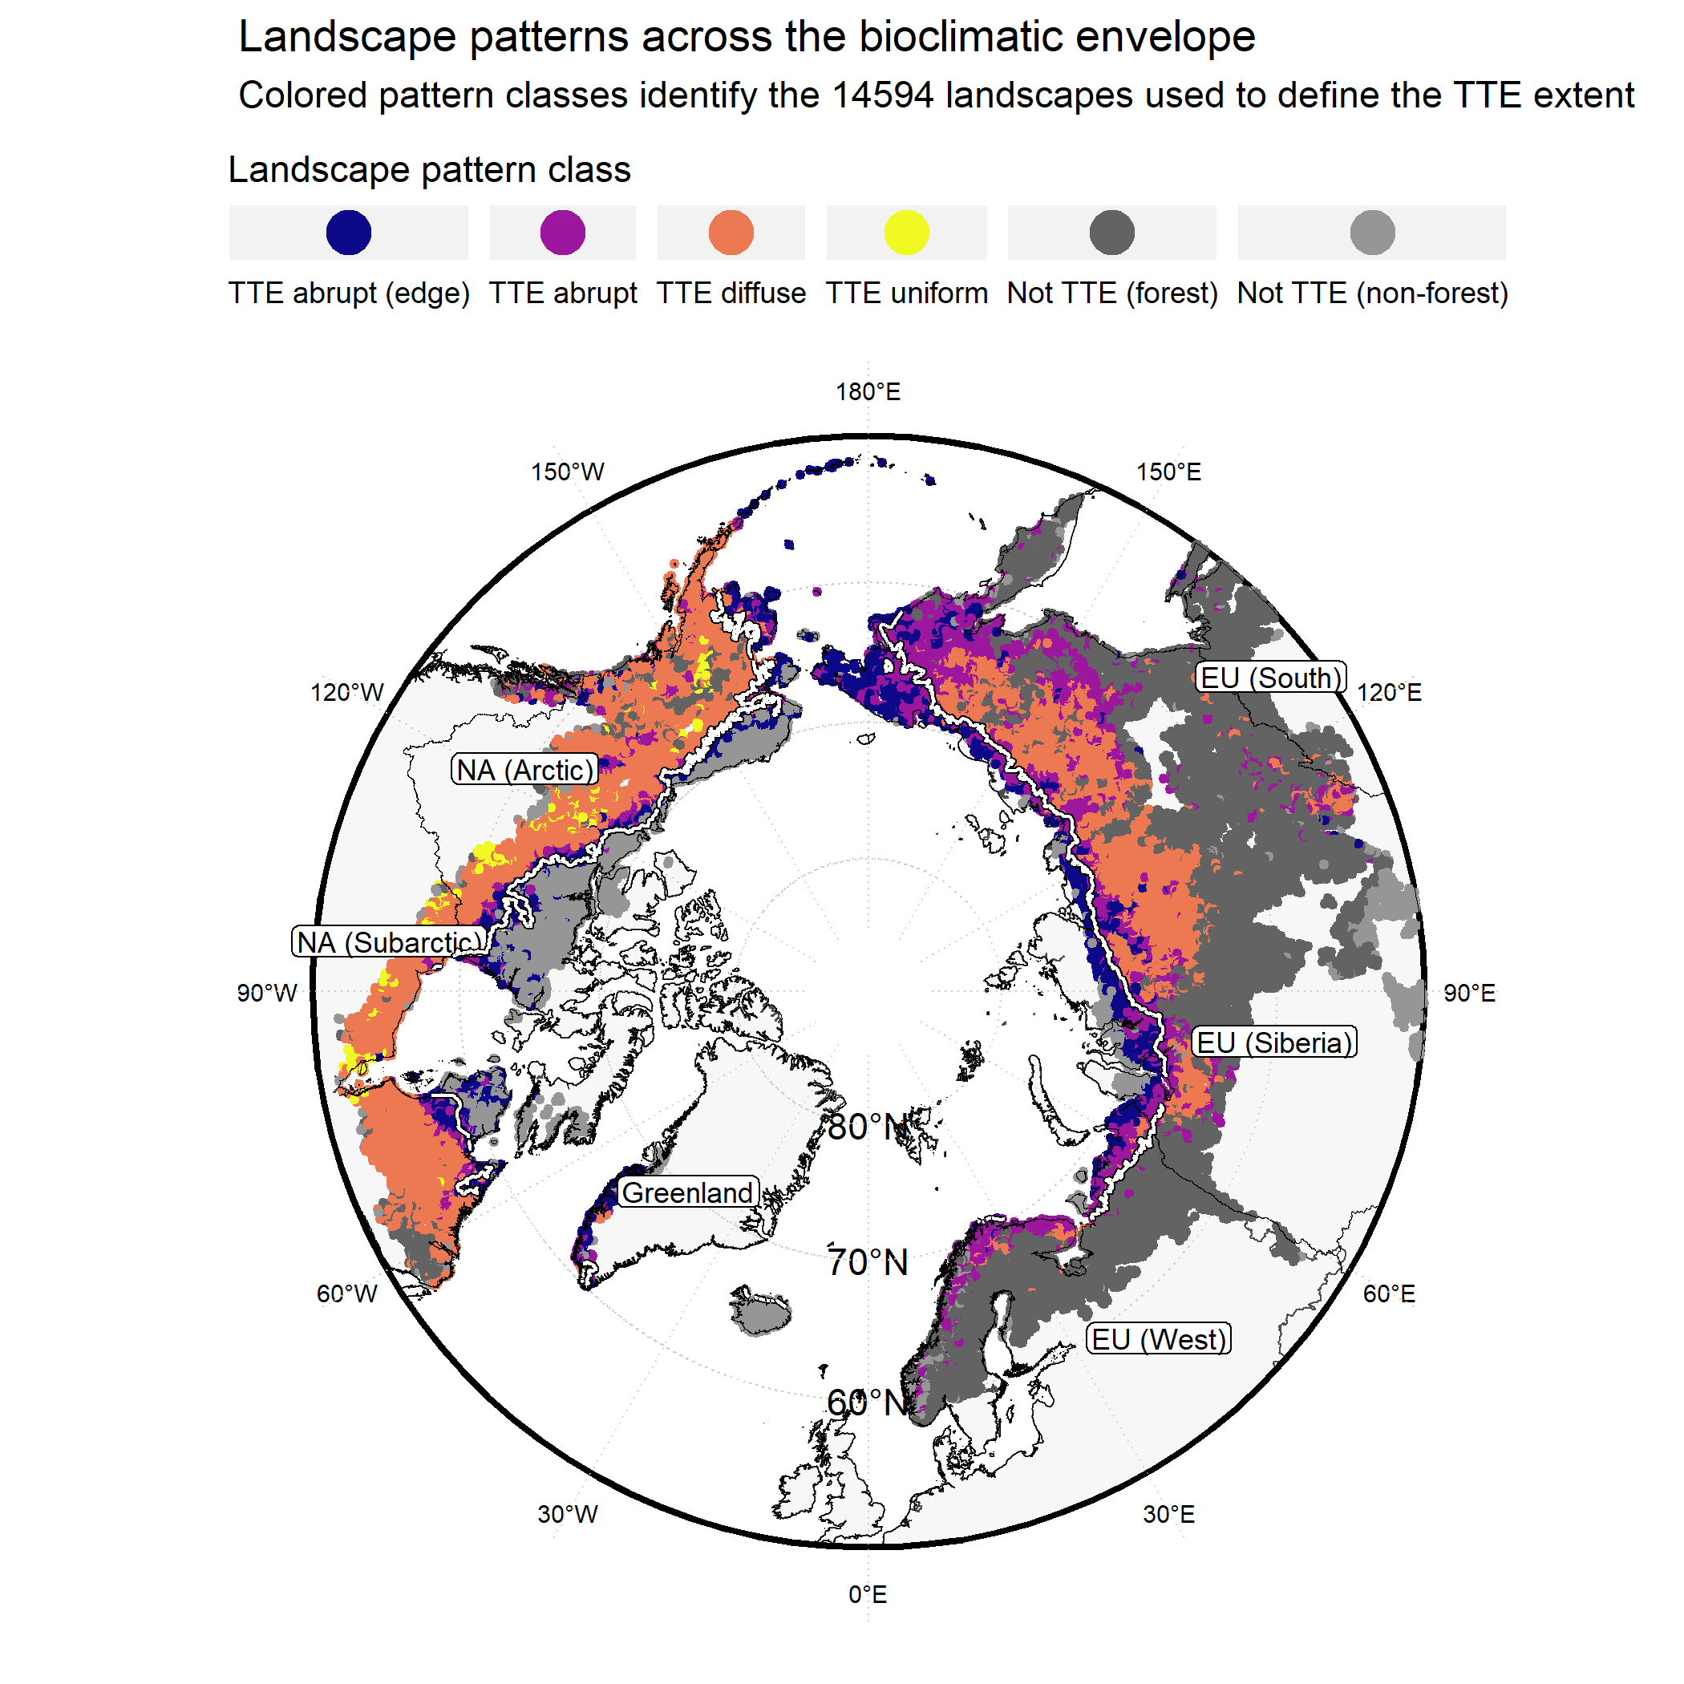
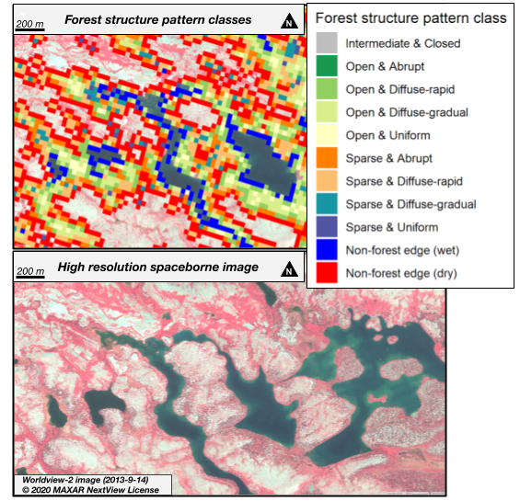
The bioclimatic extent and pattern of the cold edge of the boreal forest:
the taiga-tundra ecotone
P.M. Montesano^{1,2}, C.S.R. Neigh¹, M. Macander³, M. Feng⁴, P. Noojipady^{1,5}
¹Biospheric Sciences Laboratory, NASA-GSFC; ²Science Systems Applications Inc.; ³ABR Inc.; ⁴terraPulse Inc.; ⁵Terrestrial Information Systems Laboratory
A
B
We examined the extent and pattern of tree canopy cover (TCC) for 3 million km² of boreal forest in the taiga-tundra ecotone. We summarized gradients of TCC (Fig. A) capturing abrupt, diffuse, and uniform forest patterns at landscape scales (Fig. B). This benchmark enables identification of priority sites that may change with climate warming.
Area of detail in Northern Quebec, CA
Earth Sciences Division – Hydrosphere, Biosphere, and Geophysics

Slide 4
Name: Christopher S.R. Neigh, 618, NASA GSFC E-mail: christopher.s.neigh@nasa.gov Phone: 301-614-6681
References:
Montesano, P. M.; Neigh, C. S. R.; Macander, M.; Feng, M.; Noojipady, P. The Bioclimatic Extent and Pattern of the Cold Edge of the Boreal Forest: The Circumpolar Taiga-Tundra Ecotone. Environ. Res. Lett. 2020, 15 (10), 105019. https://doi.org/10.1088/1748-9326/abb2c7.
Data Sources: Landsat 8 Operational Land Imager Surface Reflectance imagery and Landsat 7 Enhanced Thematic Mapper + 30 m remote sensing imagery were used with the Circumpolar Arctic Vegetation Map (CAVM), WorldClim (Version 2) bioclimatic variables and the World Wildlife Fund terrestrial ecoregions as a coarse scale mask to constrain the limits of the bioclimatic envelope of the study domain.
Technical Description of Figures:
Figure 1: A) Example, in northern Quebec, CA of the forest structure pattern classes that, along with a bioclimatic envelope, denote the taiga-tundra ecotone (TTE). This area of detail show where classified forest structure pattern is overlain on imagery from Worldview-2 at ~2 m resolution. In this area of detail, water appears dark, and non-vegetated areas appear white. Across the circumpolar TTE, 0.697 million km² is non-forest edge, 0.549 million km² is sparse forest, and 1.787 million km² is open canopy forest.
B) Landscape patterns show landscape scale forest structure patterns in the taiga-tundra ecotone. Diffuse forest landscapes dominate the TTE (79%), and abrupt landscapes (~19%) indicate portions of the TTE where sparse forest and non-forest edge are the prevailing structural patterns. This account of the TTE quantifies the area of the cold edge of the boreal forest where previous global estimates show high discrepancies, and can help target monitoring and prediction of circumpolar dynamics. We classified 14,594 landscapes as those associated with the TTE within a circumpolar bioclimatic envelope (11.575 million km²), where 44.83% of the area of these landscapes were forest and non-forest edge, yet 36.43% contributed to the TTE extent. We report the overall extent of the TTE (3.032 million km²) across North America (including Greenland) (53%), and Eurasia (47%).
Scientific significance, societal relevance, and relationships to future missions: Establishing a 30-m resolution benchmark of the TTE biome boundary is critical to understand future change induced by global climate warming, and landscape scale aggregations of these 30-m pixels help identify the extent of this transition zone. Our results provide a mesoscale reference that can be used to target priority areas to study in greater detail with ICESat-2, NISAR, Landsat-9 and higher-resolution systems.
Earth Sciences Division – Hydrosphere, Biosphere, and Geophysics

