Slide 1
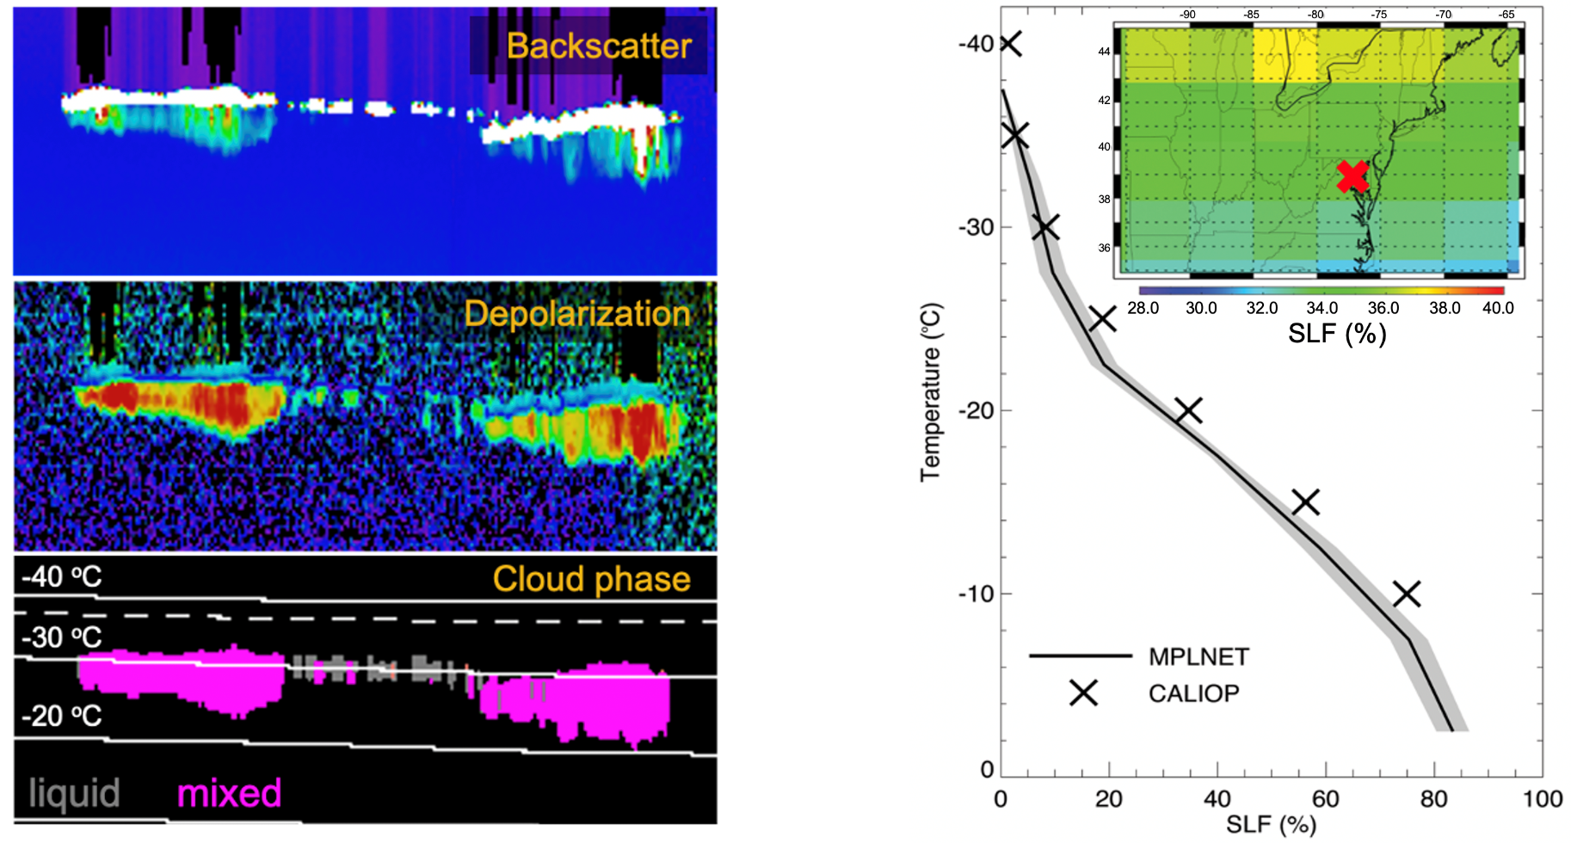
Polarized Micro Pulse Lidar Retrievals Provide Vertical
Observations of Cloud Thermodynamic Phase Jasper Lewis (Code 612, NASA/GSFC and UMBC/JCET); Ellsworth Welton (Code 612, NASA/GSFC);
James Campbell (NRL); Sebastian Stewart (SSAI), Ivy Tan (McGill Univ.); Simone Lolli (CNR-IMAA)
A new algorithm developed by MPLNET distinguishes cloud thermodynamic phase based on the volume depolarization ratio, which is a proxy for particle shape. Ice particles, which are irregularly-shaped, have higher volume depolarization ratios than spherically-shaped liquid water droplets. In between -40 ○C and 0 ○C, clouds can exist as liquid, ice or mixed phase. A comparison to satellite-derived supercooled liquid water fractions (SLF) from CALIOP shows good agreement.

Slide 2
Name: Jasper Lewis, NASA/GSFC, Code 612, UMBC/JCET E-mail: jasper.r.lewis@nasa.gov Phone: 301-614-6721
References:
Lewis, J. R., Campbell, J. R., Stewart, S. A., Tan, I., Welton, E. J., and Lolli, S. (2020): Determining cloud thermodynamic phase from the polarized Micro Pulse Lidar, Atmospheric Measurement Techniques, 13, 6901–6913, https://doi.org/10.5194/amt-13-6901-2020.
Data Sources: The NASA Micro Pulse Lidar Network (MPLNET) is funded by the NASA Earth Observing System and the NASA Radiation Sciences Program. The GEOS-5 meteorological data were provided by the NASA Global Modeling and Assimilation Office (GMAO) at GSFC. CALIPSO/CALIOP data were obtained from the NASA Langley Research Center Atmospheric Science Data Center.
Technical Description of Figures:
Graphic 1: (Left) Example of the normalized relative backscatter (top), volume depolarization ratio (middle), and cloud thermodynamic phase retrieval (bottom) at GSFC on 5 October 2019. These cloud layers have an altitude of about 8 – 9 km. The lidar return signal from liquid water droplets exhibits high backscatter (white color) and low depolarization (purple-blue color), while the return from ice particles shows low backscatter (green color) and high depolarization (yellow-red color). The phase mask indicates the presence of liquid water clouds (grey) and mixed-phase clouds (magenta). The GEOS-5 temperature is shown by the contour lines (in 10 ○C intervals). The -37 ○C isotherm, above which all clouds are considered to be in the ice phase, is indicated by the dashed contour line.
Graphic 2: (Right) Supercooled liquid fraction (SLF) averaged over GSFC (2015–2019) from observations by MPLNET (solid line) and the CALIOP instrument aboard the CALIPSO satellite (black ✖️). The inset shows the horizontal distribution of CALIOP SLFs at the -20 ○C isotherm surrounding GSFC (indicated by the red ✖️). The CALIOP SLF profile is calculated using the 2.5○ latitude x 5○ longitude grid box containing GSFC. The shaded area indicates the standard error for MPLNET observations. CALIOP standard errors are less than 0.7 at all isotherms. Satellites, like CALIPSO, provide good spatial coverage but poor temporal sampling. In contrast, ground sites in MPLNET provide poor spatial coverage globally; however, continuous observations
at a 1 min data rate provide full diurnal sampling. Despite the different sampling volumes and detection methods for ground-based and spaceborne measurements, these complementary platforms show reasonable agreement. Furthermore, the inset suggests that the correlation lengths for SLF may be rather large, based on the similar values for adjacent grid boxes.
Scientific significance, societal relevance, and relationships to future missions: Future changes in Earth’s climate may result in changes in the occurrence and global distribution of cloud types, so it is important to record and monitor cloud phases across all climate regions. Furthermore, more frequent and diverse observations of cloud phase (in particular, ice and mixed phase) are needed to improve cloud parameterizations in numerical weather prediction and climate models. The ability to provide continuous observations of cloud properties, including thermodynamic phase, across all climate regions using a standardized instrument and retrieval process is a distinctive feature of MPLNET. In future studies, we endeavour to explore how cloud properties differ amongst MPLNET sites and explain the differences between satellite and ground-based lidar measurements. This work also aligns with a goal of the Aerosols, Clouds, Convection and Precipitation (ACCP) mission - to improve our understanding of cold (supercooled liquid, ice, and mixed phase) cloud processes.
Earth Sciences Division - Atmospheres
Notes:
2

Slide 3
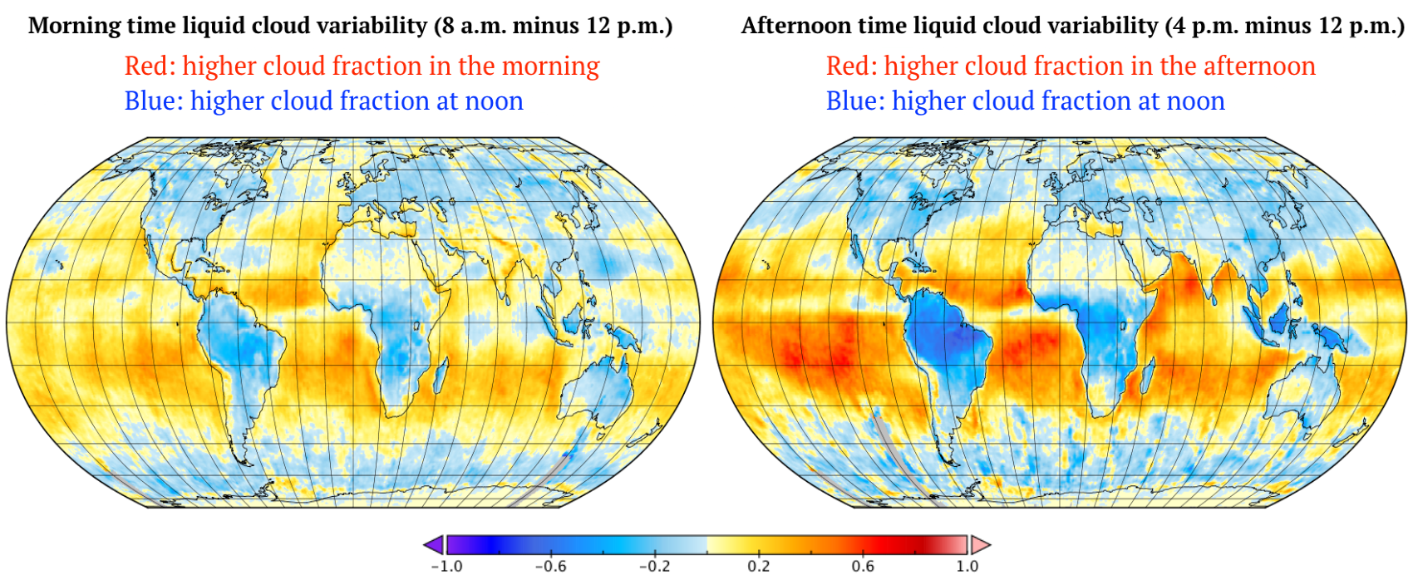
Global daytime cloud amount variability from DSCOVR/EPIC observations
Alfonso Delgado-Bonal^{1,2}, Alexander Marshak¹, Yuekui Yang¹ and Lazaros Oreopoulos¹,
¹NASA/GSFC, Code 613, ² USRA
EPIC’s observations from the first Lagrange point L1 capture the planet’s entire sunlit side and provide cloud fraction at different local times. Aggregation of four years of daytime liquid cloud fraction reveals more liquid phase clouds over land and fewer over ocean around noon compared to morning (left image) and afternoon (right image). The maps above are specific to boreal spring (March-April-May).

Slide 4
Name: Alfonso Delgado-Bonal, NASA/GSFC, Code 613, and USRA-GESTAR E-mail: alfonso.delgadobonal@nasa.gov Phone: 301-614-6293
Reference:
Delgado‐Bonal, A., Marshak, A., Yang, Y., & Oreopoulos, L. (2020). Global daytime variability of clouds from DSCOVR/EPIC observations. Geophysical Research Letters, 48, e2020GL091511. https://doi.org/10.1029/2020GL091511
Data Sources: NASA DSCOVR EPIC Level 2 – Cloud products Version 1, available at the NASA's Atmospheric Science Data Center (ASDC): https://eosweb.larc.nasa.gov/project/dscovr/dscovr_epic_l2_cloud_01
Technical Description of Figures:
Graphic 1: The figures present the morning (left) and afternoon (right) global variability of cloud fraction for boreal spring (March-April-May). The EPIC instrument aboard the DSCOVR satellite observes the recurring sunlit disc reflectance at 10 wavelengths (317, 325, 340, 388, 443, 551, 680, 688, 764 and 780 nm) either every hour (boreal winter) or every two hours (boreal summer). For each observation, combining EPIC’s UTC time of acquisition and the longitude of each pixel, we determine the local time (LT) cloud fraction for every observed pixel. Then, we split the data of each full disk granule into local LT hourly bins, creating 24 local time maps for each image. We repeat this process for four years of data from June 2015 to June 2019 (approximately 16500 granules) and average the results on each local hour independently for each of four seasons. Following this methodology, we obtain seasonal average maps of cloud fraction at all local times. The figures show the differences in cloud fraction between 8 a.m. and noon (left), and between 4 p.m. and noon (right).
Scientific significance, societal relevance, and relationships to future missions: Knowledge of the daytime variability of cloud fraction is pivotal for the accurate determination of the atmosphere's energy balance. Leveraging EPIC observations from the Lagrange L1 point, allows us to overcome common limitations of measuring global cloud variability such as (i) the fixed day time acquisition time of polar orbit observations; (ii) the regionality of geostationary satellites; and (iii) the combination of different sources of observations (as in ISCCP – the International Satellite Cloud Climatology Project). Our diurnal values of cloud fraction with hourly resolution come from a single sensor and can be used to benchmark for GCMs and improve our knowledge of the effect of diurnal cloud fraction variability on climate evolution. These findings show that there are more liquid water clouds over land and fewer over ocean around noon compared to morning and afternoon. In contrast, the daytime cycle of ice clouds is independent of the underlying surface type, with larger cloud fraction in the morning and afternoon compared to noon.
Earth Sciences Division - Atmospheres
Notes:
4

Slide 5
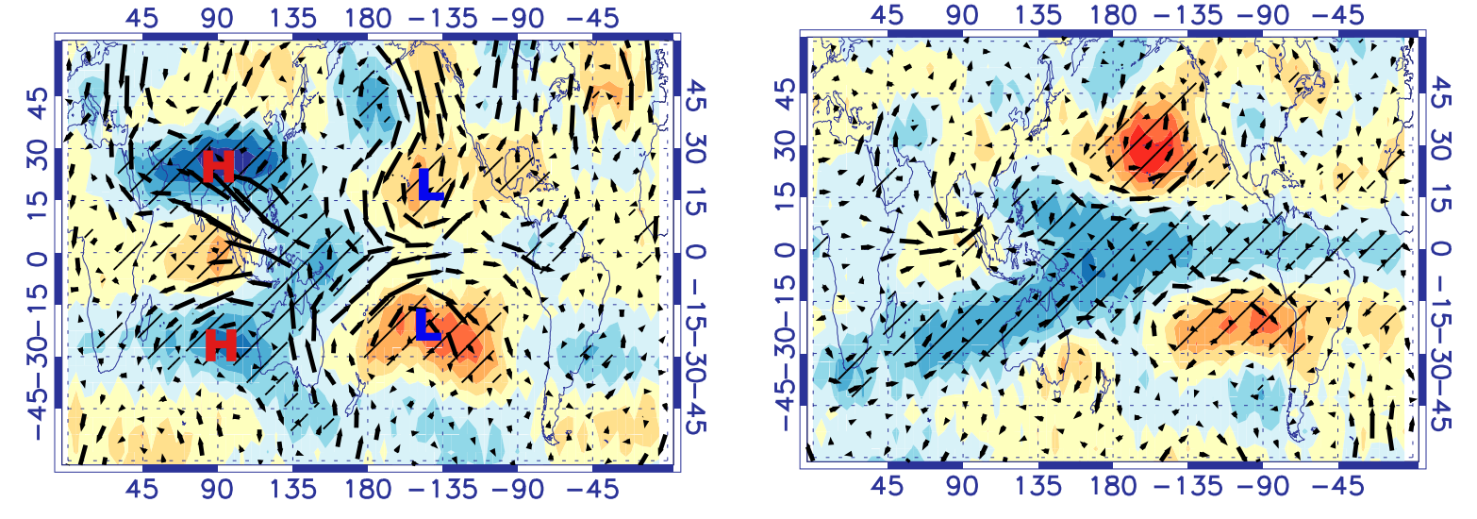
Using NASA Aura MLS and GMAO MERRA-2 data to resolve seasonal differences
in lower stratospheric temperature, circulation, and composition due to the MJO
Olga V. Tweedy et al., NASA GSFC and NPP/USRA
﻿Long-term, high-quality Aura Microwave Limb Sounder (MLS) data enabled research that explains the strong seasonal and regional variations in climatically-important lower stratospheric (LS) trace gases (e.g., O₃ and H₂O) that are associated with the Madden-Julian Oscillation (MJO) – an eastward moving weather disturbance that traverses the tropics within 30 to 60 days, on average.
A)
Boreal winter 100 hPa
B)
Boreal summer 100 hPa
MLS temperature
This study shows that:
Well-known planetary-scale perturbations (“Rossby-Wave Gyres”) in the LS temperature (Panel A- top) during boreal winters change to a more zonally uniform tropics-wide cooling (“Kelvin wave front”) during boreal summer (Panel B-top).
Enhanced tropics-wide upwelling in the regions of lower temperatures leads to reduction of ozone (in blue shade) during boreal summers (Panel B-bottom).
Seasonal differences due to the MJO result from differences in the zonal structure of Kelvin wave propagation at the equator, which strongly depends on the background zonal winds.
Rossby-Wave Gyres
Kelvin wave front
MLS ozone
Figure 1. Atmospheric sensitivities to the MJO are revealed by (top) 100 hPa MLS temperature (K) and MERRA-2 winds, and (bottom) ozone (% relative to the climatological annual mean) in boreal winter (Nov – Feb, left) and summer (June –Sep, right) months. For the latter, deep convection associated with the MJO is located over the Indian Ocean.
Tweedy, O. V., Oman, L. D., & Waugh, D. W. (2020). Seasonality of the MJO impact on upper troposphere/lower stratosphere temperature, circulation and composition. Journal of the Atmospheric Sciences, JAS-D-19-0183.1. https://doi.org/10.1175/JAS-D-19-0183.1

Slide 6
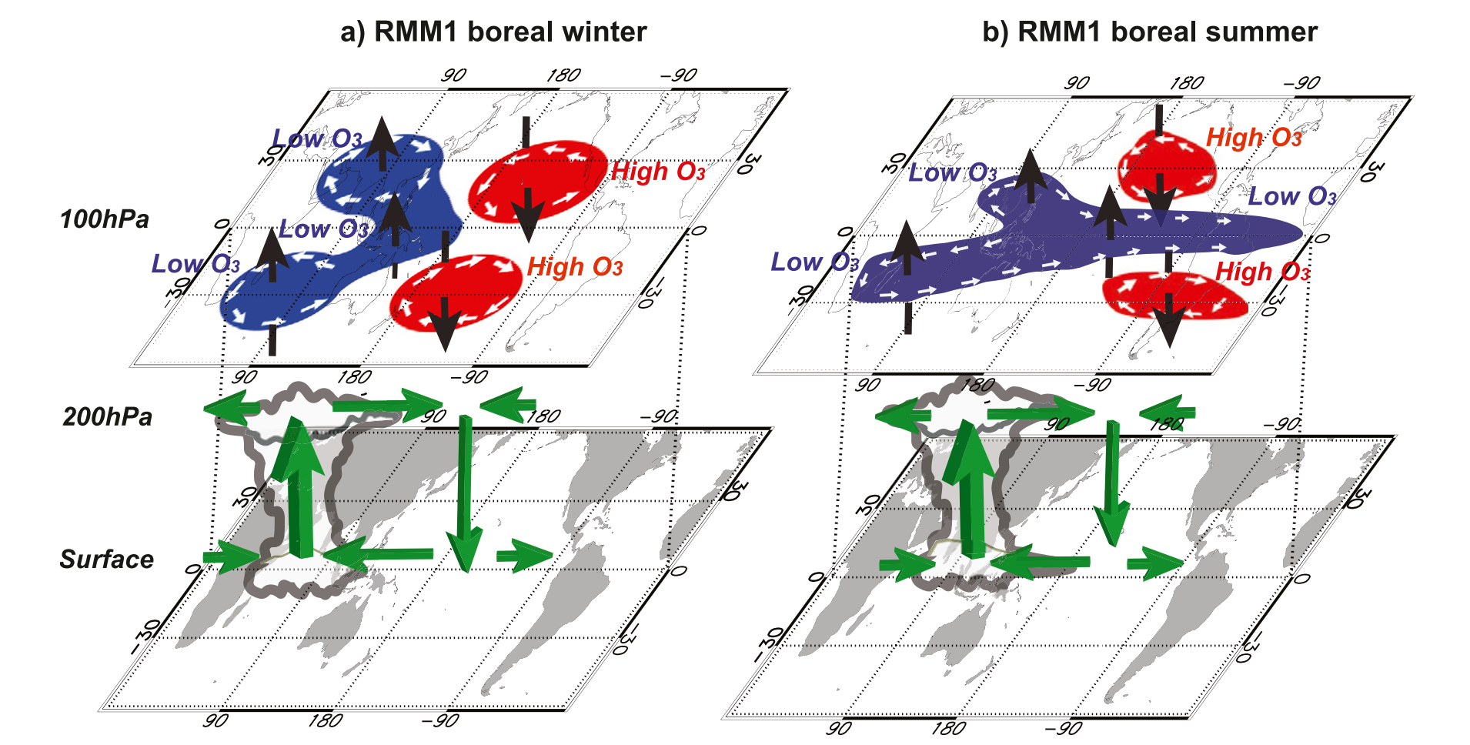
Name: Olga V. Tweedy
NASA GSFC/NPP
Olga.tweedy@nasa.gov
References:
Tweedy, O. V., Oman, L. D., & Waugh, D. W. (2020). Seasonality of the MJO impact on upper troposphere/lower stratosphere temperature, circulation and composition. Journal of the Atmospheric Sciences, JAS-D-19-0183.1. https://doi.org/10.1175/JAS-D-19-0183.1
Data Sources:
Aura MLS version 4.2 Level 2 measurements of temperature (T), ozone (O₃) and water vapor (H₂O) are available from the NASA Goddard Space Flight Center Earth Sciences (GES) Data and Information Services Center (DISC). ﻿The MLS data between 250 and 30 hPa are outputted on 12 pressure levels, and the MLS vertical resolution was retained. The MERRA-2 reanalysis of horizontal wind (U and V) fields were obtained from the NASA Earth Observing System Data and Information System (https://earthdata.nasa.gov).
Technical Description of Figures:
Figure 1: ﻿The 20–90-day bandpass-filtered (top) temperature and (bottom) ozone from MLS (shaded) and horizontal winds from MERRA-2 (arrows) at 100 hPa, regressed onto RMM1 index during boreal (Panel A) winter (NDJF) and (Panel B) summer (JJAS) months. ﻿Solid (dashed) contours overlaying ozone maps correspond to the 100 hPa temperature sensitivities with values of +(-) 0.2 and + (-) 0.4 K. Hatching indicates regions that are statistically significant at the 95% confidence level using the Student’s t test. Centers of high and low pressure systems (anticyclones and cyclones respectively) are indicated by H and L, respectively
Figure 2: Schematic depiction of the 100 hPa temperature, circulation, and ozone anomalies associated with the MJO when the enhanced convection is centered across the Indian Ocean (RMM1) during (a) boreal winter and (b) boreal summer months. Blue (red) regions correspond to areas of negative (positive) temperature and ozone perturbations. The circulation cells (white arrows) at the 100 hPa level highlight characteristic wind anomalies associated with the MJO. Vertical motions are shown by vertical black arrows [adopted from Rui and Wang,1990].
Scientific significance, societal relevance, and relationships to future missions:
The intraseasonal (20–90 day) variability of the tropical upper-troposphere and lower-stratosphere (UTLS) is dominated by the Madden–Julian Oscillation (MJO). The MJO’s impact on UTLS chemical constituents (such as ozone (O₃), which shields all living organisms from harmful Ultra-Violet (UV) radiation, and water vapor (H₂O), which is an important greenhouse gas) extends far beyond the tropics. As summarized in Figure 2, trace gas response is significantly different during boreal winter than summer, and is in agreement with the MJO-induced changes in the temperature and circulation. The analysis of MLS observations presented in this study is useful for evaluation and validation of the MJO-related physical and dynamical processes in models. ﻿For instance, it is highly desirable to examine the ability of a range of models to simulate seasonal differences in the UTLS temperature and circulation due to the MJO. The inability of the CCMs to accurately generate shorter-time-scale variability such as that from the MJO, can potentially lead to the lack of or much weaker variability in tropical and extratropical composition of the UTLS. ﻿A more realistic representation of the spectrum of variability in climate models will provide a better estimate of future projections. Thus, this study emphasizes the crucial need to continue collecting and evaluating high quality satellite measurements to trace the impact of changes in the UTLS circulation.
Acknowledgements: This work was supported by the NASA Postdoctoral Program (NPP) at NASA GSFC
Reduction in T and O₃
Increase in T and O₃
Figure 2. ﻿Schematic depiction of the 100-hPa temperature, circulation, and ozone anomalies associated with the MJO when the enhanced convection is centered across the Indian Ocean (RMM1)
Earth Sciences Division - Atmospheres

