Slide 1
PACRAIN Atoll Gauge Observations Validate High Quality Monthly IMERG Precipitation Estimates over the Data-Sparse Open Ocean
David T. Bolvin (SSAI; NASA/GSFC/612), George J. Huffman (NASA/GSFC/612), Eric J. Nelkin (SSAI; NASA/GSFC/612), Jackson Tan (USRA; NASA/GSFC/613)
The Integrated Multi-satellitE Retrievals for the Global Precipitation Measurement (GPM) mission (IMERG) dataset provides a nearly unbiased estimate of precipitation across the tropical Pacific Ocean when compared to rain gauges positioned on 37 low-lying atolls. This thin scatter of islands is considered an approximation of open-ocean conditions, and therefore provides the best validation for the highly-used IMERG data in this important but data sparse region.
Atoll Gauge Locations
Comparison Statistics
21-Year Time Series Comparison

Slide 2
Name: David T. Bolvin, SSAI/NASA/GSFC, Code 612 E-mail: david.t.bolvin@nasa.gov Phone: 301-614-6323
References:
Bolvin, D.T., G.J. Huffman, E.J. Nelkin, J. Tan, 2021: Comparison of Monthly IMERG Precipitation Estimates with PACRAIN Atoll Observations. Journal of Hydrometeorology, accepted. doi:10.1175/JHM-D-20-0202.1.
Data Sources: The Integrated Multi-satellitE Retrievals for the Global Precipitation Measurement (GPM) mission (IMERG) is free and publicly available at NASA’s Goddard Earth Science Data Information Services Center (GES-DISC) in several forms; the most complete is the half-hourly Final Run, doi:10.5067/GPM/IMERG/3B-HH/06. All products cover most of the globe at 0.1° x 0.1° every half-hour for June 2000 to the (delayed) present. Gauge observations in the Pacific Rainfall Database (PACRAIN) are used in the comparison.
Technical Description of Figures:
Top right: Locations of rain gauges sited on atolls in the western and central tropical Pacific Ocean.
Lower left: The time series of monthly precipitation for IMERG and the atolls are each averaged over the available atoll locations each month, also in mm/day. The complete monthly series and 7-month running mean are plotted as thin and thick lines, respectively.
Lower right: The scatterplot of all monthly IMERG estimates vs. individual atolls in the record has the intensive units of mm/day. The 1:1 and quantile-quantile lines are red and green, respectively.
Scientific significance, societal relevance, and relationships to future missions:
Satellite precipitation products provide a key input to environmental applications and global water and energy cycle studies. Since precipitation over land and ocean are intricately linked, it is important to perform validation over open ocean; however, validation over the vast expanses of the oceans is difficult due to the general lack of surface data. The Integrated Multi-satellitE Retrievals for the Global Precipitation Measurement (GPM) mission (IMERG) computes half-hourly 0.1° x 0.1° precipitation maps over most of the globe using the available microwave and geosynchronous infrared data. Rain gauges installed on low-lying atolls and archived in the Pacific Rainfall Database (PACRAIN) are considered to nearly represent open-ocean conditions, but the already sparse sampling is further reduced after quality control. A total of 37 atolls (top) contributed to the period June 2000 – August 2020, with monthly sampling varying in the range 0-17. The low number of samples means that the monthly averages (thin line, lower left) tend to be imprecise, but no discernable bias due to sampling was apparent. The overall bias is very small, but the scatterplot (lower right) shows nearly offsetting low(high) bias at low(high) rates, with near-zero bias at intermediate rates. Seasonally, December-January-February shows excellent agreement with a near-zero bias, March-April-May shows IMERG is low by 4.6%, June-July-August is high by 1.2%, and September-October-November exhibits the worst performance, with IMERG overestimating by 6.5%. The seasonal correlations are well-contained in the range 0.67 – 0.72, with the exception of September-October-November at 0.6.
IMERG is the most highly used GPM product and is in current use for a broad range of applications, e.g., monitoring severe weather and understanding climate variability. As such, it is important to characterize its performance in the various climate zones, including the tropical oceans. This work is important both from the standpoint of informing current users of products’ characteristics, but also for providing valuable information for future upgrades to IMERG.
Notes:
2

Slide 3
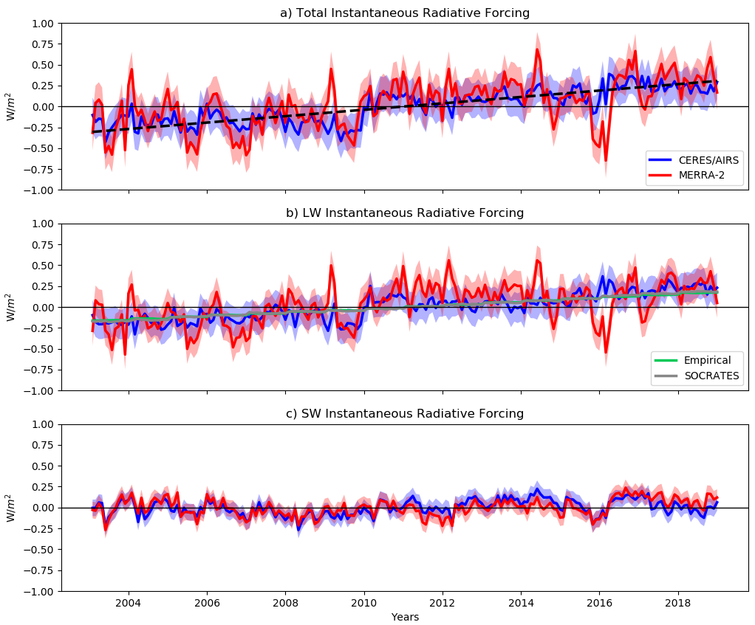
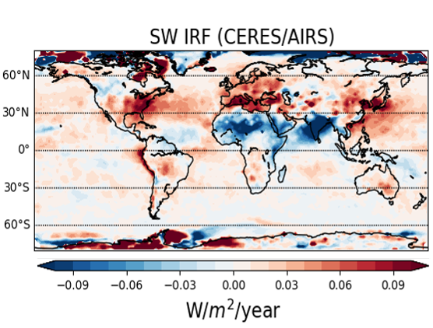
Observational Evidence of Increasing Radiative Forcing
Ryan Kramer and Lazaros Oreopoulos (NASA-GSFC, Code 613)
Increases in SW IRF (shortwave instantaneous radiative forcing)
are present over the Eastern U.S., Western Europe and East China
Using NASA satellite data, we provide the first observational diagnosis of radiative forcing, namely the component of Earth’s radiative energy imbalance directly caused by a change in the composition of the atmosphere. The steadily increasing global radiative forcing from 2003-2018 is direct evidence of human impact on climate through a combination of rising greenhouse concentrations and, to a lesser extent, reduced aerosol emissions.

Slide 4
Name: Name:Ryan Kramer, NASA/GSFC, Code 613 and UMBC/JCET E-mail: ryan.j.kramer@nasa.gov Phone: 301-614-5450
References:
Kramer, R. J., He, H., Soden, B. J., Oreopoulos, L., Myhre, G., Forster, P. M., & Smith, C. J. (2021). Observational Evidence of Increasing Global Radiative Forcing. Geophysical Research Letters, 48(7). https://doi.org/10.1029/2020GL091585
Data Sources: The CERES radiative flux observations are available at https://ceres.larc.nasa.gov/data/. The AIRS temperature and water vapor observations and the MERRA-2 reanalysis data are available at https://disc.gsfc.nasa.gov/. The CloudSat/CALIPSO radiative kernels used in this study and related code for applying them are available at https://climate.rsmas.miami.edu/data/radiative-kernels/. Funding for this study was provided by the NASA Postdoctoral Program, NASA award 80NSSC18K1032, the NASA CloudSat/CALIPSO Science Team and MEasUREs programs, the European Union’s 2020 Horizons research grant program under agreement no. 820829 (CONSTRAIN) and the UKRI NERC grant NE/N006038/1 (SMURPHS).
Technical Description of Figures:
Graphic 1: Global-mean anomalies of a) total, b) longwave and c) shortwave instantaneous radiative forcing (IRF) estimated by applying radiative kernels developed from CloudSat/CALIPSO data to observations from CERES and AIRS (red) and to MERRA-2 reanalysis data (blue). Additional calculations of greenhouse gas-only IRF are also shown using empirical formulas (green) and the SOCRATES radiative transfer model (gray). Uncertainty of ±2σ is shown with shading, computed as described in the reference above. All radiative forcing trends are statistically significant with 95% confidence.
Graphic 2: Local linear trends from 2003-2018 in shortwave instantaneous radiative forcing (SW IRF), diagnosed from CERES and AIRS observations. A positive (red) contour indicates an increase in planetary heating while a negative (blue) contour indicates an increase in planetary cooling. Large increases in radiative forcing are present over the Eastern U.S., Western Europe and East China where government regulations have decreased aerosol emissions.
Scientific significance, societal relevance, and relationships to future missions: This work provides the first observational evidence that radiative forcing has been increasing on the global scale. This is arguably the most direct evidence ever produced that human activity, largely by increasing greenhouse gas emissions, is changing the climate. The work makes use of satellite observations from CERES, AIRS and CloudSat/CALIPSO, but could be paired with any other observation of Earth’s radiative energy budget and temperature and humidity profiles. Therefore, this type of diagnosis can continue indefinitely with upcoming radiation budget missions like Libera, a successor to CERES, and infrared sounders like CrIS extending the temperature and water vapor profile record of AIRS. Since the radiative forcing is unambiguously detecting human influence on the climate, continued observations would be a key tool for monitoring the impact of future climate mitigation efforts.
Notes:
4

Slide 5
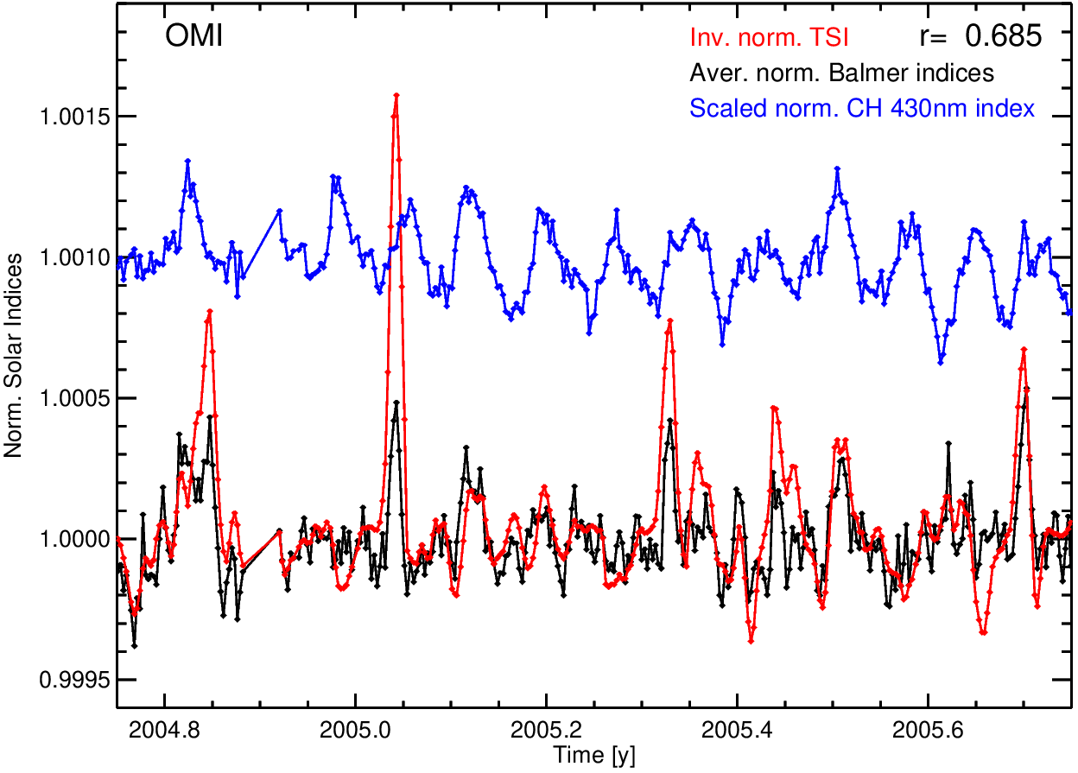
Solar activity and responses observed in Balmer lines
Sergey V. Marchenko ^{1,2}, Serena Criscuoli ³, Matthew T. DeLand ^{1,2}, Debi P. Choudhary ⁴, Greg Kopp ⁵
¹SSAI, ²NASA Goddard Space Flight Center, ³National Solar Observatory, Boulder, ⁴San Fernando Observatory, California State University – Northridge, ⁵Laboratory for Atmospheric and Space Physics, University of Colorado at Boulder
Daily solar irradiance measurements from Aura/OMI and TROPOMI show that some prominent Fraunhofer lines behave differently from the majority of UV-visible spectral transitions. This finding may ultimately help in deciphering the complex stellar-activity patterns in the search for exo-planets, which requires precise characterization of intrinsic variability patterns of the hosting stars to discriminate planetary signals. The precisions of OMI and TROPOMI are essential for our conclusion that the studied Balmer lines defy the general trends and show high sensitivity to the rise and gradual decay of big sun-spot groups, instead of the anticipated governance by hotter solar areas.
Total solar irradiance, inverted
CH 430 nm, down-scaled
Balmer lines
A solar index derived from the CH 430 nm spectral blend is traditionally used to track changes in the populations of solar faculae – the hot component.
In contrast, the hydrogen Balmer lines between 400-500 nm vary in accord with large sunspot groups - the ‘cool’ component of solar variability.
0.1 %
Marchenko, et al., Solar Activity and Responses Observed in Balmer Lines, Astronomy and Astrophysics, 646, 81-86, 2021.

Slide 6
Name: Sergey Marchenko, SSAI and NASA/GSFC, Code 614 E-mail: sergey.marchenko@ssaihq.com Phone: 301-867-6346
Reference:
Marchenko, S., Criscuoli, S., DeLand, M. T., Choudhary, D. P., Kopp, G., Solar Activity and Responses Observed in Balmer Lines, Astronomy and Astrophysics, 646, 81-86, 2021.
Data Sources:
The ~daily OMI and TROPOMI solar irradiances are publicly available at : https://daac.gsfc.nasa.gov/
Technical Description of Figure:
The ~daily OMI solar index (line-core to line-wing ratios) measurements of 3 upper-Balmer series hydrogen lines between 400-500 nm are plotted [black] for a 1-year period. The total solar irradiance (TSI) [red] predominantly tracks the development and passage of big sun-spot groups on short time scales (months), and agrees well with the OMI Balmer line index. The TSI data were inverted, scaled and de-trended in order to help demonstrate this agreement. A solar index derived from the CH 430 nm spectral blend (tracking changes in the populations of solar faculae) is also shown [blue]. The Balmer line indices in the TROPOMI data set (not shown) behave identically to the OMI Balmer index.
Scientific significance:
The flourishing field of exo-planet studies relies on robust detection techniques, which requires precise characterization of intrinsic variability patterns of the hosting stars to discriminate planetary signals. The stellar variability patterns are traced using various techniques (line-indices inclusive) and show a bewilderingly complex variety. Even for the best-studied star, our Sun, there is on-going debate on major drivers of the observed changes.
A seemingly simple question to ask is: Do all major spectral transitions (covering a wide range of the extended solar atmosphere) vary in unison on the solar-rotation (~month) time scale? Most UV-visible spectral lines predictably follow the rise and fall of numbers of the (hot) facula, as well as the changes in areas of active solar networks. However, we find an interesting exception while studying the ‘textbook’ hydrogen Balmer lines (H𝝱,H𝞬,H𝞭). These lines have been used in numerous astrophysical applications for over a century. We employ the line-index approach (i.e. core-to-wing ratio) in order to minimize instrumental effects, which enables very high individual-measurement precision: ~80 ppm (part-per-million) for the OMI data shown here, and ~30 ppm in the TROPOMI measurements. This precision is essential for our conclusion that the studied Balmer lines defy the general trends and show high sensitivity to the rise and gradual decay of big sun-spot groups, instead of the anticipated governance by hotter solar areas. Our result may help in deciphering the complex stellar-activity patterns in search for exo-planets.
Notes:
6

