Slide 1


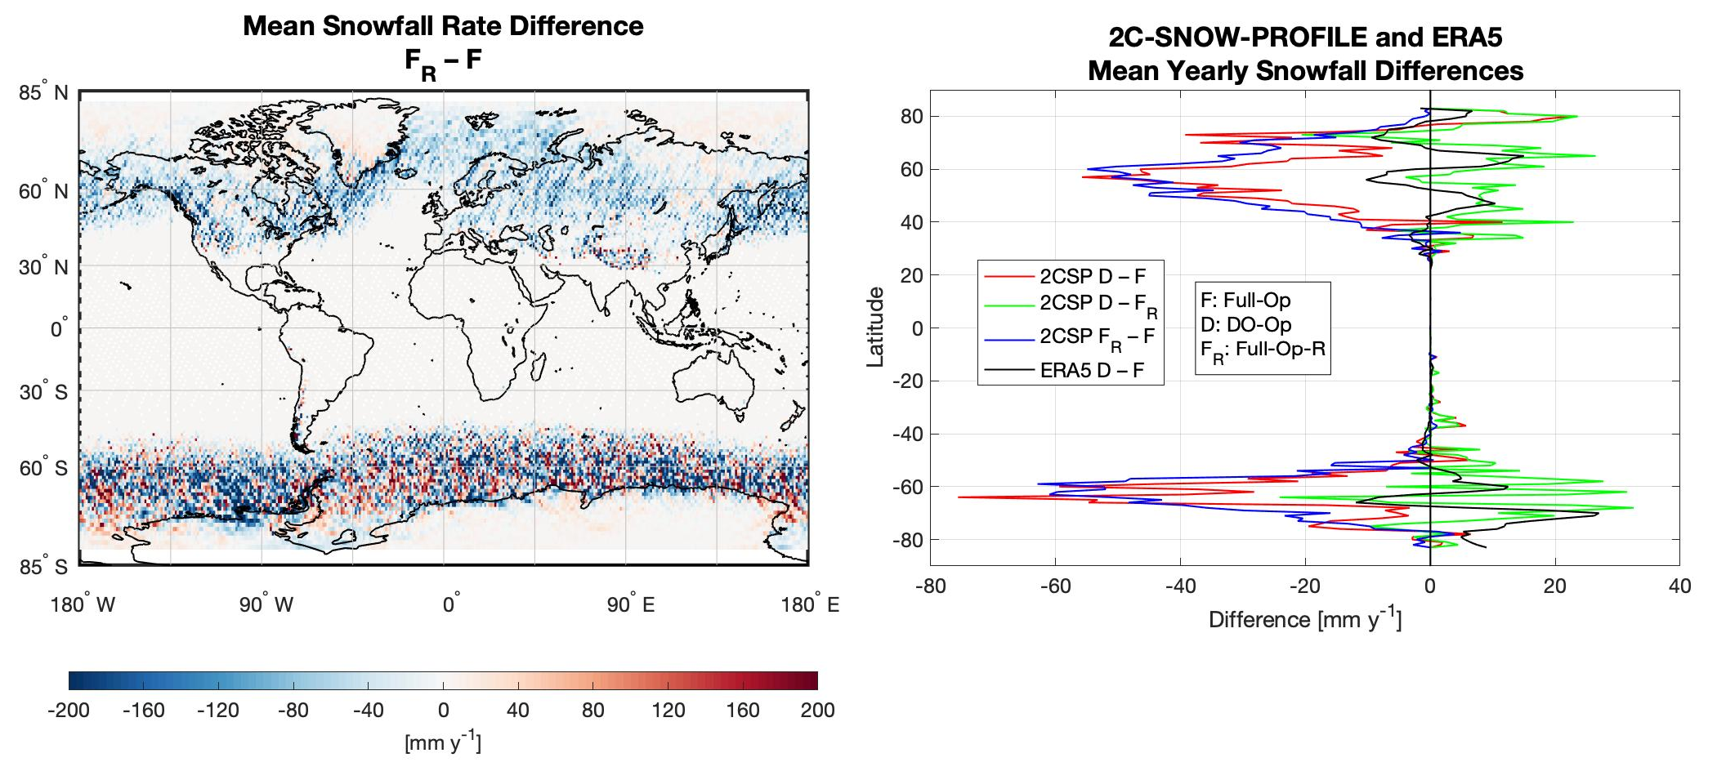

Biases in CloudSat Falling Snow Estimates
Resulting from Daylight-Only Operations
Lisa Milani (Code 612, NASA/GSFC and UMD) and Norman B. Wood (SSEC/UW-Madison)
The Cloud Profiling Radar (CPR) on board CloudSat is sensitive to snowfall, and other satellite missions (e.g. GPM) and climatological models have used snowfall properties measured by it for evaluating and comparing against their snowfall products. Since a battery anomaly in 2011, the CPR has operated in a Daylight-Only Operations (DO-Op) mode, in which it makes measurements primarily during only the daylit portion of its orbit. For multi-year global mean values, the snowfall fraction during DO-Op changes by −10.16% and the mean snowfall rate changes by −8.21% compared with Full-Op. The results highlight the need to sample consistently with the CloudSat observations or to adjust snowfall estimates derived from CloudSat when using DO-Op data to evaluate other precipitation products

Slide 2
Name: Lisa Milani, NASA/GSFC, Code 612 and UMD
E-mail: lisa.milani@nasa.gov
Phone: 301-614-5703
References:
Milani, L.; Wood, N.B. Biases in CloudSat Falling Snow Estimates Resulting from Daylight-Only Operations. Remote Sens. 2021, 13, 2041. https://doi.org/10.3390/rs13112041
Data Sources: For this work the CloudSat 2C-SNOW-PROFILE product is used for snowfall frequency and snowfall rate data.
Technical Description of Figures:
Graphic: The Full Operations (Full-Op) dataset (2006-2010), the Daylight-Only Operations (DO-Op) dataset (2012-2016) and the Full-Op resampled to mimic the sampling of the DO-Op data (Full-Op-R) are compared. (left) Snowfall rate difference between Full-Op-R and Full-Op; (right) difference between different 2C-SNOW-PROFILE datasets (mm y⁻¹), ERA5 is included for a trend comparison. While the comparison between Full-Op and DO-Op includes the effect of precipitation variability between the two periods and the sampling biases, for the differences between Full-Op-R and Full-Op (F_{R}−F), there is no precipitation variability affecting the results and any dissimilarity is solely due to the different sampling applied.
Scientific significance, societal relevance, and relationships to future missions: Snow provides much of the water we drink and use for irrigation, and large snowfall events can have significant impacts on commerce and public safety. Additionally, both falling, and ground-cover snow are important components of climate variability and change. Thus, the ability to properly sample and quantify snowfall and maintain long-term, consistent records is key for snow science and applications. The Cloud Profiling Radar (CPR) on board CloudSat is sensitive to snowfall, and other satellite missions and climatological models have used snowfall properties measured by it for evaluating and comparing against their snowfall products. Since a battery anomaly in 2011, the CPR has operated in a Daylight-Only Operations (DO-Op) mode, in which it makes measurements primarily during only the daylit portion of its orbit. This work provides estimates of biases inherent in global snowfall amounts derived from CPR measurements due to this shift to DO-Op mode. We use CloudSat’s snowfall measurements during its Full Operations (Full-Op) period prior to the battery anomaly to evaluate the impact of the DO-Op mode sampling. For multi-year global mean values, the snowfall fraction during DO-Op changes by −10.16% and the mean snowfall rate changes by −8.21% compared with Full-Op. These changes are driven by the changes in sampling in DO-Op and are very little influenced by changes in meteorology between the Full-Op and DO-Op periods. The results demonstrate the need to consider the biases introduced by the transition to DO-Op when using the 2C-SNOW-PROFILE CloudSat product. Unless addressed, these biases will influence the evaluation of trends using CloudSat snowfall data; the comparison of CloudSat snowfall against other snowfall products, whether observation- or model-based; and the use of the CloudSat data in machine learning. Sampling-awareness extends to observational studies as well. As an example, comparisons of the GPM radar-based snowfall product against CloudSat snowfall in DO-Op, using thorough normalizations for differences in retrievals and instrument performance, found a −43% difference in mean snowfall over roughly 60S to 60N. These results suggest the difference is larger. Finally, the CloudSat precipitation datasets are increasingly used as sources of training and a priori constraints for other retrievals. Recent machine learning applications use collections of CloudSat profiles coincident with the desired remote sensing observations as training datasets or constraints. A collection of such coincident observations from the DO-Op period will be biased toward day-time observations. Developers should carefully evaluate the impact of such biases on their algorithms. These results are not only important when interpreting CloudSat data. They are vital for ensuring consistency between CloudSat observations and the upcoming joint ESA/JAXA EarthCARE mission and NASA’s Atmosphere Observing System (AtmOS), both of which will include W-band radars.
Earth Sciences Division - Atmospheres
Notes:
2

Slide 3

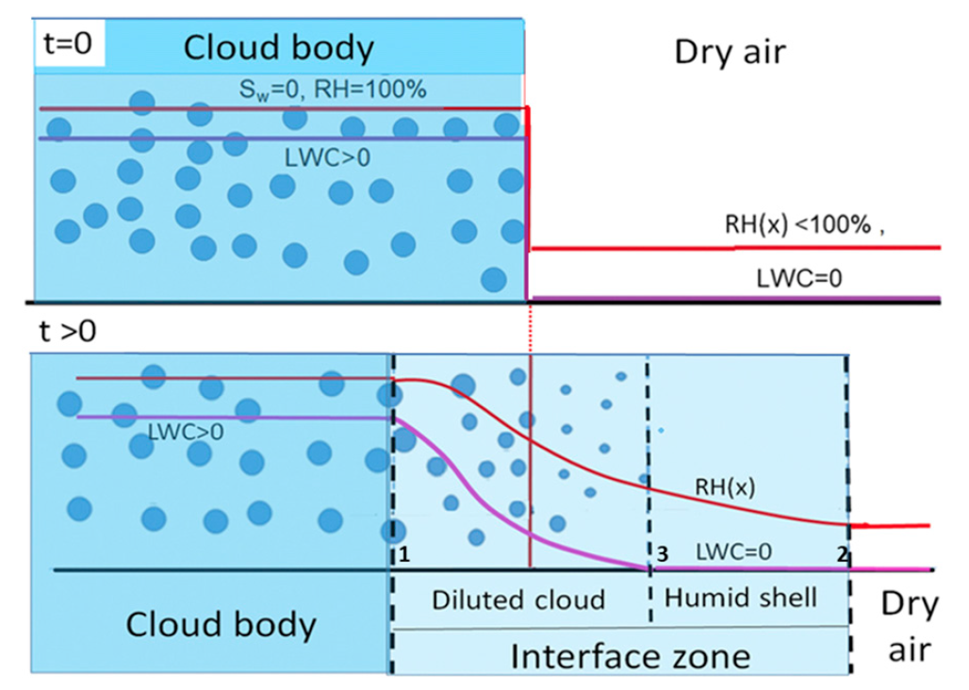
Observing Water Vapor Changes Near Clouds
with Ground-Based Shortwave Spectrometers
Guoyong Wen^{1,2} and Alexander Marshak¹
¹ (NASA/GSFC Code 613), ²(GESTAR/Morgan State University)
(From Pinsky and Khain, 2018)
We have developed a new technique to retrieve precipitable water vapor (PWV) amount in the clear-cloud transition zone using ground-based measurements of the relative difference in zenith radiance at the 720 nm water vapor band and the adjacent non-absorbing band at 750 nm. By being able to infer PWV variations in the cloud-clear transition zone we will be better positioned to understand aerosol-cloud interactions.

Slide 4
Name: Guoyong Wen, NASA/GSFC, Code 613 and Morgan State University
E-mail: Guoyong.Wen@nasa.gov
Phone: 301-614-6220
References:
Wen., G. & Marshak, A., (2021). “Precipitable Water Vapor Variation in the Clear-Cloud Transition Zone From the ARM Shortwave Spectrometer,” IEEE Geoscience and Remote Sensing Letters, doi:10.1109/LGRS.2021.3064334.
Pinsky, M., & Khain, A. P. (2018). Theoretical analysis of the entrainment–mixing process at cloud boundaries. Part I: Droplet size distributions and humidity within the interface zone. J. Atmos. Sci., 75, 2049–2064, https://doi.org/10.1175/JAS-D-17-0308.1.
Data Sources: Atmospheric Radiation Measurement (ARM) data sets available at https://www.arm.gov/data.
Technical Description of Figures:
Graphic 1: (Left) A conceptual schematic of a cloud and its surrounding structure showing the entrainment mixing process in the vicinity of the cloud-dry air interface. The cloud-clear transition zone is characterized by decreasing droplet sizes away from the cloud body accompanied by a decrease in relative humidity due to cloud mixing with dry air.
Graphic 2: (Middle) Transmittance calculated from the SBDART radiative transfer code. The water vapor band at 720 nm and the adjacent non-absorbing band at 750 nm are used to retrieve column water vapor amount.
Graphic 3: (Right) Relative zenith radiance differences from spectroradiometer measurements (left axis) and retrieved column water vapor amount (right axis). While the relative zenith radiance difference between 550 nm and 660 nm channels increases from cloud (~20.9542 UTC) to clear (~20.9856 UTC) as cloud particle size decreases (green line), the difference between the non-absorbing channel (at 750 nm) and water vapor absorbing channel (at 720 nm) (red line) decreases as a result of decreasing water vapor amount (blue line). An approximate 10% decrease in column water vapor amount occurs from definite cloud to definite clear.
Scientific significance, societal relevance, and relationships to future missions: The transition zone between cloudy and clear air is a region of strong aerosol-cloud interactions where aerosol particles humidify and swell when approaching the cloud, while cloud drops evaporate and shrink when moving away from the cloud. Thus, cloud droplets, aerosol particles, and water vapor coexist and and interact in this special region. We developed a new technique to retrieve column water vapor amount from a ground-based spectroradiometer with narrow FOV and high sampling frequency that resolves the fine structure of the transition zone. Quantifying water vapor variation complements our earlier studies which focused on cloud optical depth and droplet size variation in the clear-cloud transition zone. It can potentially lead to improvements in space-based estimates of aerosol radiative forcing and aerosol indirect effects.
Earth Sciences Division - Atmospheres
Notes:
4

Slide 5


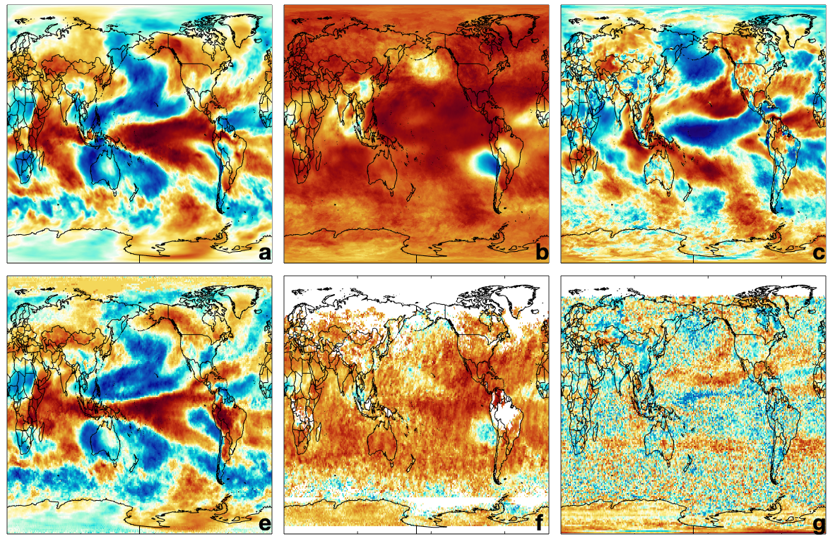
﻿ Spatial and temporal variability in the hydroxyl radical (OH): understanding the role of large-scale climate features and their influence on OH through its dynamical and photochemical drivers
D. Anderson^{1,2}, B. Duncan², A. Fiore³, C. Baublitz³, M. Follette-Cook^{2,4}, J. Nicely^{2,5}, G. Wolfe²
¹USRA/GESTAR, ²NASA GSFC, ³Columbia University, ⁴Morgan State University/GESTAR, ⁵UMD ESSIC
NASA satellites capture the variability of tropospheric H₂O, CO, and NO₂ related to the El Niño-Southern Oscillation (ENSO), a recurring climate pattern involving changes in the temperature of waters in the central and eastern tropical Pacific Ocean. These tropospheric constituents are key drivers of OH abundance.
We demonstrate that NASA satellite data of atmospheric constituents from NASA’s EOS Terra, Aqua, and Aura may be used to indirectly constrain the spatio-temporal variations of tropospheric OH, the atmosphere’s primary oxidant and dominant methane sink, over broad global regions.
OH is difficult to directly observe and previous indirect constraints on OH variability (e.g., MCF) are becoming less feasible and provide no information on spatial variability.
Analysis of a 39y NASA GEOS Chemistry Climate Model (GEOSCCM) simulation shows that ENSO is the dominant mode of global OH variability across all seasons, accounting for 30% of total variance in the tropospheric column.
ENSO-related OH variability is driven by changes in NO_{X} in the upper troposphere and H₂O near the surface.
The correlation between ENSO and tropospheric column H₂O, CO, and NO₂ is well-captured by both GEOSCCM and retrievals from AIRS, MOPITT, and OMI.
GEOSCCM
GEOSCCM
GEOSCCM
Simulated
H₂O
CO
NO₂
Aqua
Terra
Aura
Observed
AIRS H₂O
MOPITT CO
OMI NO₂

Slide 6

Name: Daniel C. Anderson
Affiliation: USRA GESTAR/NASA GSFC
Email: daniel.c.anderson@nasa.gov
References:
Anderson et al. (2021). Spatial and temporal variability in the hydroxyl radical: understanding the role of large-scale climate features and their influence on OH through its dynamical and photochemical drivers. Atmospheric Chemistry and Physics, 21, 6481-6508. https://doi.org/10.5194/acp-21-6481-2021.
Data Sources:
  For AIRS H₂O on the Aqua satellite, we use the monthly averaged, Level 3, Version 6 standard physical retrieval of tropospheric column H₂O (Susskind et al., 2014) from 2003 to 2018. For MOPITT CO on the Terra satellite, we use the Level 3, V008 retrieval that uses both near and thermal infrared radiances (Deeter et al., 2019) from 2001 to 2018. Both satellite products have a global horizontal resolution of 1° × 1°. We also use the OMI NO₂ Version 4, Level 3 product (Lamsal et al., 2021) from 2005 to 2018. Data have been regridded to 1° × 1° horizontal resolution. OMI is located on the Aura satellite. Data for all three retrievals are available at https://disc.gsfc.nasa.gov. Model output is from a simulation of the NASA GEOSCCM model (Strode et al., 2019) run in replay mode (Orbe et al, 2017) with MERRA2 meteorology (Gelaro et al, 2017) and the GMI chemical mechanism (Duncan et al., 2007). The model was run at a horizontal resolution of 0.625° longitude × 0.5° latitude with 72 vertical levels from 1980 to 2018. The simulation is available at https://acd-ext.gsfc.nasa.gov/Projects/GEOSCCM/MERRA2GMI/. Model output is for the satellite overpass time and has been regridded to a 1° × 1° horizontal resolution.
Technical Description of Figures:
  The regression coefficient of tropospheric column H₂O (left), CO (middle), and NO₂ (right) averaged over December – February against the Multivariate ENSO Index (MEI) is shown for the GEOSCCM simulation (top) and for the AIRS, MOPITT, and OMI (bottom) satellite retrievals, respectively. Correlations were performed over the lifetime of the satellites, as outlined above.
  Scientific significance, societal relevance, and relationships to future missions:
  Tropospheric OH is the dominant sink of CH₄, the second-most important anthropogenic greenhouse gas. Understanding spatial and temporal variability of OH is therefore necessary to understand recent trends in methane, whose atmospheric abundance can be controlled both by changes in emissions and changes in sinks. Observations of OH are sparse, however, as it is low in abundance and short-lived. OH has traditionally been constrained on a global and hemispheric basis by observations of methyl chloroform (MCF). Because of recent declines in MCF concentration, which is now at or below instrumental detection limits, alternative constraints on OH are necessary.
  Here, based on analysis of the GEOSCCM model, we show that the El Niño Southern Oscillation is the dominant mode of OH variability across all seasons and that satellite retrievals are capable of capturing the ENSO-related variability of OH drivers, including CO, H₂O, and NO_{2.} These results provide new constraints on the atmospheric oxidative capacity and interannual variability of OH, necessary for understanding the chemistry of a myriad of species. This work also provides the path forward for a potential new way to constrain OH, and thus the methane lifetime, from space using the approximately 20 years of data from EOS satellites. Because most of the species necessary to constrain OH will also be retrieved from recent and upcoming geostationary satellites (e.g., GEMS and TEMPO), the results here could potentially provide a novel use for these missions.

